Slide 1
Americans with Disabilities Act (ADA) Youth Training
May 9 , 2018
Rene Cummins
Sierra Royster

Slide 2
Prep for the Webinar
This is going to be interactive…so get ready to join in!
You will be able to join in the conversation over the phone or microphone…so speak up!
If you would like to ask a question prior to that please raise your hand. You can do that by pressing the image of a person at the top with their hand raised to voice your question or write your question in the chat box.
To mute from home, you can press *#/unmute press *#
We will have Q&A times, if you think of a question before that time please put your question in the chat box and we will come to it during the Q&A break.

Slide 3
Training Outline This is a seven week training covering the Americans with Disabilities Act.
February 14, 2018
Overview of the ADA
Disability Disclosure (1st Key)
February 28, 2018
Overview of Title 1
Reasonable Accommodations (2nd Key)
March 14, 2018
Requesting an Accommodations
(3rd Key)
March 28, 2018
Overview of Title II- State and Local Government
3 Keys
April 11, 2018
Transportation
April 25, 2018
Overview of Title III-Private Entity
3 Keys
May 9, 2018
Overview of Title IV-Telecommunication
Overview of Title V-Miscellaneous Provisions
3 Keys
Review

Slide 4
Title IV-Telecommunications
Telecommunications Relay Services
2-way Communication
Deaf & Hard of Hearing
Speech Limitations

Slide 5
Title IV-Telecommunications
Closed Captioning
Public Service Announcements
Funded in whole or in Part by Federal Funds
Development of Improved Technology
Recover Costs from All Subscribers of Services

Slide 6
Title V-Miscellaneous Provisions
Relationship to Other Laws
Valid if Equal or Better Protection
Cannot Apply a Lesser Standard
Access Board-Guidelines
Prohibition Against Retaliation & Coercion

Slide 7
Title V-Miscellaneous Provisions
Historic Sites & Properties
Covered by standards
Do not alter the fundamental nature of historic
Implementation of Titles
Failure to Receive Assistance is No Excuse
10 ADA Centers for Technical Assistance
Encourage Use of Alternative Dispute Resolution

Slide 8
Title v-Miscellaneous Provisions
Term Disability Shall Not Include:
Compulsive Gambling
Current Illegal Use of Drugs
Exhibitionism
Kleptomania
Pedophilia
Pyromania
Voyeurism (non-consensual)
Gender Identity
LGBTQIAP+
Lesbian
Gay
Bisexual
Transgender
Queer
Intersex
Asexual
Pansexual
Other Sexual Behavior
https://www.eeoc.gov/laws/statutes/ada.cfm

Slide 9
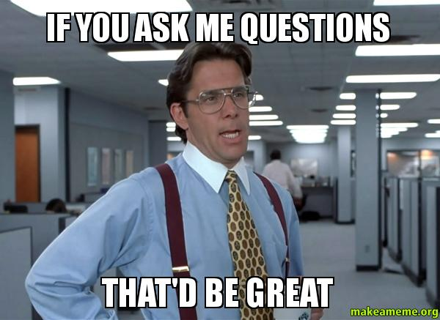
Q&A

Slide 10
Wrap Up
Thanks for joining!
Youth Advocacy Committee Calls
2nd Friday of the Month at 4:00pm EST
Next Call: May 11, 2018 4:00pm EST

