Slide 1
Americans with Disabilities Act (ADA) Youth Training
March 14, 2018
Rene Cummins
Yolanda Vargas

Slide 2
What is an accommodation you may need in the application Interview Job offer or On the Job area?
Drop your answer in the chat box

Slide 3
Prep for the Webinar
This is going to be interactive…so get ready to join in!
You will be able to join in the conversation over the phone or microphone…so speak up!
If you would like to ask a question prior to that please raise your hand. You can do that by pressing the image of a person at the top with their hand raised to voice your question or write your question in the chat box.
To mute from home, you can press *#/unmute press *#
We will have Q&A times, if you think of a question before that time please put your question in the chat box and we will come to it during the Q&A break.

Slide 4
Training Outline This is a seven week training covering the Americans with Disabilities Act.
February 14, 2018
Overview of the ADA
Disability Disclosure (1st Key)
February 28, 2018
Overview of Title 1
Reasonable Accommodations (2nd Key)
March 14, 2018
Requesting an Accommodations
(3rd Key)
March 28, 2018
Overview of Title II- State and Local Government
3 Keys
April 11, 2018
Transportation
April 18, 2018
Overview of Title III-Private Entity
3 Keys
May 9, 2018
Overview of Title IV-Telecommunication
Overview of Title V-Miscellaneous Provisions
3 Keys
Review

Slide 5
Have you ever asked for an accommodation, at school, somewhere you volunteer or a place you’ve worked? How did it go? Did you get your accommodation?

Slide 6
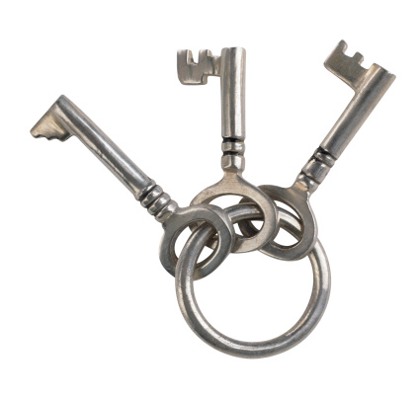
Reasonable accommodations
How to request a reasonable accommodation
Image of three keys on a ring

Slide 7
Interactive Process
Disclose Disability to Boss
Have an Interactive Discussion with Boss

Slide 8
Discussion
WHY am I having problems or difficulty with my work?
WHAT accommodation might help me at work?
HOW might that accommodation help me?

Slide 9
What is “reasonable”?
Not too costly
Not too difficult to provide
Must work for the Employee

Slide 10
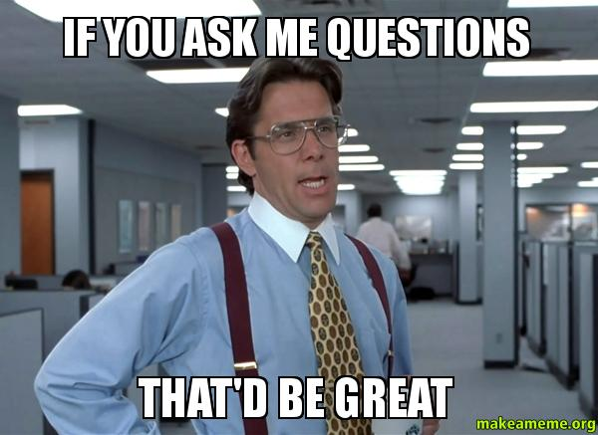
Q&A

Slide 11
Spot the landmines
We will list three different words under category. Two will be acceptable one will not.
Category:
Tone
Timing
Person’s report to
Ways to highlight that accommodations are protected under the law

Slide 12
Wrap Up
Next Training date
March 28, 2018 from 4:00-5:00pm(EST) (3:00-4:00pm CST, 2:00-3:00pm MST, 1:00-2:00pm PST)
Overview of Title II- State and Local Government
3 Keys
Homework:
What do you think is an organization/entity that is covered under state and local government?
Have you ever participated in services or programs from these organizations?

