Slide 1
Progressive Independence
Our Mission Is To Encourage And Facilitate Self-Sufficient, independent lifestyles and to enhance the quality of life for individuals with disabilities in central Oklahoma.
Progressive Independence Envisions an American society where people with disabilities experience full inclusion and opportunities in all aspects of society.

Slide 2
STOP!
First Google Oklahoma ADA/504 Self-Evaluation Plans
Secondly, Google Oklahoma Olmstead Plan

Slide 3
HUD Guidance
June 4th, 2013 – HUD issues new (Olmstead) guidance to encourage participation in State efforts to assist individuals moving out of institutions and into housing.
Individuals with disabilities have historically faced discrimination that limited their opportunity to live independently in the community and required them to live in institutions and other segregated settings.
In 1999, the United States Supreme Court issued the landmark decision in Olmstead v. L.C., 527 U.S. 581 (1999), affirming that the unjustified segregation of individuals with disabilities is a form of discrimination prohibited by Title II of the Americans with Disabilities Act (ADA).

Slide 4
HUD Guidance
Individuals with disabilities, like individuals without disabilities, should have choice and self-determination in housing and in the health care and related support services they receive.
For communities that have historically relied heavily on institutional settings and housing built exclusively or primarily for individuals with disabilities, the need for additional integrated housing options scattered throughout the community becomes more acute.
HUD programs serve as an important resource for affordable housing opportunities for individuals with disabilities, including individuals who are transitioning out of, or at serious risk of entering, institutions.
HUD funds the operation, management, development, preservation, and rehabilitation of affordable housing.

Slide 5
HUD Guidance
HUD is committed to providing individuals with disabilities a meaningful choice in housing and the delivery of long-term health care and support services.
HUD is working with its federal partners to align policies and promote understanding of the integration mandate of the ADA and Section 504 of the Rehabilitation Act of 1973 (Section 504).

Slide 6
Section 504
States that:
No otherwise qualified individual with a disability in the United States…shall, solely by reason of her or his disability, be excluded from the participation in, be denied the benefits of, or be subjected to discrimination under any program or activity receiving Federal financial assistance or under any program or activity conducted by any Executive agency or by the United States Postal Service.

Slide 7
Section 504
Every recipient of federal financial assistance from HUD is subject to Section 504 and HUD’s Section 504 implementing regulations.
This includes both public and private entities.
Individuals with disabilities also cannot be denied the opportunity to participate in an integrated program, despite the existence of separate programs for persons with disabilities

Slide 8
The ADA and Olmstead
Title II of the ADA and its implementing regulations extend this integration requirement to all services, programs, and activities administered by public entities (primarily state and local government entities) regardless of whether these entities receive federal funding.
Congress specifically mandated that the ADA regulations be consistent with Section 504 coordination regulations.

Slide 9
Paula’s Story
Paula is a T4 Para who was living in the Senior Village n/h in Blanchard.
Paula first contacted PI with her desire to live independently in 2014.
In 2016, Paula chose to utilize one of the apartments being renovated by Alafaro Properties.
In a collaborative effort between the City of Norman and PI, the City agreed to utilize up to $125,000 of its Community Development Block Grant funds to renovate up to 5 units for optimum accessibility.

Slide 10
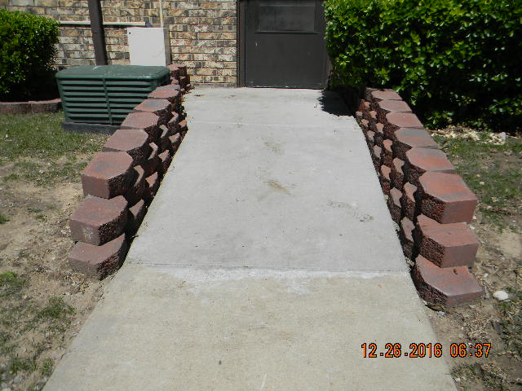
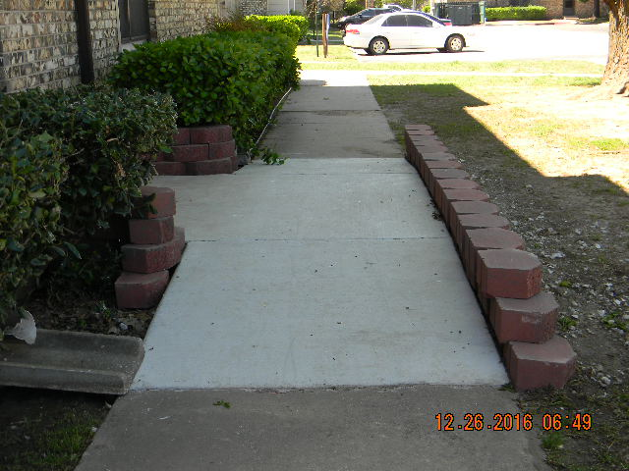
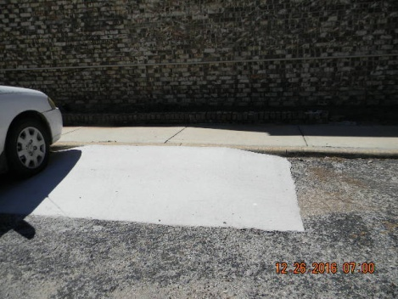
Paula’s Story
Path of Travel -

Slide 11
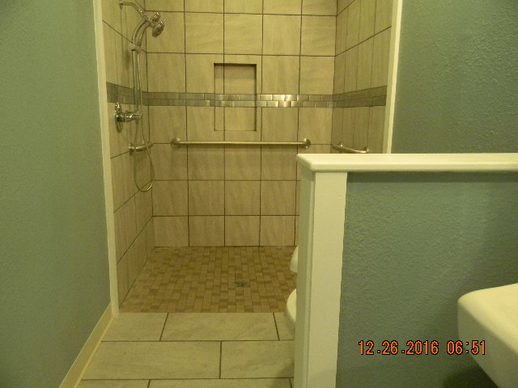
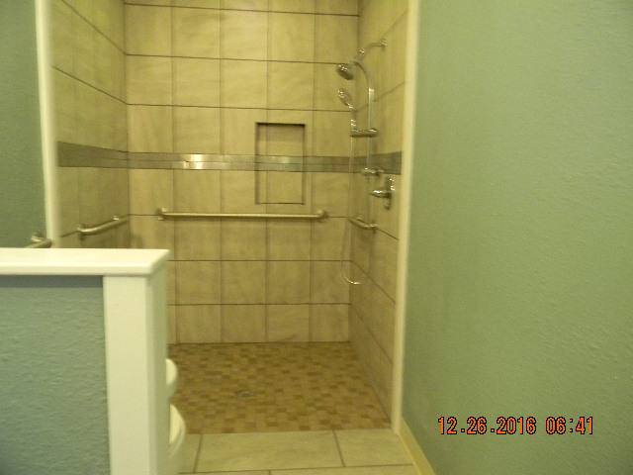
Paula’s Story
Accessible Bathroom –

Slide 12
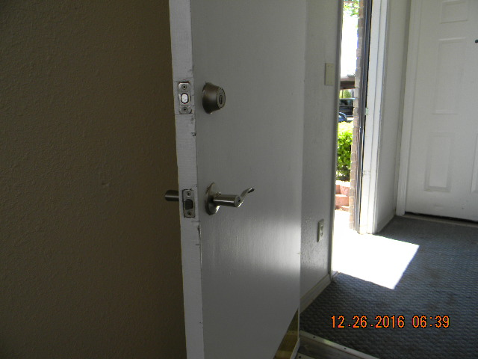
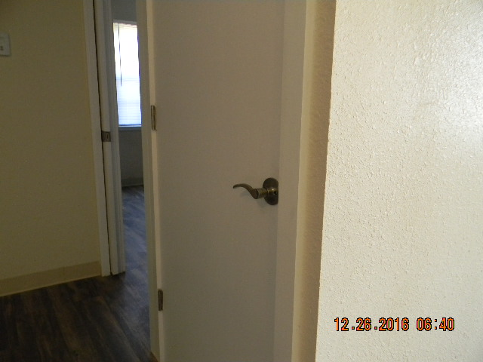
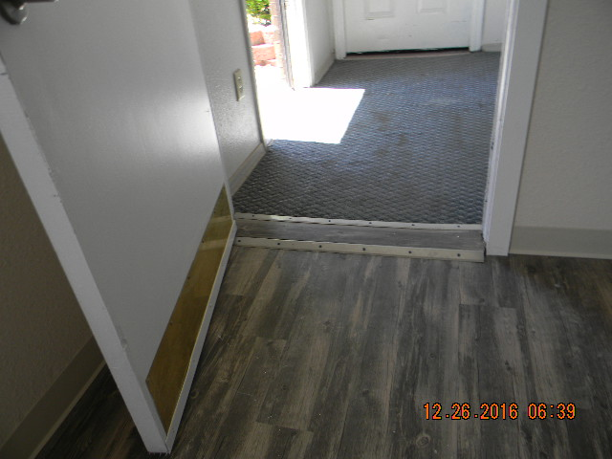
Paula’s Story
Accessible features –

Slide 13
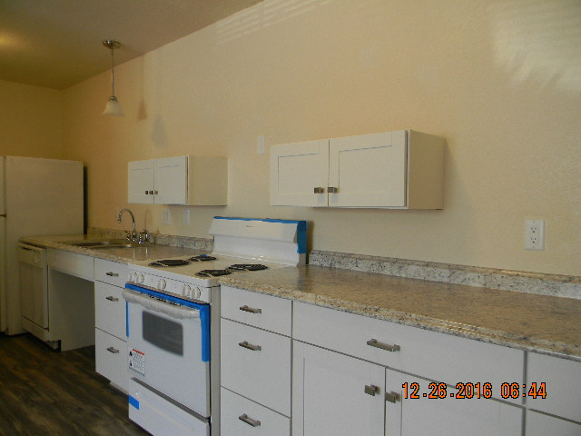
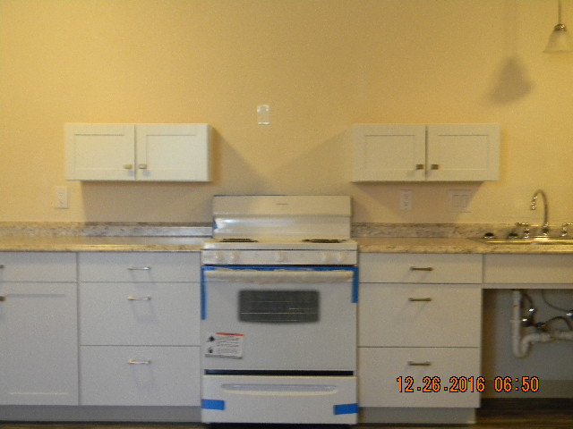
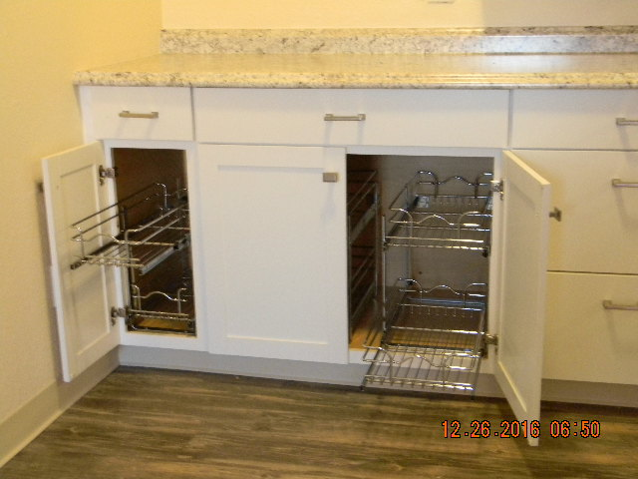
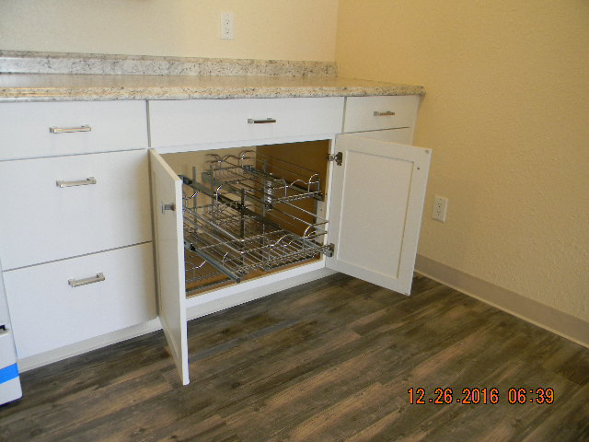
Paula’s Story
Accessible features –

Slide 14
Paula’s Story
Paula moved into her home on February 28th, 2017.
Lastly, what did you find in your Google search?

Slide 15
Additional Resources
https://aspe.hhs.gov/report/medicaid-and-permanent-supportive-housing-chronically-homeless-individuals-emerging-practices-field/82-olmstead-compliance-and-consent-decrees
https://portal.hud.gov/hudportal/HUD?src=/press/press_releases_media_advisories/2013/HUDNo.13-086
https://portal.hud.gov/hudportal/documents/huddoc?id=OlmsteadGuidnc060413.pdf
https://www.usich.gov/resources/uploads/asset_library/Olmstead_Brief_02_2016_Final.pdf

