Slide 1
The Importance of Parental Rights for the Disability Community: An Attempt to Address Discriminatory Termination of Parental Rights Codes in the US
William Toombs¹, Robert Crooks² and
W. Kirt Toombs²
1 – ISU Doctoral Candidate & Idaho SILC Member, 2 – EOCIL Institute for Disability Studies and Policy
Notes:
Note about citations:
- Due to space constraints on slide (prevent clutter), all cited sources are located at the end of PPT.
- Upon request we will provide specific sources for data used
NOTE: reference that we are starting with the research and then we will transition into discussion of root cause and plan development. It may feel a little backwards at first.

Slide 2
AGENDA
Define current issue and problem
Historical background
Contemporary overview
CIL Perspective
Small group discussion
Strategic policy development
Accountability
Conclusion/Discussion
Notes:
1 minutes

Slide 3
Key Terms
Termination of Parental Rights (TPR):
Ends the legal parent-child relationship; Voluntary or Involuntary
State issue
Behavior vs. Condition/status
Family/family units:
Includes biological and adoptive children-parent relationships
Traditional and nontraditional families
Legally recognized
Parental Disability:
The parent has the disability; not child
Notes:
Ask how many people are familiar with TPR codes
- Get a rough hand, nod or shout outs count

Slide 4
The Problem
Why family units are important
Plato, the Republic, Bk 3-4: Natural desire amongst all to have family throws the “perfect society” ideal out the window
Aristotle, Politics, Bk 1: “the first human association”
Nicomachean Ethics, Eudaimonia = “happiness” = flourishing
Countless other philosophers, anthropologists, behavioral scientists, social scientists agree with the role of the family
Family units, led by parents with disabilities, are directly under assault!
Notes:
Metals – Gold class, Silver class, Bronze/tin class
Noble lie: Mother earth is parent…born with metals
Families joined with several others to create a village; A village realizing its true potential becomes a city-state.

Slide 5
The Problem cont.
Discriminatory legislation within child custody and termination of parental rights statutes exist throughout the US
“Parental disability” as grounds to terminate
Child custody AND Child protection hearings (the State)
Very high rates of parental termination for disability community
Recent research has found that parents with disabilities are not more likely to maltreat their children than parents without disabilities
TPR should be based strictly on behavior and status

Slide 6
How We Got Here
Decree of the French Parliament (1606) ordered the disabled be driven from the city; forbid entry at all city gates
Bartolome De Las Casas, 16th C., speaking on the conditions of American Indians as “natural slaves”:
If any individuals satisfied Aristotle’s standards for natural slaves, they would have to be rare mistakes of nature – those with unusual mental and physical disabilities from birth…….(Carro 1974)
In North America:
Poorhouse/Almshouse
Institutionalization
Sterilization
Segregation
Notes:
Historically, PwDs have been one of the most ostracized, alienated, and persecuted communities globally
Spanish Conquistadors claimed that the American Indians were “ideal slaves.”
Aristotle: “only those humans suited to life as a slave should become one – natural slaves”

Slide 7
How We Got Here cont.
Implicit & Explicit Biases are at play
1962/2007 Minnesota Survey of Attitudes Regarding Developmental Disabilities
Over 1/3 of respondents believe PwDs should be “allowed to have children”
US state policies reflect these discriminatory biases
Notes:
Deep-rooted bias against PwDs persists throughout society; across multiple cultures

Slide 8
Contemporary Overview
35 states have discriminatory TPR codes
District of Columbia, etc.
15 states have appropriate TPR codes
Problems still persist
Medical-Industrial Complex (MIC)
Authoritarian government
Child-custody battles

Slide 9
Contemporary Overview
n=35
Figure 1. Specific disability identified in state TPR codes.
Figure 2. Disability as a condition for terminating parental rights.

Slide 10
State by State TPR Codes
State |  | Y | N | ID/DD | Cogn. | Emot. | Phys.
AK |  | X |  | X | X | X
AL |  | X |  | X | X | X
AR |  | X |  | X | X | X
AZ |  | X |  | X | X
CA |  | X |  | X | X
CO |  | X |  | X | X | X
CT |  |  | √
DE |  | X |  | X | X
FL |  |  | √
GA |  | X |  |  | X | X | X
HI |  | X |  | X | X

Slide 11
State |  | Y | N | ID/DD | Cogn. | Emot. | Phys.
ID |  |  | √
IL |  | X |  | X | X | X
IN |  |  | √
IA |  | X |  |  | X
KS |  | X |  |  | X | X | X
KY |  | X |  |  | X
LA |  |  | √
MA |  | X |  | X | X
MD |  | X |  | X | X
ME |  |  | √
MI |  |  | √

Slide 12
State |  | Y | N | ID/DD | Cogn. | Emot. | Phys.
MN |  |  | √
MO |  | X
MS |  | X |  | X |  |  | X
MT |  | X |  | X | X | X
NE |  | X |  | X | X
NV |  | X |  | X | X | X
NH |  | X |  | X | X
NJ |  |  | √
NM |  | X |  | X | X |  | X
NY |  | X |  | X | X
NC |  | X |  | X | X
ND |  | X |  | X | X | X | X

Slide 13
State |  | Y | N | ID/DD | Cogn. | Emot. | Phys.
OH |  | X |  | X | X | X | X
OR |  |  | √
OK |  | X |  | X | X
PA |  |  | √
RI |  |  | √
SC |  | X |  | X | X |  | X
SD |  |  | √
TN |  | X |  |  | X | X
TX |  | X |  | X | X | X
UT |  | X |  | X | X | X
VT |  |  | √

Slide 14
State |  | Y | N | ID/DD | Cogn. | Emot. | Phys.
VA |  | X |  | X | X | X
WA |  | X |  | X | X
WV |  | X |  | X | X | X
WI |  | X |  | X | X
WY |  |  | √
Source: University of Minnesota, Institute on Community Integration; EOCIL’s Institute for Disability Studies and Policy

Slide 15
Texas
§§161.001;161.002(b);161.003;161.007
“mental or emotional illness”; “Mental deficiency”
GOP dominant state
Executive
Legislature

Slide 16
California
§§ 361.5(b); 366.26(c)(1)
“Mental disability”
Democratic Party dominant state
Executive
Legislature

Slide 17
Colorado
§§19-3-604
“mental illness”; “emotional illness”’ “mental deficiency”
Democratic Party dominant state/ mixed
Executive
Legislature – split (2016)

Slide 18
New York
§§358-a;384-b
“mental illnesses”; “mental retardation”
Democratic Party dominant state
Executive
Legislature

Slide 19
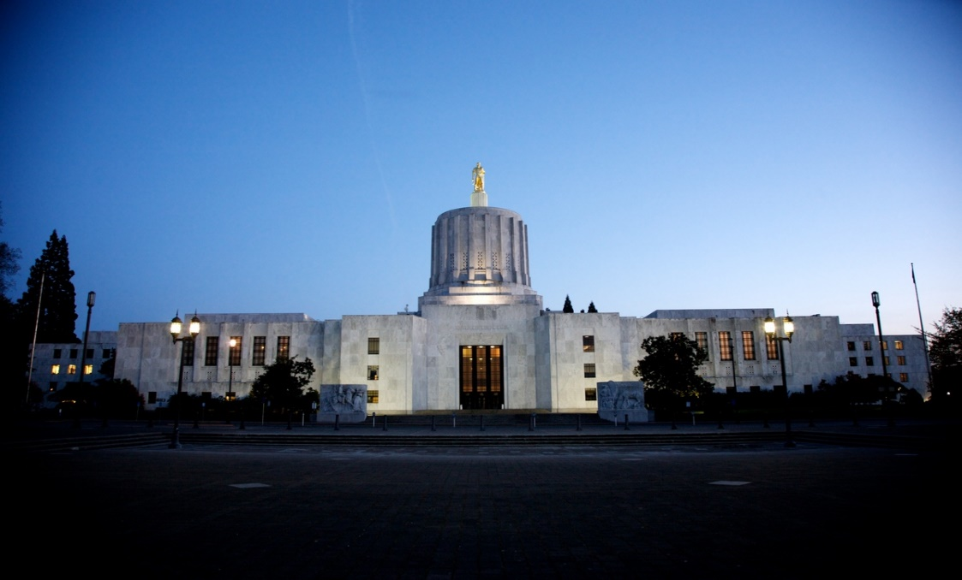
Oregon
Power of the narrative
Narrative Policy Framework (NPF)
Case out of central Oregon
EOCIL’s IDSP
Researched the topic
Developed white sheet
Identified the issue; specific law
Provided a narrative
Action steps
Worked with Oregon ADAPT and sought remedy through the legislature
Notes:
NPF: characters – villains and heroes, setting, plot
How we understand politics and policy situations
Kirt will talk more about root causes, scope of conflict, and more in a few minutes but I will mentioned this was not easy to achieve. 6 of the 7 CILs and their association were not involved. DRO was working independent of CILs (failed past attempts) and Oregon’s SILC was totally absent.

Slide 20
Idaho
Grassroots-led movement
Idaho SILC
Fathers And Mothers Independently Living with their Youth (FAMILY) committee
PwDs, advocates, legislators, & SMEs
I am Sam; Power of the narrative
FAMILY successfully introduces legislation in 2002 & 2003
1st state in nation to include disability protections in TPR codes
Notes:
SMEs= “members of disability organizations”
Chair of the House Health and Welfare Committee watches movie;
Provided a clear narrative for policymakers
2002: focused on divorce, adoption, guardianship, and termination of parental rights, with an emphasis on provisions that allow parents to present evidence detailing how adaptive equipment and support services enable them to parent effectively.
2003: regarded child protection, with a special emphasis on creating an evaluation system that is consistent and fair for parents, and requiring that child protection investigators be knowledgable about disability accomodations.

Slide 21
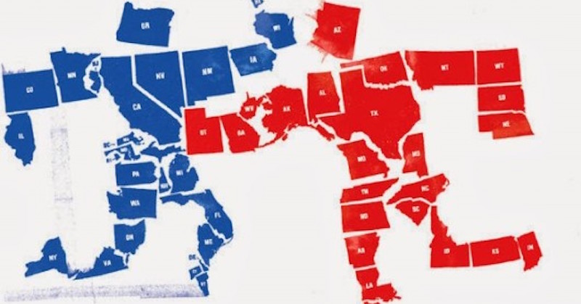
Political Party Analysis
8 Republican dominant states
FL, ID, IN, LA, MI, PA, SD, WY
7 Democratic dominant states
CT, ME, MN, NJ, OR, RI, VT,
State legislatures
Governors
Federal legislators

Slide 22
Take Home Message
Develop a two-party policy plan

Slide 23
CIL Perspective: Starting Premise/Disclosures
I am a member of the deaf and hard of hearing community, please use the microphone to ask your questions
I have a short term memory loss so my slides can be filled with recent thoughts that I cannot retain
I acknowledge I DO NOT SPEAK FOR THE ENTIRE DISABILITY MOVEMENT
Notes:
Eleanor Lisney, Co-founder of Sisters of Frida
At EOCIL’s Institute for Disability Studies and Policy, we believe academia should work with CILs to identify “list of issues” and academia should produce actionable research.
RCA: For todays exercise we are accepting that we have provided the issue of discriminatory TPR codes to our academia partners and they have provided us with actionable research. Now it is time for CILs to complete the RCA with action steps.
Analytically honest: Overly critical; uncomfortable; does not feel good; it will force accountability and necessary if we really want to determine root causes.

Slide 24
CILs must define the movement and create system change. We are accountable to constituents we represent. All other entities (our three branches of government and all their agencies, the U.N., our SILCs and USCID,APRIL, NCIL other national advocacy groups, must listen to us and not the other way around. We define the movement! Our movement has to be bottom up liberation movement and not top down!
Notes:
Eleanor Lisney, Co-founder of Sisters of Frida
At EOCIL’s Institute for Disability Studies and Policy, we believe academia should work with CILs to identify “list of issues” and academia should produce actionable research.
RCA: For todays exercise we are accepting that we have provided the issue of discriminatory TPR codes to our academia partners and they have provided us with actionable research. Now it is time for CILs to complete the RCA with action steps.
Analytically honest: Overly critical; uncomfortable; does not feel good; it will force accountability and necessary if we really want to determine root causes.

Slide 25
“I am an activist – I am not an academic”
Eleanor Lisney, Co-founder of Sisters of Frida
At the Institute for Disability Studies and Policy, we believe academia and CILs are a natural marriage
CILs List of Issues--}Academia actionable research--}CILs root cause analysis--}CILs White Sheets with action steps--}System Change

Slide 26
RCA: Bird’s-eye view, think bigger picture approach, and be analytically honest
Analytically honest: Overly critical; peeling te onion: uncomfortable; does not feel good; it makes us cry. If we do the best job we can, it will get us to the core, force accountability which is necessary if we really want to attempt to alleviate root causes of threats to our movement.

Slide 27
CIL Perspective: RCA
Quick root cause analysis for our exercise
Discriminatory TPR codes are a symptom of a bigger problem
Why do we have discriminatory TPR codes in the majority of the U.S.?
Despite the narrative, our U.S. disability system has serious flaws (family, education, employment, correctional institutionalization, etc.)
Notes:
Due to time constraints, I am going to make some assumptions and complete the RCA for you. Write down anything I am missing as we go through this process. You can use it in your breakout session.
We are told the ADA solved all disability issues and we have a better system then any other country. Maybe! The statistical data and actionable data lead me to believe we need more action, more tools, because we have not achieved equality.

Slide 28
CIL Perspective: RCA
Our system is flawed…U.S. discriminatory TPR Codes connotation:
We do not have equality and non-discrimination (as defined: 1. recognize that all persons are equal before and under the law and are entitled without any discrimination to the equal protection and equal benefit of the law. 2. prohibit all discrimination on the basis of disability and guarantee to persons with disabilities equal and effective legal protection against discrimination on all grounds)
Violation of women with disabilities human rights
Our government does not support/engage in affective awareness-raising
We still do not have access to Justice
We still do not have full liberty and security of the person
We still do not have freedom from torture or cruel, inhuman or degrading treatment or punishment
We still do not have our government’s respect for home and the family
We still do not have adequate funded support services
Notes:
I want to pause here and really dig down what discriminatory TPR codes mean before we move on with the RCA!

Slide 29
CIL Perspective: RCA
Quick root cause analysis:
Why is our system not perfect?
CILs focus on symptoms and not root causes. Root causes are allow to exist, influence, and expand!
CPS removes a child. Parent/CIL at CPS office (individual advocacy). Family unit is restored (until next time).
CIL community adequately conducts system advocacy (legislative system)?
Notes:
If not, we are focused on symptoms not real root cause system advocacy.

Slide 30
CIL Perspective: RCA
Quick root cause analysis:
Why do CILs focus on symptoms and not root causes?
Limited/nonexistent partnerships (CILs--}academia)
Why is there a nonexistent partnership?
CILs have not adopted the Academia---}CILs---}Systems Change philosophy
Why have CILs not adopted philosophy?
Lack of awareness of best practice

Slide 31
CIL Perspective: RCA
Quick root cause analysis:
Why are CILs unaware of this best practice?
There is friction among PWDs, DPOs, NGOs preventing our community from uniting in harmonized unity
Notes:
Article 5 – Equality and non-discrimination
1. States Parties recognize that all persons are equal before and under the law and are entitled without any discrimination to the equal protection and equal benefit of the law.
2. States Parties shall prohibit all discrimination on the basis of disability and guarantee to persons with disabilities equal and effective legal protection against discrimination on all grounds.

Slide 32
CIL Perspective: RCA
“…there are challenges and gaps between everyday PwDs and the so called leaders of the disability communities.” Professor Gabor Gombos

Slide 33
CIL Perspective: RCA
Why is there friction among PWDs, DPOs, NGOs preventing our community from uniting in harmonized unity?

Slide 34
CIL Perspective: RCA
Five reasons:
1. Schattschneider’s Scope of Conflict: If a coalition perceives itself as the primary power in a policy arena, they will want to keep the scope of conflict limited in order to maintain their control and influence
Notes:
I DO NOT SPEAK FOR THE ENTIRE DISABILITY MOVEMENT.
We do not have time today but these five answers could and should result in their own root cause analysis. They need to be addressed and are symptoms of a bigger problem.
This may be our local, state, regional, national and international advocacy organizations (Regional IL Advocacy group, NCIL, APRIL, etc.)

Slide 35
CIL Perspective: RCA
2. CILs are not cohesive! Good intentions but lack:
educational qualifications/career
qualifications/BIG EGO preventing SME
counsel!
business experience
historical/contemporary knowledge
we allow others to define and constrain the movement (ACL, USICD, APRIL, NCIL, ILRU)
we allow partisanship to guide our actions
Notes:
CILs hiring people with or without disabilities that are not qualified to provide services or operate a disability liberation civil rights organization;
SILCs comprised of individuals with and without disabilities without fundamental knowledge of our movement or CILs;
I have observed system advocacy being on hold “until democratic control of government is regained.”
Contemporary knowledge of services; who should define the movement (organization providing training to us on how to provide transition services without identifying the real root causes of discriminatory TPR codes (how to provide training to parents with disabilities on being parents instead of changing the discriminatory codes). Another example is transition. You will see a training for CILs relating to Designing a CIL transition youth program to move youth from school to work. Then we hear CILs are not reporting or failing at transitioning. Root cause analysis would validate the five reasons we are discussing now and specially CILs cannot provide effective transition services because we do not have funding and yes we have a root cause analysis for the funding issue also.

Slide 36
CIL Perspective: RCA
3. Alternative motives (marking time)
4. Inadequate funding for CILs
5. Non-U.S. CRPD treaty ratification
The Convention on the Rights of Persons with Disabilities (CRPD) is an international disability treaty. The CRPD is a vital framework for creating legislation and policies around the world that embrace the rights and dignity of all people with disabilities.
Please join USICD and Women Enabled INTL(excellent leadership, publish wonderful tools for U.N. advocacy, and provide shadow reporting)
Notes:
How many of you have heard of the CRPD?

Slide 37
CIL Perspective: RCA
CRPD as a tool to address U.S. disability system inadequacies. Discriminatory TPR codes conflict with:
Article 5 – Equality and non-discrimination
Article 6 – Women with disabilities
Article 8 – Awareness-raising
Article 12 – Equal recognition before the law
Article 13 – Access to Justice
Article 14 – Liberty and security of the person
Article 15 – Freedom from torture or cruel, inhuman or degrading treatment or punishment
Article 23 – Respect for home and the family
Notes:
The CRPD is a tool we can use for system advocacy! When ratified by the U.S., our government would submit a comprehensive report on measures taken to give effect to its obligations within two years after the entry into force of the Convention. CILs and other DPOs should submit shadow reports to prevent the fox guarding the hen house scenario. (youth with disabilities not graduating high school, lack of peer based youth transition, and youth in corrections as examples). We can do the shadow reporting ourselves or we can direct our national advocacy organization to use our information. The U.S. became a signatory on July 30, 2009 and Senate ratification failed in 2012.

Slide 38
Breakout Session
Notes:
2-5 minutes

Slide 39
Exercise 1: Policy Goal
State selection
Identify policy goal
Language
Practice
Further research
Education/outreach
Etc.

Slide 40
Discuss/Strategize – 10 min.

Slide 41
Exercise 2: Policy Venue
Identify policy venue
State legislature
Executive
Judicial
SPIL

Slide 42
Discuss/Strategize – 10 min.

Slide 43
Exercise 3: Policy Implementation
Develop policy implementation plan
Public opinion
Media campaign
Coordination with other CILs
Identify key policy makers
Allies
Foes
Community partners
Cultivate relationships
Liaison
Lobbyist
Notes:
Develop that narrative

Slide 44
Discuss/Strategize – 10 min.

Slide 45
Commitments
Develop, implement, and evaluate annual TPR policy plan.
Research, join, and participate (USICD)
Research, join, and participate (WEI)
Join our IDSP TPR quarterly conference calls where you can provide updates and obtain peer technical assistance (business cards/sign-in sheet)

Slide 46
QUESTIONS/COMMENTS
Notes:
5 minutes

Slide 47
Work Cited
Collentine, Alexis C. 2005. “Respecting Intellectually Disabled Parents: A Call for Change in State Termination of Parental Rights Statutes.” Hofstra Law Review 34 (2): 535-64.
Hill, Katharine M., Lightfoot, Elizabeth, and Traci LaLiberte. 2010. "Child Abuse & Neglect: The inclusion of disability as a condition for termination of parental rights." University of Minnesota, St. Paul. Social Work Faculty Publications, Paper 35.
Kerr, Susan. 2000. “The Application of the Americans with Disabilities Act to the Termination of the Parental Rights of Individuals with Mental Disabilities.” Journal of Contemporary Health Law and Policy 16 (2): 387-426.
Lightfoot, Elizabeth, and Traci LaLiberte. 2006. “The Inclusion of Disability as Grounds for Termination of Parental Rights in State Codes.” Policy Research Brief 17 (October): 1-11.
Lightfoot, Elizabeth, LaLiberte, Traci, and Katharine Hill. 2007. Guide for Creative Legislative Change: Disability Status in Termination of Parental Rights and Other Child Custody Statutes. Minneapolis: University of Minnesota.

Slide 48
Work Cited cont.
Mathis, Jennifer. 2012. “Keeping Families Together: Preserving the Rights of Parents with Psychiatric Disabilities.” Clearinghouse Review: Journal of Poverty Law and Policy 46 (March): 517-24.
McConnell, David, and Gwynnyth Llewellyn. 2002. “Stereotypes, Parents with Intellectual Disability and Child Protection.” Journal of Social Welfare and Family Law 24 (August): 297-317.
National Council on Disability. 2012. Rocking the Cradle: Ensuring the Rights of Parents with Disabilities and their Children. Washington, D.C.: National Council on Disability.
Sackett, Rosemary S. 1991. “Terminating Parental Rights of the Handicapped.” Family Law Quarterly 25 (Fall): 253-98.
Vennochi, Joan. “Disability does not Preclude Parental Rights.” Boston Globe, 12 February, 2015.
Arnhart, Larry. 2016. Political Questions: Political Philosophy from Plato to Pinker. Long Grove, IL: Waveland Press, Inc.

Slide 49
Work Cited
Carro, Venancio. 1974. “The Spanish Theological-Juridical Renaissance and the Ideology of Bartolome de Las Casas.” Dekalb, IL: Northern Illinois University Press.
Child Welfare Information Gateway. 2017. “Grounds for Involuntary Termination of Parental Rights.” Washington, DC: US Department of Health and Human Services, Children’s Bureau.
Ben-Moshe, Liat, Chris Chapman, and Allison C. Carey. 2014. Disability Incarcerated: Imprisonment and Disability in the United States and Canada. New York, NY: Palgrave Macmillan.
United Nations, 2008. Convention on the Rights of Persons with Disabilities. New York.
Eleanor Lisney, Co-founder Sisters of Frida. London, United Kingdom. National University of Ireland Centre for Disability Law & Policy. Galway, Ireland. June 18-22 2018. 10th International Disability Law Summer School.
Professor Gabor Gombos, Co-Chair, World Network of Users and Survivors of Psychiatry, Odense, Denmark . National University of Ireland Centre for Disability Law & Policy. Galway, Ireland. June 18-22 2018. 10th International Disability Law Summer School.

