Slide 1
Exploring The Resources And Supports of the Paralysis Resource Center
Craig Hospital September 7, 2017

Slide 2
The Christopher & Dana Reeve Foundation is dedicated to curing spinal cord injury by funding innovative research, and improving the quality of life for people living with paralysis through grants, information and advocacy.
Today’s Care. Tomorrow’s Cure.®
Notes:
Tell story of Chris & Dana
Chris wanting cure
Dana focusing on QOL issues
Brought together care and cure

Slide 3
Over 5.3 million Americans are Living with Paralysis
Stroke
1,804,850 Americans living with Stroke.
Spinal Cord Injury
1,462,220 Americans living with Spinal Cord Injury.
34%
27%
Multiple Sclerosis
999,080 Americans living with Multiple Sclerosis.
Cerebral Palsy
44,880 Americans living with Cerebral Palsy.
19%
8%
2013 Paralysis Surveillance Survey of the General Population
Notes:
As a Model System, you are probably aware of the current method of calculating how many people live w/SCI as you send the #s to UAB. However UAB’s method of collection via the SCI Model Systems had not changed since the 1970s yet the life expectancy had.
We took a different approach. Take home message – there are a lot of people living with paralysis – more than most people realize or appreciate
2013 Paralysis Surveillance Survey of the General Population
Conducted by ICR International in 2013
Over 70,000 U.S. households were surveyed using a stratified, single-stage random-digit-dialing sample of telephone households
Utilized the WHO (World Health Organization) definition of disabilities that utilizes function rather than impairment (the medical model) as its frame
4. Very similar results to our 2009 survey, where half the number of households were surveyed
Results published in the American Journal of Public Health in 2016

Slide 4
1.46 million Americans are Living with Spinal Cord Injury
*The overall pie chart represents the causes of paralysis for 1,079,866 valid responses. Of the 1.4 million persons who reported a spinal cord injury, the cause of paralysis could not be determined for 26% (n=382,334) due to missing, unintelligible, or incomplete data.

Slide 5
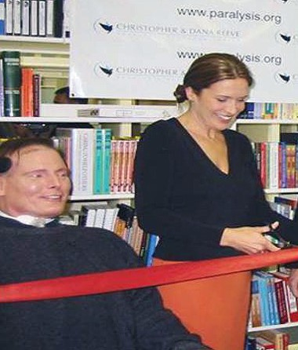
Today’s Care: Paralysis Resource Center
We created the Paralysis Resource Center to help people navigate the chaos of paralysis with reliable information, referral services, and a message of hope.
- Dana Reeve
Notes:
Here’s a photo of Christopher and Dana Reeve at the opening of the Paralysis Resource Center. We opened our doors in May of 2002, serving the community for 14 years.
Resource Center was Dana’s vision
She said that being confronted with paralysis was like being transported to a different planet. She and Christopher were completely disoriented and had no idea where to turn for answers, support and comfort. The PRC is that place.
The Paralysis Resource Center (PRC) provides resources and services that enable people living with paralysis to live independently.

Slide 6
Information Services
Set up an appointment or ask a question online at:
https://www.christopherreeve.org/get-support/ask-us-anything
Information Specialists provide support and answer paralysis related questions
Call us at:
1-800-539-7309
Email us at:
InfoSpecialist@ChristopherReeve.org
Notes:
The IS team provides assistance to people as they move through various stages of their injury or their life. Over 80,000 people helped.
Multilingual – We have language interpreters for phone calls and translation services for print and web.
Common questions – How can I get funding for…?
I have a newly injured family member, how can I choose a rehab center for them?
Is there a clinical trial I would be eligible for?
Can I get paid for being a family caregiver?

Slide 7
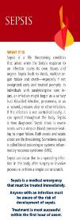
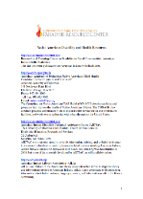
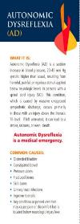
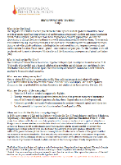
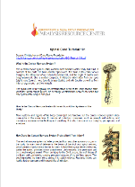
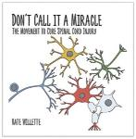
Free Materials & Resources
Books
Wallet Cards
Fact Sheets
Publications
Notes:
We have distributed over 195,000 copies of the PRG
The PRG is highly regarded and is used by many universities as a standard text book.
General guidebook for living a healthy, active and independent life.
Some more in-depth resources would be our Wallet Cards.
One example would be our AD card – autonomic dysreflexia
A secondary condition that affects a T6 level or higher individual with a spinal cord injury
If left unattended, it can lead to stroke, seizures or even death
Allows patient to help inform physicians on how to quickly and properly treat AD
Factsheets: one for each state and DC, almost 200 Topical factsheets on topics like pain, Multiple Sclerosis, bladder
management. Over 100 topical factsheets in Spanish.
Don’t Call it a Miracle: 237 page book written by the spouse of a person living with spinal cord injury. Also available in e-reader formats.
It also covers the approaches scientists are taking to heal, mend or bypass the nervous system and what you, as a non-scientist, can do to speed things along.

Slide 8
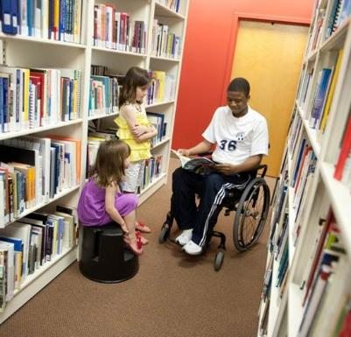
National Lending Library
5000+ books, videos, and e-books available on paralysis – related subjects
Free book/video loan with free mailing and return postage
Interlibrary loans state-wide and nationally
Online catalog and children’s catalog @ Reeve Website
Notes:
Online catalog can be found on the Reeve website: www.ChristopherReeve.org/Library
Separate catalog for children, see http://108.53.47.52:8000/kids#/categories to enter the children’s catalog
To see e-books and e-audiobooks, see (http://reeveprc.axis360.baker-taylor.com)
The Reeve library is a national clearinghouse of information on all subjects related to paralysis:
5,000+ books & videos available for free loan
Items can be mailed to a person’s home with return postage
Interlibrary loans state-wide and nationally

Slide 9
Online Community
On-demand videos
Facebook, Twitter, and online forums
Monthly web chats
Paralysis- related blogs and webcasts
Free social networking platform dedicated to the paralysis community
Notes:
Dr. Dan is a licensed psychotherapist who lives with spinal cord injury.
Nurse Linda is PhD and nursing professor who specializes in spinal cord injury.
They are available live for e-mail chats weekly and both broadcast a live web chat monthly. Nurse Linda’s live webchats occur the fourth Wednesday of each month.

Slide 10
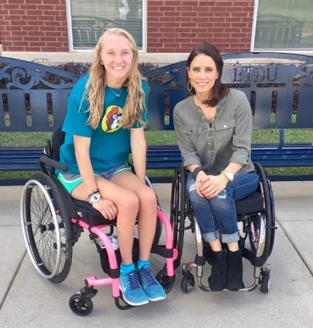
Peer & Family Support Program
National Peer Mentoring Program
Support for people living with paralysis, families & caregivers
Matched to people with similar experiences
Mentors are trained & experts in local resources
Local ambassador program at Level I Trauma Centers
Notes:
Individuals living with Paralysis can feel overwhelmed and sometimes alone. Reeve peer mentors provide support (emotional as well as resourceful) to members of their community, their families and caregivers.
PROGRAM
People are matched, to the best of our ability, with someone who is living with similar experiences. Mentoring can take place in many forms, such as in-person, over the phone, online, or video chat.
The mentoring relationship can be a single or long term experience.
Peer mentors are people who have been injured for over a year and have had time to adjust.
They are experts in local resources and can tap into our information specialist team for national resources as well
This year we plan to expand our program so our peer mentors become local ambassadors, forging relationships with Level I trauma centers.

Slide 11
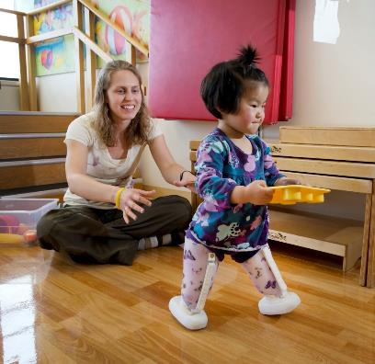
Quality of Life Grants Program
QoL
Funds nonprofit initiatives that support people living w/ paralysis in all 50 states
Impact
Over $22 million awarded through QoL Grants
Notes:
Supporting programs that provide opportunity
Grants provide funding for programs including service animals, accessible camps, assistive technology, arts, accessible playgrounds, adaptive sports and durable medical equipment loan banks.

Slide 12
Military & Veteran Program
MVP
Supports all military services members- no matter what era they served in
Injury doesn’t need to be combat- related
Information & referral services tailored for Military and Veteran population
Notes:
Guides service members through the military and veterans health care systems
Outreach to Military Treatment Facilities and VA Medical Centers
Connects service men, women and their families with the Peer & Family Support Program, matching them to MVP Peer Mentors
MVP Advisory Council composed of volunteers

Slide 13
Community Outreach Program
Targets gap areas and underserved communities
Partner with local organizations
Provides services in 150+ languages
Notes:
We’re providing outreach to individuals who are often uninformed of what's available to them, or in other words lack resources, mostly due to cultural, racial, geographic, economic factors, and biases.
Provide assistance, education, awareness on available help/resources no matter what your circumstances may be; e.g low-literacy, LGBT friendly physician, no health insurance, etc.
Partner with Community Based Organizations, local clinics (FQHC’s), and Community Centers to help target these hard to reach communities/individuals.
Culturally and Linguistically relevant translated materials.
Diverse group of peer mentors available
Interpretation services available in over 150 languages in writing or via phone
Our website offers info in 7 languages https://www.christopherreeve.org/international

Slide 14
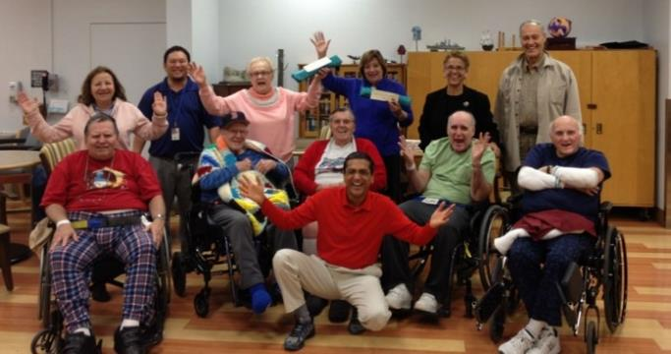
Reeve Community Education Program
j
j
j
Educational training
Seminars
Web-based learning opportunities
Upcoming events:
www.ChristopherReeve.org/Newsletter
www.ChristopherReeve.org/Events
Notes:
Our speakers represent the Foundation out in the community through educational presentations that enrich people’s lives and provide practical knowledge and evidence based practices with a goal of allowing people affected by paralysis to live independently and make informed decisions.
Current efforts:
Caregiver Day at Abilities Expo
Seated Therapeutic Yoga Seminars
Webinars and Facebook Live videos on a range of topics
The Reeve Community Education Program offers educational training, seminars, and web-based learning opportunities that deliver a variety of tools for living well after paralysis.
Please sign up for our newsletter at ChristopherReeve.org/newsletter
or visit ChristopherReeve.org/events for upcoming events.

Slide 15
NeuroRecovery Network®
Clinical Research
Evidence - based, activity- based therapy
Functional Recovery & Improved Quality of Life
Notes:
11 Papers published in the Archives of Physical Medicine & Rehabilitation
NRN Clinical Centers:
Craig Hospital, Denver, CO
Kessler Institute for Rehabilitation, West Orange, NJ
Magee Rehabilitation Hospital, Philadelphia, PA
Ohio State University Medical Center, Columbus, OH
Shepherd Center, Atlanta, GA
The Institute for Rehabilitation and Research (TIRR), Houston, TX
Toronto Rehabilitation – UHN Lyndhurst Center, Toronto, ON
University of Louisville/Frazier Rehab Institute, Louisville, KY
Community Fitness and Wellness Facilities:
Courage Center, Minneapolis, MN
Frazier Rehab Institute – Community Fitness and Wellness Facility, Louisville, KY
Neuroworx, South Jordan, UT
NextStep Fitness, Lawndale, CA
NextSteps Chicago, Willow Springs, IL

Slide 16
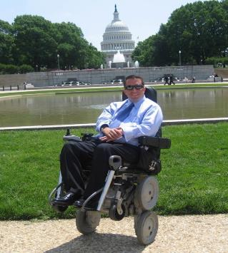
Advocacy and Education
Building coalitions w/ disability organizations
Sharing advocacy stories w/ Congress
Informing policymakers on paralysis issues
Improving existing policy
Analyzing new policy proposals
Notes:
Focus is on federal legislation and policy:
Current initiatives include:
Complex Rehab Technology - refers to the individually configured wheelchairs and components people with paralysis need for daily life. We are working to preserve and enhance access to this crucial equipment.
Competitive Bidding
Therapy caps and reimbursement
Essential health benefits including long term services and supports, medicare and Medicaid
Caregiver supports
Parents with Disabilities – White House event in May to launch the Parenting with Disability toolkit – cross disability
Enforcing the ADA and making sure Congress does not “chip away” at the law
Supporting research and funding at NIH
The Reeve Foundation elevates the voices of people living with paralysis and their families through:
Building coalitions with other disability organizations
Informing policymakers on the issues important to people living with paralysis
Analyzing new policy proposals and ways to improve existing policy
Alerting advocates of opportunities to share their stories with Congress

Slide 17
Conference Outreach
Attending
Exhibiting
Presenting
Outreach about PRC services and products
Notes:
We average 25+ conferences per year. The audiences include:
Healthcare providers
Consumers
Caregivers
Various professionals that work in the field of paralysis.
Military
Underserved and diverse populations.

Slide 18
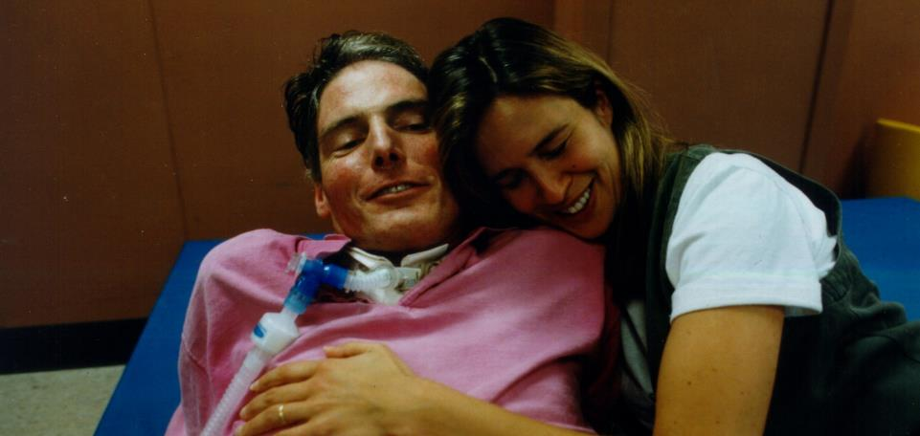
Nothing of any consequence happens unless people get behind an idea. It begins with an individual and they share the idea with more individuals…and eventually, it becomes a movement.
-Christopher Reeve
Notes:
Thank you, again! We would be happy to take any questions.

Slide 19
Contact Us!
Maggie Goldberg Vice President, Policy and Programs
(973) 933-7206
MGoldberg@ChristopherReeve.org
Bernadette Mauro Director, Information and Resource Services
(443) 512-8801 BMauro@ChristopherReeve.org

