Slide 1
How to EQUIP Young Adults with Disability Pride and Self-Advocacy
A Tool for Successful Young Adult Program Creation, Implementation, and Sustainability
APRIL Conference
October 22, 2016
1:30 – 3 pm
Notes:
It sounds great to be able to start a group for young adults with disabilities that hits on the topics and concepts of transition-related services - but what does it actually MEAN step-by-step to get a group that is for young adults and peer-led off the ground, create a successful well-known group in your area, and find a way to make that group sustainable within the community and through young adult buy-in? That is what this session will go into detail to do - assist you all in either:
Providing you with tools, framework, and some questions to begin starting a Young Adult Transition Group
Assist with you ideas and ways to facilitate this group in a meaningful and impactful way to the consumers in your community
Find ways to sustain this Peer Support Group and create young adult buy-in so the program is truly for and by young adults
Formal Proposal for NCIL Conference: July 25-28, 2016
Title: EQUIPing Young Adults with Disability Pride and Self-Advocacy Skills
Description: An Overview of the EQUIP Leadership Group, a Statewide group in South Carolina for Young Adults ages 13-28 with all types of disabilities to learn disability pride, information about the Disability Rights Movement, self-advocacy skills, professionalism, and transition-oriented skills for independence. This workshop is to provide a model of peer-to-peer mentoring being successfully utilized and facilitated in SC so that other states can see the value in peer mentoring as it relates to the above skills.
Abstract: Able South Carolina and the EQUIP Leadership Group will provide information on a working and thriving model of peer-to-peer self-advocacy, disability pride, communication, goal setting, professionalism skills, and transition-oriented skill building for young adults with disabilities ages 13-28 in South Carolina. EQUIP Leadership Group is funded through a grant with the SC Developmental Disabilities Council, and is in the 2nd year of a 3-year grant to build self-advocacy skills (knowing what you want, speaking up for yourself, and never giving up) for young adults with disabilities in South Carolina. To-date, EQUIP Leadership Group employs 12 active EQUIP Leaders across the state, facilitates a state-wide online peer support meeting, and three in-person peer support meetings in Richland, Greenville, and Anderson Counties. This workshop will not only cover how to start and up-keep a successful peer mentoring leadership group for young adults with disabilities, but also provide examples of agendas and lesson plans that have been created for young adults BY young adults; including interactive activities that promote inclusion and accessibility for all disability types.
Presenters: Youth Transitions Coordinator at Able South Carolina (a Center for Independent Living), Rachel Kaplan and members of the EQUIP Leadership Group.
Date of Presentation: Flexibility of any date and time available during NCIL.
Presentation Length: 1 hour
Technology Needs: Computer, Projector, & Sound System/Mic depending on size of crowd

Slide 2
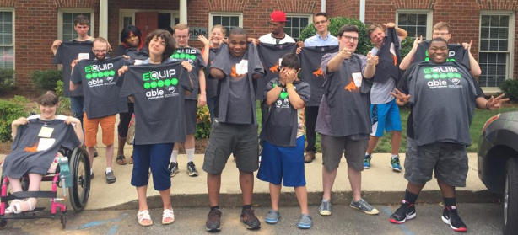
Importance of Youth Programs
Notes:
Youth Programs provide an avenue and opportunity for young adults with disabilities to learn the skills they need for success after high school and in other transitional times and areas of their lives. Youth Programs have the opportunity to teach skills that are specific to this age group and assist with making sure that young adults are learning about self-advocacy, understanding and setting goals for themselves, communicating what they want and need to those around them, and understanding their disability and the accommodations they need to be successful. Having a good handle on all of these skills are what helps to mold a strong and independent young adult who can be an active and engaging member of their family life, school life, work life, church life, community life, etc.
To really showcase the importance of Youth Programs, I would like to tell you a little bit about the EQUIP Leadership Group

Slide 3
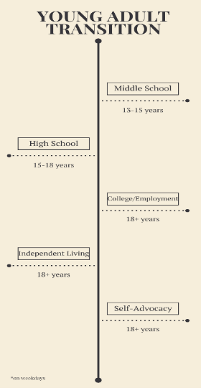
Definition of Transition?

Slide 4
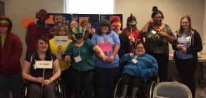
Transition
Transition = Process or period of changing from one state or condition to another.
Middle School to High School
High School to College
High School to Employment
College to Employment
Major Life Changes related to housing, relationships, careers, etc.
In South Carolina, transition services to prepare for post-secondary success (life after high school) starts at age 13 and ends at age 21, which is how long a student can stay in high school. Transition Planning must start before a student’s 13th birthday, and all IEPs must include a statement of goals for after high school and the transition services needed to reach these goals.
- Protection & Advocacy
Notes:
While transition from high school to the next step within the school systems may only range from 13-21 years in SC, Able SC believes that there are many transitional periods that young adults go through where they need support, self-advocacy skills, and assistance from their peers to navigate.

Slide 5
Building a Successful Young Adult Group
Notes:
Have the group throw ideas out for what they consider a successful young adult group.

Slide 6
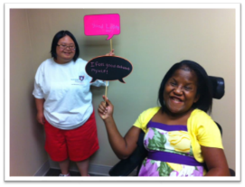
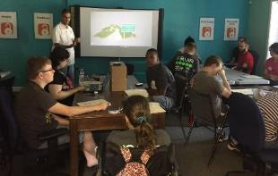
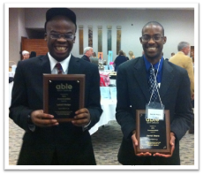
Empowering young adults with disabilities to prepare for their future, advocate for their rights, and become leaders in their communities.
Columbia Greenville Upstate Advocacy Center
136 Stonemark Lane | Suite 100 330 Pelham Rd. | Suite 100A 1 Creekview Court I Suite A
Columbia, SC 29210 Greenville, SC 29615 Greenville, SC 29615
800.681.6805 800.681.7715
TTY 803.779.0949 TTY 864.235.8798

Slide 7
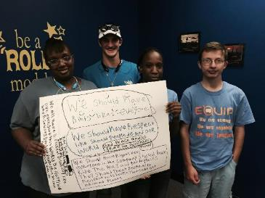
What is ?
Statewide in South Carolina
FOR Young Adults with Disabilities,
Run BY Young Adults with Disabilities
Cross-Disability
Ages 13 - 28
Promotes Self-Advocacy
Funded by SC Developmental Disabilities Council
Currently in Year 3 of the Grant with SC DDC

Slide 8
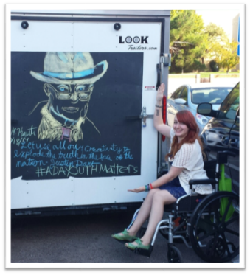
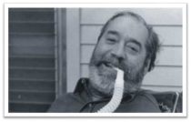
Key Topics Addressed through EQUIP
Self Advocacy
Self-Esteem and Self-Awareness
Disability Rights Movement
Individual and Community Barriers
Future Planning and Goal Setting
Community Involvement
Communication Skills

Slide 9
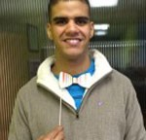
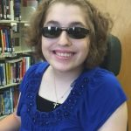
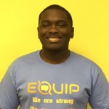
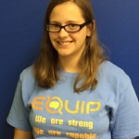
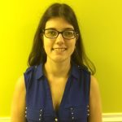
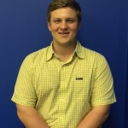
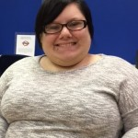
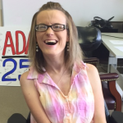
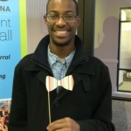
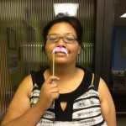
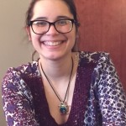
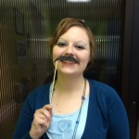
Notes:
These are images of the current EQUIP Young Adult Leaders across the State of South Carolina. We currently have 14 active young adults on staff. All EQUIP Leaders go through an orientation and volunteer hour process before being assessed for a paid position on staff. The EQUIP Leader positions are competitive pay and hours are on an “as needed” basis depending upon the events available from month to month, the location of events, and availability of EQUIP Leaders.Our leaders bring a lot of diverse experiences, ages, disabilities, and self-advocacy/leadership styles and goals to the group. This ensures that everyone who attends the EQUIP Leadership Group events as a participant and attendee has at least one person they feel they can relate to and communicate with.
Need to mention that we have consistent in-office staff as well, you work part time on EQUIP and part-time on another youth program, Effy works three days a week on EQUIP.

Slide 10
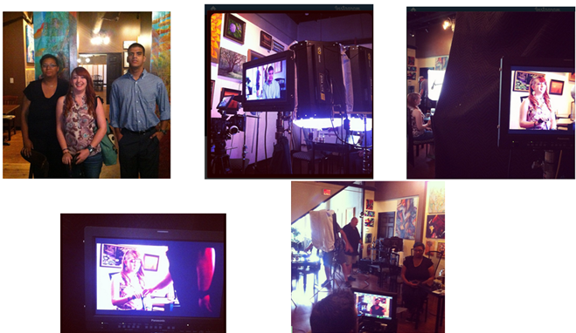
“The Same”
Click Here to Watch "The Same" Youtube Video!
Notes:
Young adults WANT to learn from their peers. THey want to hear about someone close in age to them who has experienced, or is still experiencing, the same situations, barriers, successes, etc. that they are. Due to this fact, we have had the EQUIP Leaders participate in professional videos that have been created to help ensure that the young adult with a disability perspective is being broadcast across South Carolina. These videos allow for other young adults to see people with disabilities close in age to them who are striving for, or what have reached goals that they themselves might want to achieve in the future. These videos also help to build up a sense of disability pride and self-identity that assists young adults in learning that they are NOT their disability. Disability is one part of who they are, and while it may bring challenges, these disabilities also bring strengths. With accommodations, young adults with disabilities can reach their goals and be successful. A dual purpose of the video we are going to watch is also to showcase that people with disabilities are the same as people without disabilities - they have the same hopes and dreams - they just may go about reaching these hopes and dreams differently and with accommodations. So this video can empower young adults with disabilities, but can also serve to educate those without a disability - which is another goal of the EQUIP Leadership Group.

Slide 11
Main Goals of EQUIP (1)
Collaborate with SC Developmental Disabilities
Council and key stakeholder organizations
Quarterly Meetings with active stakeholder organizations
Creation of newsletters geared towards young adults

Slide 12
Main Goals of EQUIP (2)
Empower Self-Advocates in South Carolina
New additional EQUIP Leaders trained and put on staff each year
Professional Development meetings for EQUIP Leaders each year
Participation in SCYLF
Facilitate Peer Support Meetings

Slide 13
Main Goals of EQUIP (3)
Educate the community about disability rights and the value of inclusion
Presentations at Self-Advocacy events
Webinar and Video creation and distribution
Professional Trainings
Serving on Boards and Committees in the community
Parent Trainings
Young Adult Self-Advocacy Trainings

Slide 14
Main Goals of EQUIP (4)
Program Evaluation
Are participants in EQUIP increasing in:
Disability Pride
Self-Advocacy
Communication
Goal Setting and Goal Attainment

Slide 15
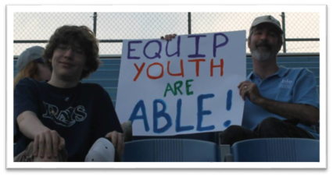
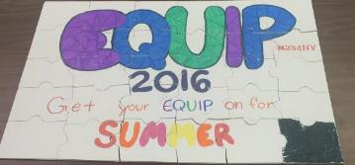
Skill Building Opportunities:
Monthly In-Person Hangouts
Greenville
Anderson
Columbia
Lancaster/York *
Aiken *
Spartanburg *
Quarterly In-Person Hangouts
Saturdays every 3 months in Greenville and Columbia
Monthly Statewide Online Hangouts
Community-Oriented Self-Advocacy Events
Social Media Presence
Twitter
Instagram
Facebook
6-week Summer Series

Slide 16
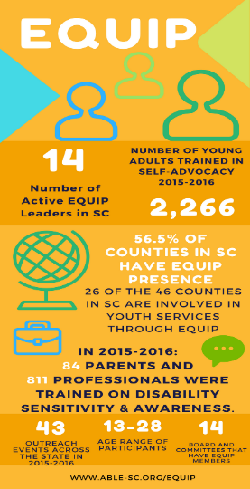
End-of-Year Snapshot of EQUIP
Notes:
New Stakeholders: 13 total Stakeholders
6 new Stakeholders between July 1, 2015 - June 30, 2016 grant year
Peer Support:
Goal = 16 Peer Support Meetings [Greenville, Columbia, Anderson, Online Statewide]
Actual Number Facilitated = 34 Peer Support Meetings
Outreach Events:
Goal = Never Defined [Vendor Fair Events and Collaborative Attendance of Events where no direct skill building was facilitated by EQUIP Leaders]
Actual Number Facilitated = 43
Professional Trainings: 811 professionals trained total
Goal = 4
Actual Number Facilitated = 10
Board or Committee Involvement:
Boards or Committees that EQUIP Leaders are MEMBERS Of/Asked to Sit On = 14
Boards or Committees that EQUIP Leaders Attend = 20
Parent Trainings: 84 parents trained total
Goal = 4
Actual Number Facilitated = 10
Youth Trainings about Self-Advocacy: 2,266 young adults trained total [does not include number of participants at outreach events]
Goal = 6
Actual Number Facilitated = 63

Slide 17
EQUIP Stakeholders
SC Developmental Disabilities Council Center for Disability Resources (CDR) SC Interagency Deaf-Blind Project Protection and Advocacy (P&A) South Carolina Assistive Technology Program (SCATP) DHEC USC School of Medicine SC Autism Society SC Voc Rehab Commission for the Blind - Charleston Eat Smart, Move More Tell Them, SC DDSN P&A Voting Coal. PROVIDE
Notes:
All of the Stakeholders that are identified in partnership with EQUIP are organizations that have an active role in providing EQUIP Leaders with events and opportunities to get involved, promote collaboration between our organizations, and attend Quarterly Stakeholder meetings with EQUIP to get updates on events that have been held, provide feedback and suggestions, and assist EQUIP with finding more ways to get out in community and participate. What is nice about these EQUIP Stakeholder organizations is that a good chunk of them (6) joined the team this past grant year and are not necessarily disability-oriented organizations. This creates a well-rounded opportunity for EQUIP to get into the community and not only educate people with disabilities or those who work with people with disabilities or have kids with disabilities - but members of the community that are otherwise unexposed to this population and community. This aspect is what helps to foster and create change and community acceptance and inclusion.

Slide 18
Getting Started...

Slide 19
Creation of a Young Adult Program
Identify Potential Funders
Identify Staff Members
Determine Age Range of Participants
Develop Goals/Strategic Plan
Recruit Peer Leaders & Participants
Choose Stakeholders/Advisory Group to Facilitate Community Relationships
Notes:
*** Have a brainstorming session in small groups for a few minutes to come up with their “ideal” program by answering the questions stated on the slide and then have groups answer these questions to the whole room.
The way that EQUIP got started was that we partnered with the National Youth Leadership Network (NYLN), who came in and helped us brainstorm (with a group of young adults) what topics and goals were important to the young adults in South Carolina. This same exercise was also done with organizations within the state that expressed interest in being a part of EQUIP’s growth, success, and reach within the young adult disability community in South Carolina.For EQUIP, after much brainstorming and narrowing down the topics and different focus points, things were narrowed down to three over-arching goals to focus on.

Slide 20
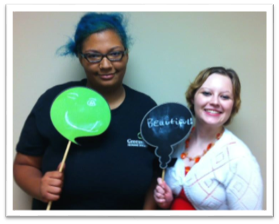
Getting Young Adult Feedback
During the Brainstorming Process
Brainstorm Goals
What organizations do young adults want to collaborate with?
Who do they feel is the target age group? What is their view on the purpose of this group?
Who do they want to educate?
Young Adults?
Professionals?
Parents?
Community Members?
During the Group Creation Process
Young Adult Involvement During Group Facilitation
Young Adult Buy-in for Sustainability
Notes:
Since this is a group for young adults, you want to make sure that the young adult population has a say in what is going on. You want young adults to provide feedback about what they think is important to their age group and their community.

Slide 21
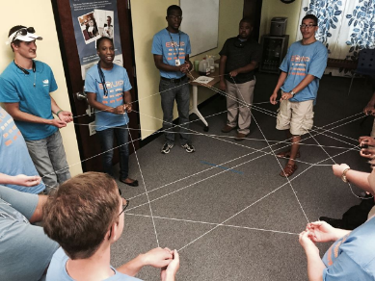
Core Concepts and Message
Self-Advocacy
Disability Pride
Disability History Movement Awareness
Goal Setting
Communication Skill-Building
Accommodation Awareness in schools, employment, and community
Professionalism Skills

Slide 22
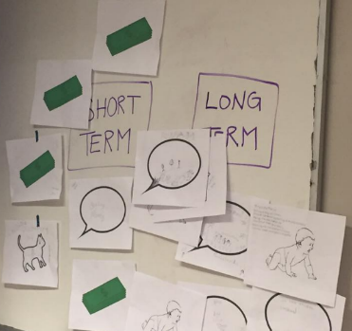
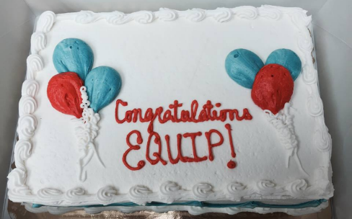
Establishing Goals for Youth Transition Programming
Notes:
Let’s actually take a moment to identify some short-term and long-term goals YOU ALL think are important for developing a sustainable group that promotes the tenets and integrity of the 5th core service of youth transition services.

Slide 23
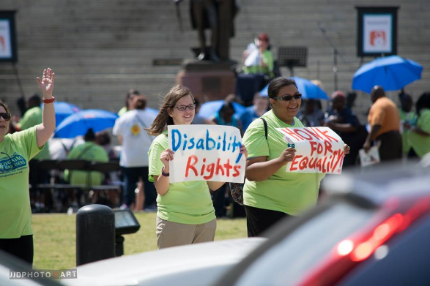
Creating Young Adult Buy-in

Slide 24
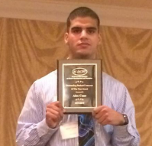
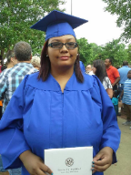
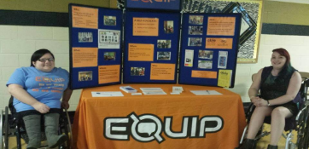
The Power of a Peer-Led Group
Having Young Adults with strong leadership and self-advocacy be at the table for events and major decisions
Relevant Discussion Topics
Peer to Peer Role Models
Opportunity for professional development for young adult leaders/activity facilitators
Opportunity for increased skill building and disability pride for young adult participants
Notes:
When we talk about skill building with young adults, we at Able SC are firm believers that activities with young adults need to be interactive and hands-on. Young adults need the stimulation of practicing key concepts and skills in order to get better at them. Everyone learns differently, and doing hands on activities that provide different formats and opportunities to practice skills is the best way to increase confidence and competence for young adults. We are a little limited in what we can do today with only a little over an hour for this presentation and such a large number of people here. If there is time at the end I would love to show you all some activities that we facilitate with EQUIP Leadership Group young adults to prmoote skill building in a fun and interactive capacity.

Slide 25
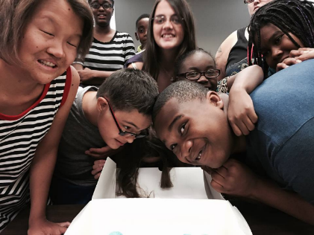
How to Create a Peer-Led Group
Having Young Adults with strong leadership and self-advocacy at the table for events and major decisions
Stakeholder Meetings
Attending community events
Serving on Boards and Committees
Co-creation of agendas and presentations
Co-facilitation of events and activities

Slide 26
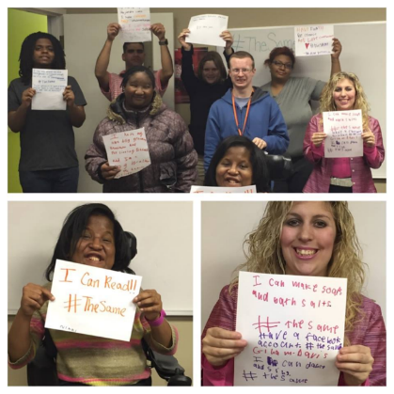
Attendee and Leader Expectations
Respect/Safe Space
Young Adults Only
Creation of Group Guidelines
Disability Awareness
Focus on Self-Advocacy
Promote Skill Building
HAVE FUN!
Diversity of Disabilities, Ages, Races, Goals

Slide 27
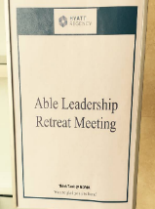
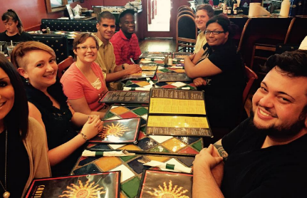
Leadership Component
Young Adult Leaders are still young adults. They need:
Continued professional development
Mentorship components to their position
Professional Development Opportunities
To be held to professional expectations
No exceptions based on age or disability
This teaches real-life employment skills
Notes:
In creating a strong young adult leadership group that has the peer mentoring component, it is important that the young adults involved in the facilitation of events and community outreach have the professional development to improve and become stronger leaders. This means mentoring the young adult leaders so that they can continue to improve their professionalism and can become more and more independent with events and activities - which helps to create a stronger and more sustainable group within the community.
As the Youth Transitions Coordinator at Able South Carolina, a large part of my role is overseeing the professional development and growth of the 14 EQUIP Leaders we have on staff. This means having leader retreats, quarterly professional development events and opportunities, having one-on-one check-ins to go over goals and progress, providing leadership training and professionalism trainings for leaders, etc.
This allows for growth of a stronger group AS WELL AS assisting these young adults with the skills they need to become independent adults in their community. The professionalism and work standards that EQUIP Leaders are held to in this position assist them in being prepared for the next employment position they accept in terms of reliability, professionalism, time management, initiative, community experience, disability and accommodation awareness, and the day-to-day aspects of employment such as timesheets, meetings, and communication with a supervisor.
For many of the EQUIP Leaders, this is their first time having official employment - which means that while they are assisting other young adults to get to the level of self-advocacy and leadership that they are currently at, I am assisting them as their supervisor to become even stronger professionals so they can go on to be successful with their long-term career goals as well.

Slide 28
Use of Social Media and Promotional Flyers/Videos
EQUIPinSC Twitter
EQUIPinSC Instagram
Notes:
Part of building a successful group is getting the attention of young adults - this means really utilizing technology to reach the young adult population. Many young adults have email addresses through school, but don’t really use them. Facebook is also a social media platform that is becoming more uncommonly used by the younger population. To reach young adults, your organization needs to have technology that the youth age group actively uses: Twitter, Instagram, Emails that can be sent as a text message, Youtube channels, etc.

Slide 29
Hear From an EQUIP Young Adult Leader
Effy Francis provides young adult perspective on EQUIP as a Leader, someone with a disability who is in the same age range as those she interacts with in the community
Click Here to Watch Video of Effy Francis!

Slide 30
Funding & Sustainability
Notes:
In order for a group to continue to grow and be successful, it has to be sustainable, that is where the community partnerships, identification of key stakeholders, and increased leadership responsibility roles by young adults comes into play--if you don’t have funding to pay youth leaders find students who are looking for ways to boost their resume or college applications

Slide 31
History of Developing a Young Adult Leadership Group
Developed in 2013- with $10,000 from the National Youth Leadership Network with some Part B funding.
Strong programming and outreach efforts opened opportunities for increased funding via multiple funders.
Now over $350,000 is dedicated to Youth Transition Programs.
Notes:
How many of you are or were a young adult with a disability? Do you remember what you wish people knew about PWDs? Do you remember what you wish you knew about rights, expectations, access?

Slide 32
Able SC’s Youth Transition Programs
Youth Leadership Programs: School Grants:
Project Inclusion
Empowering Students Program
Parent Training & Information (Subcontract)
CareerBOOST
Notes:
List of other programs and funding-
Project Inclusion- UWP, DDC, Department of Education

Slide 33
Young Adults are now the Majority at our CIL
704 Data:
2013: Ages 5-24 = 135 Consumers
2014: Ages 5-24 = 157 Consumers
2015: Ages 5-24 = 713 Consumers
Increased Youth by over
80% in 2 years!

Slide 34
Community Partnerships & Collaboration
-Don’t be a “best kept secret” in your community
-Collaborate with local disability-related organizations, school districts, colleges/universities, etc.
- BE ACTIVE with education programs for students with disabilities. (ie. Advisory Councils for Education for Students with Disabilities, Parent Training and Information Center, statewide transition efforts, VR, etc.)
- Become friends with your state’s Department of Education and local school districts.
- Create a stakeholders group for your youth programs
- Practice what you preach
Notes:
Kimberly Tissot
Advisory Councils-- Required under IDEA to be made mostly of individuals and parents

Slide 35
Community Activism
EQUIP Leaders serve on 14 Boards or Committees consistently at this point in time:
PAIMI Advisory Council SC SILC Family Connection of SC Parent and Youth Advisory Board Self-Advocates Becoming Empowered (SABE) NCIL Youth Caucus Meeting Kids As Self Adocates (KASA) HCBS Person Centered Planning Workgroup through DHHS SC Assistive Technology Advisory Council Palmetto Coordinated System of Care Leadership Team Family Connection Board of Directors: Youth Position SC Advisory Council for the Education of Students with Disabilities Board Member Got Transition's National Young Adult Advisory Board APRIL Youth Steering Committee Greenville County Transition Cooperative Committee
Notes:
Some of these Boards and Committees are local or specific to the state of South Carolina. Others are national and allow for young adults with disabilities in South Carolina to have an opinion and say on what is happening for their community on a large scale level.
Since the young adult with a disability voice and perspective is often not represented on councils, boards, or committees - one of the goals of EQUIP is to get young adults involved these opportunities to help make significant changes in their community, their state, and nationally in the United States. One way that we ensure that EQUIP Leaders are ready to serve on boards or committees is by having them go through a program offered at Able SC called the Community Leadership Academy (CLA). CLA is a 6-week leadership academy that assists people with disabilities to increase their professionalism and working knowledge of boards and committees so they feel confident and polished representing others in this capacity.
Out of the 14 EQUIP Leaders currently on staff, 6 have gone through and graduated from CLA and two are currently going through the training. That is OVER half of our EQUIP Leaders, which creates a very strong and confident group of young adults that are ready to advocate for themselves and their entire young adult population within the disability community.

Slide 36
Ways EQUIP Stays Engaged in within the South Carolina Community
EQUIP Leader Participation in:
-Peer Support Groups: Online and In-Person -EQUIP Summer Series [4th Annual This Past Summer 2016]
- South Carolina Youth Leadership Forum (SCYLF)
-Professional Trainings
- Parent Trainings
- Self-Empowerment activities with students
- Advocacy Events
- Outreach events at Transition Fairs and Community Events
- Creation of Webinars and Videos
- Quarterly Newsletters geared towards young adults

Slide 37
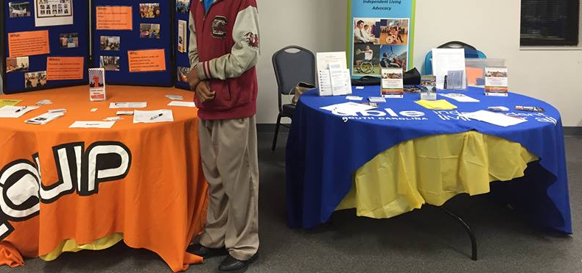
Questions and Discussion
Notes:
Does anyone have any questions? Or want to discuss anything that you are doing in your state or within your Center for Independent Living to promote transition services for young adults? This is a time for open discussion and collaboration of ideas.

