Slide 1
Emergency and Disaster
Preparedness

Slide 2
…. From Volcanos to Earthquakes to Tornados to Flooding and even Hurricanes!
Presenters: Jim Baker, Ernie Martinez

Slide 3
Whether facing volcanos, tornados, earthquakes, flooding, hurricanes or any other disaster, preparedness can help minimize the danger and help keep you alive. We will take a look at how to hold a training presentation for the disability community, how to prepare an individualized emergency plan and how to motivate people to think ahead. We will look at resources and partnerships as well as discuss pitfalls and the promotion of choice.

Slide 4
Introductions
Your name?
Where are you from?
Have you been through a natural disaster?

Slide 5
Why preparedness?
No matter which disaster occurs, preparedness can help minimize the danger and help keep you alive.
In this presentation we will take a look at how to:
Hold a training presentation for the disability community;
Prepare an individualized emergency plan;
Motivate people to think ahead
We will also look at resources and partnerships, as well as discuss pitfalls and the promotion of choice.

Slide 6
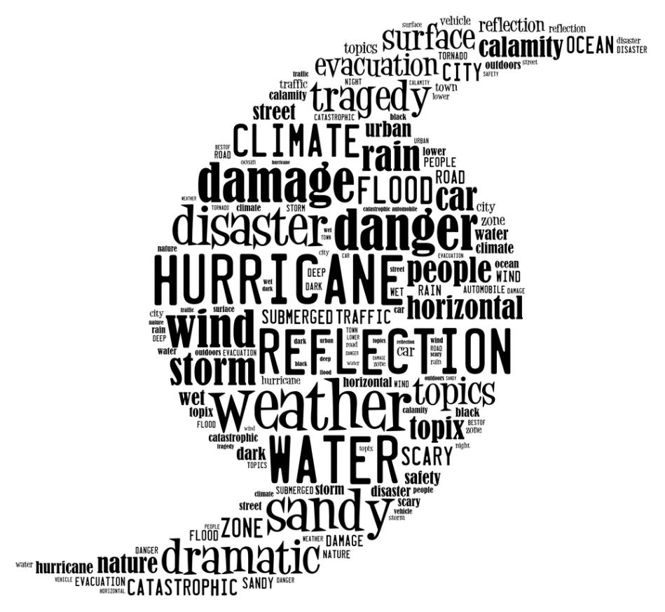
Part 1: about disasters

Slide 7
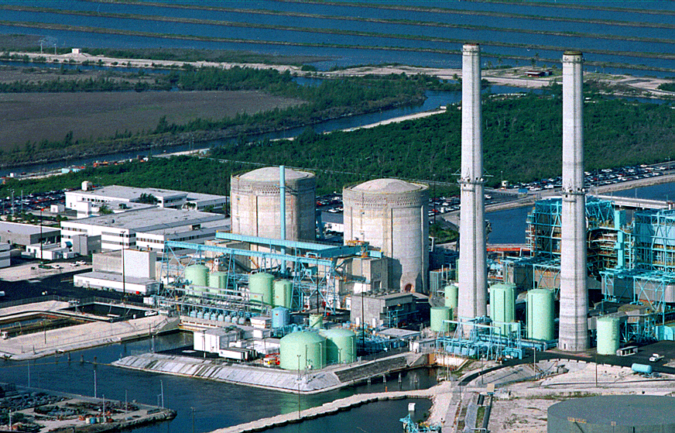
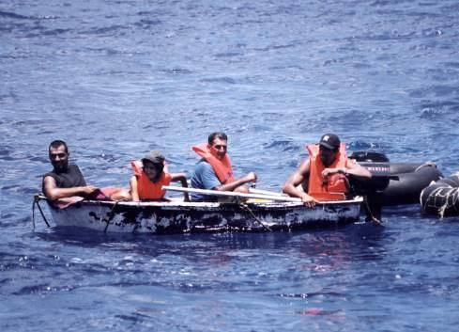
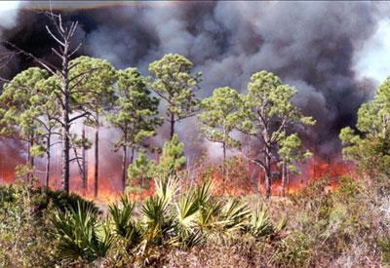
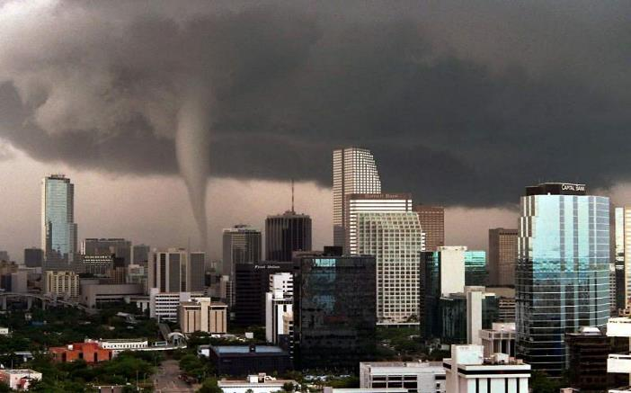
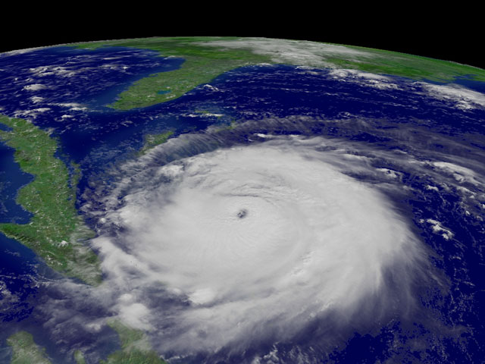
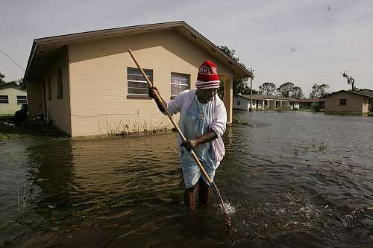
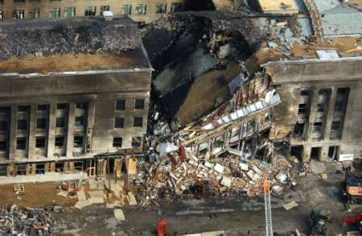
Hazardous Materials
Mass Migrations
Hazmat
Wildland Fires
Tornadoes
Hurricanes
Pandemics
Terrorism
Major Events
Floods

Slide 8
Types of Disasters
Earthquakes
Volcanoes
Storms
Tornados

Slide 9
Floods

Slide 10
Occurrences (historical)
Statistics:
X
X
X
Examples:
X
X
X

Slide 11
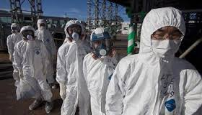
Risks to general population

Slide 12
Isolation

Slide 13
Unable to get out into the community
Unable to communicate
Phone
Email
Neighbors
What is happening?
Television
Radio

Slide 14
Risks to general population (Continued)
Power outage
Refrigerator/freezer
Outside temperature
Heat/air conditioning
Television
Radio
Lack of necessities
Food
Water
Extreme temperatures (heat or cooling)

Slide 15
Risks to general population (Continued)
Dangerous situations
Electrical shock
Physically hurt
Flying or floating debris
Swept away
Buried
Etc.

Slide 16
Risks to People with Disabilities

Slide 17
All of the above
Plus + increased risk of inability to get to safe place
Higher – flooding
Lower – underground (tornados)
Move to another room
Plus + increased risk of inability to get out (before or after)
Plus + risk of isolation (communication)
Lack of food and water (medical condition)
Power outage (medical equipment)
Medications
Damaged
Running out
Medical equipment or adaptive equipment damaged

Slide 18
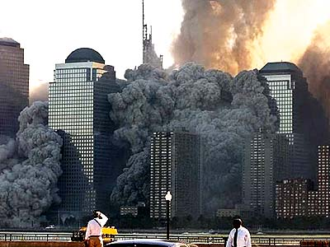
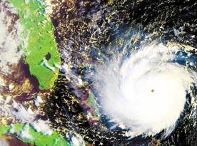
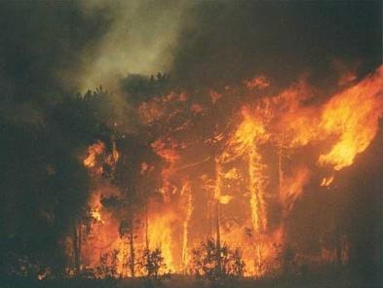
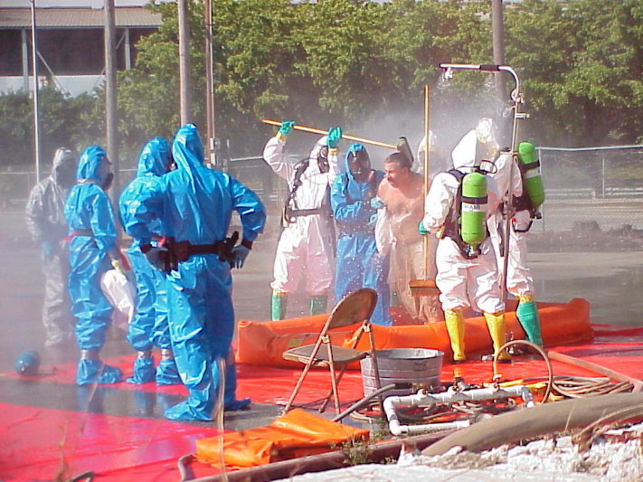
D
I
S
A
S
T
E
R
What you need to know
G
U
I
D
E

Slide 19
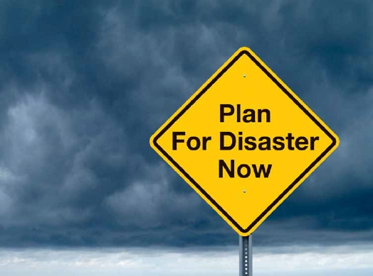
Part 2: Need of a plan

Slide 20
Disaster is likely to strike at some point. Having a plan for escape or a plan on what to do when it hits and after it is over are essential.
Develop a Plan for YOU!
There is no need to develop a plan for when a volcano erupts if you live thousand of miles from a volcano.
But if you live in the Midwest or South, a plan for a tornado hitting would be appropriate.
If you live in Florida you may not need to consider planning for a blizzard, but a hurricane or tropical storm is very possible.
Power outages are possible everywhere!
There are many threats to running out of medication or food or water.
Whether a storm or earthquake, lack of accessibility may become a problem.

Slide 21
Community Training
Types of disasters most likely in your area
Vulnerability – who is most vulnerable – but remember all are vulnerable
Options for training
Person to person – peer support
Small group – take into consideration the targeted audience
Larger group – may be better for reaching more people
Language/Interpreters (ASL)
Ethnic and disability culture
Age groups (children, youth, adults, seniors)
Follow all the general principles you would follow in a training
Accessible location with parking and/or public transportation
Accommodations
Food – to many of the people we work with, educational events are also social events

Slide 22
Community Training (continued)
Arrange for guest speakers
We are not always the experts! We may provide a perspective that is different than that of others, but we are not experts in all things. In Independent Living we have to know about housing, transportation, medical services, employment, education, accommodations, accessibility, depression, food stamps, social security, personal care attendants, etc.
You have to look at the perceived credibility of the speaker or presenter.
Find the experts and then share our perspective; help them to be as prepared as they can be, by sharing about issues affecting people with disabilities.
Counties and cities often have emergency management teams and they are usually looking for opportunities for outreach.
These teams want to reach out, but they do not know how to find us. If we organize a training they get to report that they are doing their job.
But we get to count it, too…and maybe save lives!

Slide 23
The Training
Have participants introduce themselves
Keep in mind that this is also a form of peer support. Ask them to share something related to emergency preparation. (An experience of their own or a family member, what they have done to get ready for a disaster, or anything that will help them open up for an interactive training experience.)
Move into the meat of the training
Introduce your speaker or let them know that you will be presenting.
Establish credibility; what makes the speaker credible?
If there is not a speaker, is there a video? Or perhaps a guest speaker will have a video to show. Or give topics for areas of additional discussion. (Make sure it is accessible for your entire audience.)

Slide 24
The Training (continued)
Open it up to the group for discussion
What can they do to prepare for a disaster? This may reveal that the needs are greater than the resources. In that case, you can offer to keep the discussion going by forming an ongoing support or planning group.
Notifications and possible help from friends or neighbors
Discuss pros and cons of Voluntary Registration (option).
Personal care attendants
If you use an attendant, how will you communicate in event of disaster?
Do you have someone who could be an emergency attendant until life is back to normal?
Assist the person in being creative.

Slide 25
Medications and medical equipment
Encourage the participants to keep an accurate current list of meds with dosages and times.
Determine the need for an emergency supply including how many days.
Talk to pharmacist or doctor on how to have an emergency supply.
If electricity or batteries are needed look at options (there may not be many).
Service animals
What supplies are needed (food, water, meds, etc.)?
Education on shelters
Evacuation:
Develop a personalized plan.
Know where to go.
Emergency Information Kit. Preparing for Emergencies & Disasters
Do an overview of the Step by Step Guide and Checklist.
Adapt to make your own or find similar in your area.

Slide 26
The Training (continued)
Other items
Water
Food options
Radio (battery operated)
Flashlight
Batteries
Discuss optional Volunteer Registration
Pros and cons
It’s a choice, but not the plan

Slide 27
Wrap Up
? Questions or Discussion ?

