Slide 1
AgrAbility and APRIL: Is Your CIL Farm Friendly?
Paul Jones, Billy Altom, Sierra Royster

Slide 2
Session Overview
What is AgrAbility?
Why are AgrAbility/CIL partnerships a win-win?
Support AgrAbility can give to CILs
Support CILs can give to AgrAbility
How can you serve agricultural workers if your state doesn’t have an AgrAbility project?
What resources can AgrAbility provide CILs?
What are some of the opportunities and barriers to serving agricultural workers?

Slide 3
New AgrAbility – APRIL partnership
National AgrAbility Project grant 2016-20
APRIL is subcontractor
Billy Altom = APRIL project director and member of AgrAbility advisory team
Sierra Royster = outreach coordinator for AgrAbility – APRIL activities
Specific initiatives to capitalize on strengths of both organizations

Slide 4
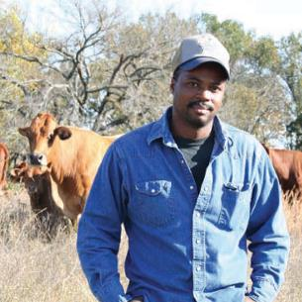
AgrAbility Mission
The vision of AgrAbility is to enhance quality of life for farmers, ranchers, and other agricultural workers with disabilities.
Through education and
assistance, AgrAbility helps to eliminate (or at least minimize) obstacles that block success in production agriculture or agriculture-related occupations.
Notes:
Our basic mission statement

Slide 5
Whom Does AgrAbility Serve?
AgrAbility addresses a wide variety of functional limitations in agriculture, including, but not limited to:
Amputation
Arthritis
Back impairment
Deafness/hearing impairment
Development disabilities, such as cerebral palsy or autism
Disabling diseases, such as cancer or heart disease
Mental/behavioral health problems
Respiratory diseases
Spinal cord injuries
Stroke
Traumatic brain injury
Visual impairments
Notes:
Not a comprehensive list. Point out this disability is a wide continuum and that many people with disabilities don’t consider themselves to be disabled. We essentially deal with any type of disability.

Slide 6
Disability within the Agricultural Community
Causes of disability
Traumatic injury (agriculture is one of the most hazardous occupations). Many injuries also come from off-farm incidents.
Disease
Aging (Average age of U.S. farmers is 57+)
Prevalence of disability
Approximately 15-20% of farm population impacted by disability
1.04 – 2.23 million of the U.S. farm, ranch, and agricultural community impacted by disability
Notes:
Deboy, G.R., P.J. Jones, W.E. Field, J. Metcalf, and R.L. Tormoehlen. Estimating the Prevalence of Disability within the U.S. Farm and Ranch Population. Journal of Agromedicine, 13(3).

Slide 7
Agriculture

Slide 8
Agriculture

Slide 9
Agriculture

Slide 10
Agriculture

Slide 11
Agriculture

Slide 12
Agriculture

Slide 13
Agriculture

Slide 14
Agriculture

Slide 15
Agriculture

Slide 16
Agriculture

Slide 17
Agriculture

Slide 18
Agriculture

Slide 19
Agriculture

Slide 20
Agriculture

Slide 21
Agriculture

Slide 22
Agriculture

Slide 23
Whom Does AgrAbility Serve?
Just as disability is wide continuum, agriculture is also:
Row crops: corn, soy, wheat, cotton, etc.
Ranching
Sheep and goats
Dairy
Produce, including organic
Orchards
Agritourism
Niche markets, like llamas, herbs, etc.
Floriculture
Aquaculture
Hydroponics
Aquaponics
Notes:
Not a comprehensive list. We are supposed to focus on production agriculture.

Slide 24
AgrAbility History
AgrAbility began in 1991 as part of the USDA Cooperative State Research, Education, and Extension Service (now NIFA)
In 1991, there were 8 funded state and regional AgrAbility projects (SRAPS); as of 2016, there are 20 SRAPs and several previously-funded affiliate projects
One National AgrAbility Project (NAP) supports the SRAPs
Competitive funding
Notes:
Included in 1990 Farm Bill; funded in 1991. Other pre-AgrAbility models existed in Vermont and Iowa. Maximum number of funded AgrAbility projects was 23 covering 25 states – reduced since 2013.

Slide 25
AgrAbility Projects 2015
Notes:
As of October 2014

Slide 26
AgrAbility Partnerships
All AgrAbility projects – state projects and the national project – are partnerships between a land-grant university and at least one disability-services program.
CILs can be, have been, and are currently partners (subcontractors) on AgrAbility Projects.
Notes:
Many projects have more than one partner. Land-grant university Extension service must hold the grant. 1862 and 1890 land-grants are eligible to apply. 1994 are currently not eligible.

Slide 27
Special Responsibilities of the NAP
Provide support to the state and regional AgrAbility Projects
Training
Resources
Consultations with NAP specialists
Provide direct services to customers in states without AgrAbility Projects
Notes:
SRAPs complete annual assessment of NAP and also suggestions for future work. Services in non-AgrAbility states generally consist of email or phone contact.

Slide 28
What Does AgrAbility Not Provide?
Funding
Equipment (though some Tech Act Project partners provide certain AT)
Most funding for assistive technology comes through state vocational rehabilitation systems
Other sources of grants and loans are available
Notes:
Some states partner with AT Act Projects, which usually have a lending “library” of AT or an AT re-use program.

Slide 29
AgrAbility Services/Priorities
Education
Workshops; resource development; online education
Networking
Leveraging efforts with other groups; peer support
Direct Assistance
Site visits; consultations; business planning
Marketing
Publics awareness activities and materials
Notes:
These are the priority areas listed in the RFAs. Not exhaustive lists

Slide 30
AgrAbility: It’s About Hope

Slide 31
The AgrAbility – CIL “Win-Win”
What can AgrAbility offer to enhance services provided by CILs?
What can CILs offer to enhance services provided by AgrAbility?

Slide 32
AgrAbility can provide…
Agricultural expertise
Unique issues faced by producers
Unique culture of farming
“Speaking the language”
Networking within the agricultural community and its organizations

Slide 33
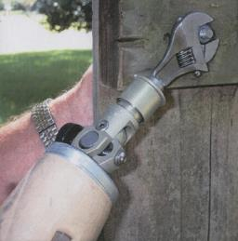
AgrAbility can provide…
Expertise in agricultural assistive technology
Knowledge of modified work practices

Slide 34
AgrAbility can provide…
Agricultural worksite and farmstead assessments and recommendations

Slide 35
AgrAbility can provide…
Networking with other organizations
Vocational Rehabilitation
Veterans’ groups
Cooperative Extension
Land-grant universities
Funding sources

Slide 36
AgrAbility can provide…
Potential funding through subcontracts or fee-for-service agreements
Public awareness of CIL services, resources, and activities
Participation in AgrAbility activities, such as conferences and workshops

Slide 37
CILs can provide…
Information and referral
IL skills training
Peer counseling
Individual and systems advocacy
Services that facilitate transition from nursing homes and other institutions to the community, provide assistance to those at risk of entering institutions, and facilitate transition of youth to postsecondary life.

Slide 38
CILs can provide…
Information & referral
IL skills training
Newly injured farmers may have little/no knowledge of disability and rehabilitation resources. They may have never dealt with systems related to their conditions.

Slide 39
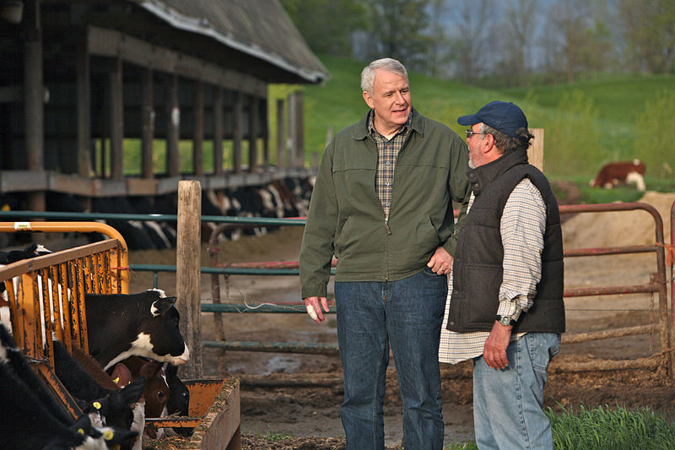
CILs can provide…
Peer counseling
Farmers and ranchers can be socially isolated and have an independent mindset that keeps them from reaching out.

Slide 40
CILs can provide…
Individual and systems advocacy
Agricultural workers may be reluctant to confront barriers or unaware of how to do so.

Slide 41
CILs can provide…
Services that facilitate transition
Farm youth may need assistance in moving into post-secondary education or employment. Others may need assistance with nursing home-related issues.

Slide 42
CILs can provide…
Public awareness of AgrAbility services, resources, and activities
Participation in CIL activities, such as conferences and workshops

Slide 43
Specific AgrAbility – APRIL Initiatives
AgrAbility resources distributed to each APRIL member organization
Participation at each organization’s national meetings
AgrAbility participation in IL Conversations
APRIL will conduct an assessment of its membership to determine the level of services being provided to AgrAbility clientele
Meetings between the state AgrAbility Projects and representatives of APRIL members operating in each state.
APRIL participation in the AgrAbility Webinar Series

Slide 44
CILs without AgrAbility Projects
Can still get support from the National AgrAbility Project
Resources available at www.agrability.org
Encourage your state’s land-grant university(s) to apply for an AgrAbility grant

Slide 45
Resources: www.agrability.org
Project information and contacts
Downloadable resources
Online training
News and upcoming events
Mobile-friendly
Notes:
Discuss importance of site and give tour if feasible.

Slide 46
The Toolbox Assistive Technology Database
Print, CD, and web versions www.agrability.org/Toolbox www.thetoolbox.info
More than 1250 products to help farmers and ranchers with disabilities

Slide 47
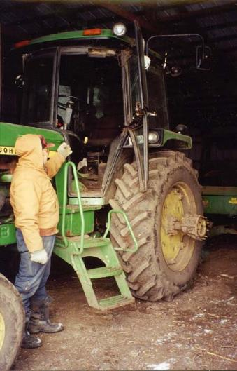
The Toolbox Assistive Technology Database

Slide 48
Arthritis Resources
www.arthritis-ag.org
Arthritis and Agriculture
Plain Facts about Arthritis
¿Podrá ser la Artritis lo que me causa Dolor? (Could Arthritis be the cause of my Pain?)
Gaining Ground on Arthritis DVD
Notes:
Arthritis and Agriculture is AgrAbility’s most popular print resource with 70,000 copies in print. Plain Fact is for Old Order/Amish Communities. ¿Podrá ser la Artritis lo que me causa Dolor? is a fotonovla (comic book) in Spanish for migrant/seasonal workers.

Slide 49
Arthritis Resources
Arthritis and Gardening
New in 2016
Designed to replace Arthritis Foundation booklet Gardening and Arthritis
Topics include:
Garden pre-planning
Tools and accessories
Preparing the body for gardening
Minimizing discomfort
Notes:
Arthritis and Agriculture is AgrAbility’s most popular print resource with 70,000 copies in print. Plain Fact is for Old Order/Amish Communities. ¿Podrá ser la Artritis lo que me causa Dolor? is a fotonovla (comic book) in Spanish for migrant/seasonal workers.

Slide 50
BACK on the Farm, BACK in the Saddle
Back problems = most common disabling conditions reported by AgrAbility clients.
21-page booklet discusses many aspects of back problems in ag settings
www.agrability.org/ resources/back
Notes:
Newest print resource. 30,000 copies in print.

Slide 51
AgrAbility 1991 – 2016: 25 Years, 25 Stories
25 stories of AgrAbility client and program success
Program information
Impact statistics
www.agrability.org/ 25years
Notes:
Newest print resource. 30,000 copies in print.

Slide 52
Social Media
Facebook
Twitter
YouTube

Slide 53
Questions and Discusssion
What are some examples of serving agricultural workers in your CIL?
What are some opportunities for serving agricultural workers in your CIL?
What are some barriers to serving agricultural workers in your CIL?
What are some creative ideas for serving agricultural workers in your CIL?

Slide 54
Contact Info
Paul Jones
AgrAbility Project
Breaking New Ground Resource Center
Purdue University
ABE Bldg., 225 S. University St.
West Lafayette IN 47907-2093
800-825-4264
www.agrability.org
agrability@agrability.org
The National AgrAbility Project is supported by AgrAbility Project, USDA/NIFA Special Project 2012-41590-20173

