Slide 1
#VoteDisability
Election 2016:
Increasing the Disability Vote for Impact
2015 APRIL Annual Conference

Slide 2
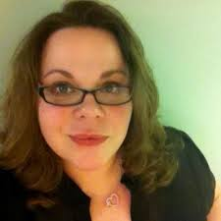
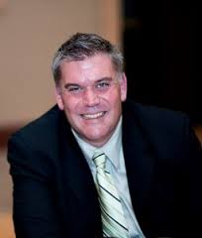
Today’s Presenters
Michelle Bishop
Disability Advocacy Specialist for Voting Rights
National Disability Rights Network
Ted Jackson
Community Organizing Director
California Foundation for Independent Living Centers

Slide 3
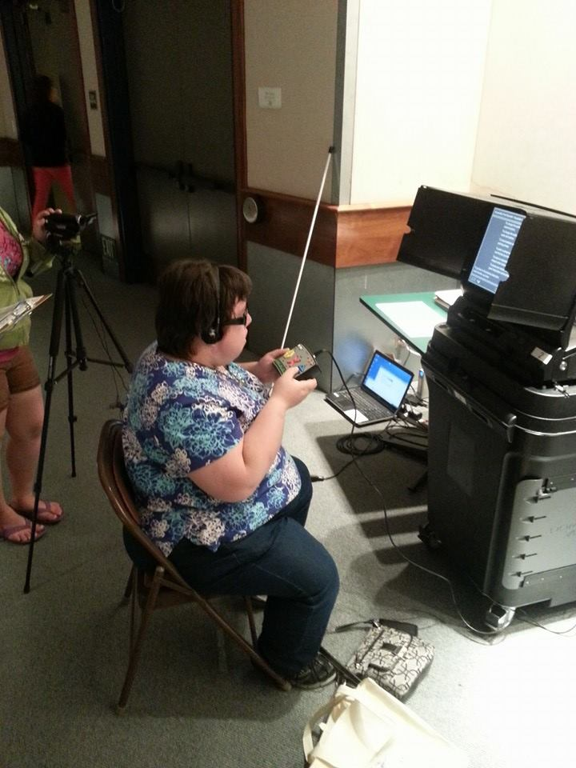
Election 2016 Landscape
Past and Present Voter Turnout & Registration
2000
Voters without a disability- 52%
Voters with a disability- 41%
Gap of 11%
2012
Voters without a disability- 62.5%
Voters with a disability- 56.8%
Gap of 5.7%
*Registration has improved since 2000 when registration was estimated at 62% (with disability) versus 78% (without disability), a 16% gap versus a 2.3% gap in 2012 (69.2% vs. 71.5%).

Slide 4
Election 2016 Landscape
Individuals with disabilities have had made successful advances in both voter turnout (from 41% to 56.8%) and registration rates (from 62% to 69.2%) over the years (from 2000 to 2012), yet persistent gaps still exist.
In the 2012 presidential election registered voters with disabilities voted nearly 6% less than registered voters without a disability.
Accordingly, There would be 3 million more voters with disabilities if they voted at the same rate as people without disabilities who are otherwise similar in age and other demographic characteristics.

Slide 5
Election 2016 Landscape
What would 3 million extra voters look like?
2012 demographic groups (# of participating voters)
White, non-Hispanic- 98 million
Blacks- 17.8 million
Individual w/ disabilities- 15.6 million
Hispanic-11.2million
Asians- 3.9million
An extra 3 million voters with disabilities would make individuals with disabilities one of, if not the largest minority group of voting eligible Americans (15.6+3 = 18.6 million).
#VoteDisability

Slide 6
Election 2016 Landscape
Why 2016?
25th Anniversary of the ADA – Renewed Energy
Presidential Candidates
Who Want to continue programs?
Who is saying the ADA is unconstitutional?
Who’s taking employment?
How are people with disabilities being characterized?
What’s at stake?
The Door has opened-this is our year!
Electoral Power

Slide 7
Power Analysis
What is Power?
How do you define power?
A simple definition: the ability to act

Slide 8
How Powerful Are We?
1. No one even knows who we are or have heard of our organizations.
2. We are considered a great charity.
3. We meet with our legislators annually and take photos.
4. We meet with our legislators routinely but have trouble getting meetings.
5. We meet with our legislators routinely and sometimes get our “asks.”
6. We are asked for our input, but after a closed planning/drafting process.
7. Legislators fear upsetting our community in decision-making.
8. We are always part of the planning process, and our input is used.
9. Elected officials try to woo our community for votes.
10. Our priorities become the governor’s/president’s “to do” list.

Slide 9
How Do We Know Where We Rate?
What are some important challenges that we have won?
How does this show power that we have?
What are some important challenges that we have lost?
How does this show a need for more power?

Slide 10
So What Is Power Really?
Power is…the ability to act to create change, while undergoing a change in the process.
The ability to act is the most basic understanding of power. It means we are alive and have free agency.
The creation of change is how we measure our level of power, as well as what gives it meaning and purpose.
Undergoing a change is how we know we are using our power collectively to build the movement and how we evaluate our work.

Slide 11
So Once Again…How Powerful Are We?
1. No one even knows who we are or have heard of our organizations.
2. We are considered a great charity.
3. We meet with our legislators annually and take photos.
4. We meet with our legislators routinely but have trouble getting meetings.
5. We meet with our legislators routinely and sometimes get our “asks.”
6. We are asked for our input, but after a closed planning/drafting process.
7. Legislators fear upsetting our community in decision-making.
8. We are always part of the planning process, and our input is used.
9. Elected officials try to woo our community for votes.
10. Our priorities become the governor’s/president’s “to do” list.

Slide 12
All This Talk About Power…
Power and empowerment are not the same thing.
That voting is part of personal empowerment is great.
In the end- voting is about POWER, not empowerment.
It requires action but only has meaning when it creates change.
In order to be effective, it requires shared power and collective action – which force us to undergo a change.

Slide 13
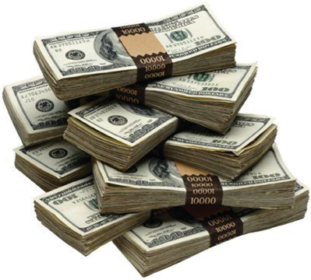
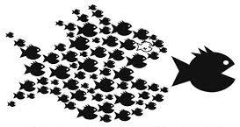
In Politics, There Are Two Types of Power:
Money power
People power

Slide 14
Which Levels Need a Voting Bloc to Achieve?
1. No one even knows who we are or have heard of our organizations.
2. We are considered a great charity.
3. We meet with our legislators annually and take photos.
4. We meet with our legislators routinely but have trouble getting meetings.
5. We meet with our legislators routinely and sometimes get our “asks.”
6. We are asked for our input, but after a closed planning/drafting process.
7. Legislators fear upsetting our community in decision-making.
8. We are always part of the planning process, and our input is used.
9. Elected officials try to woo our community for votes.
10. Our priorities become the governor’s/president’s “to do” list.

Slide 15
We Have To MAKE Them Honor Our Credo

Slide 16
Electoral Power - Strategy
What is Electoral Power – The New Math
Organized People
+ Organized Money
= Political Power
Delivering Votes

Slide 17
Electoral Power - Strategy
Lessons from the Field
Massachusetts: Protecting Marriage Equality
Cincinnati: Repealing Article XII

Slide 18
Electoral Power - Strategy
Who do we need to Get Out To Vote?
The Community Circle
Disability Community
Registered Voters
Likely Voters
50%+1=Win

Slide 19
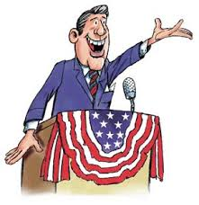
Electoral Power - Strategy
Let me introduce you to Senator Peacock…
Senator Julius Peacock (Xanadu)
Came to CIL Candidate Forum
Met with Disability Advocates
Voted against us on expanding IHSS
Voted for an Access Notification Bill
Was quoted saying “The ADA was intended to be limited, it doesn’t cover everything. You can’t have everything in this life.”
Won his last election by 4500 votes.
Xanadu has 1 Million Citizens with 55% Voter Registration

Slide 20
Electoral Power - Strategy
Lets look at the Senate race from the state of Xanadu!
200K PWD
110K VWD
44K Likely VWD
4500+1 New VWD

Slide 21
Electoral Power - Strategy
Who are these NEW voters with disabilities?
People who didn’t vote last time
People who weren’t voting age yet last time
Peacock voters from last time-switching sides
How do we find these NEW voters with disabilities?
Call them
Visit them (Home or CIL)
Events Festivals and Fairs
4501 / Time Until Election (Nov 2015-Sept 2016)
409 per Month
94 per week
13-14 per day

Slide 22
Effective Messaging
We have a bit of an uphill battle.
Disenfranchisement = powerlessness that looks like apathy.
It is our job to engage our community:
To believe that we can be powerful.
That voting is everyone’s role to play.

Slide 23
Effective Messaging
Messaging is how we talk to each other to engage our own community.
Voting is not particularly sexy.
Traditional messaging has not been effective.
Connect voting to power.
Power means REAL CHANGE in people’s lives.
Voting is about our everyday lives and circumstances.

Slide 24
The Bottom Line For Messaging
Connect voting to issues that matter in our community.
How do we know what issues matter most to our people?
ASK THEM!

Slide 25
Message Strategy
14-7-3: Boiling down the message…
6-12 Months Out: 14 word statements
3-4 Months Out: 7 words
1-2 Months Out: 3 words or Hashtag
Example:
14 Words: Proposition X is an anti-disability law that unfairly segregates people with disabilities by blocking their access to equal healthcare coverage.
7 Words: Prop X blocks people with disabilities from getting equal healthcare.
3 Words: Vote “NO” on Prop X –or- #VoteNOX

Slide 26
Social Media Messaging
#VoteDisability
Short, sweet and ready to tweet!
Key Word Messaging
Instructive
Pictures are Worth a 1000 Words
Memes
People + Action = Success
Lessons from the Field
Facebook
Twitter
Storms: Many clouds create a storm!

Slide 27
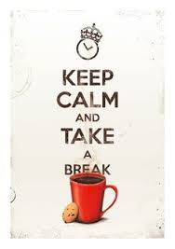

Slide 28
Handbook Review: Who is responsible
Structured for your organization:
See Yourself in the Campaign
Section 1: Introduction
Section 2: Background and 2016 Election Landscape
Section 3: The Director – The Decider
Section 4: The Program Manager - The Supervisor
Section 5: The Advocate or Organizer – The Leader
Addendum Materials
The Care and Feeding of Volunteers
Final Push GOTV Materials
Social Media Tool Kit

Slide 29
Handbook Review: Who is responsible
The Director – The Decider
Board Approval
Budget
Staff Assignment
GOTV Plan Approval
The Program Manager - The Supervisor
Lead Organizer Supervision
Timeline Tracking
Staff Time Allocation
The Advocate or Organizer – The Leader
Develops GOTV Plan
Implements GOTV Plan
Progress Reports
GOTV Campaign Director

Slide 30
Building Your Team
Organizational Commitment
Management and senior staff must “buy-in” to the mission
Dedicate time and resources
Include vote work in the budgeting process
Carve out staff time for vote work
Empower talented volunteers to fill staff/budgeting gaps

Slide 31
Building Your Team
Community Commitment
Establish partnerships with “common ground” organizations.
No one organization has the time/money resources for this work.
No one organization typically has sufficient expertise.
No one organization has a large enough contact list to build a voting bloc.
Partnerships add to our ranking on the 1-10 power scale.

Slide 32
Building Your Team
Community Commitment
Creating a real/named coalition enhances resources by:
Solidifying organizational level commitment/buy in.
Assisting in name recognition and messaging.
Opening new opportunities for obtaining funding.
Develops a structure for group accountability.

Slide 33
Building Your Team
A Quick Word On Accountability
Coalitions fail because they are not effective at holding each other accountable.
Set goals that are concrete/measurable and have a firm timeline. Identify a partner responsible for completion of each goal.

Slide 34
Building Your Team
A Quick Word On Accountability
Create ground rules for effective communication.
Use the ground rules to have a real conversation, up front about how we will hold each other accountable.
Assign an “enforcer” to ensure that we don’t let each other off the hook.

Slide 35
Building Your Team
The One-On-One Conversation
The Questions
Who?
What?
Why? Why? Why?
Probing Questions
Transparent and Truthful: Reciprocal
Personal but Professional
Round 2: The Catch Up 1 on 1
Holding accountable

Slide 36
Building Your Team
Pyramid Identification
They Choose: Self Identification = Accountability
The 5
Leaders - like a part time job.
The 50
Volunteers who interact on a recurring basis
The 500
Participants who interract once or twice

Slide 37
Building Your Team
Everyone Counts
Take no one for granted-your next leader is someone your not thinking about
Be numbers driven
Report outcomes in numbers and words that imply evaluation of size or growth
Counting: numbers tell the truth

Slide 38
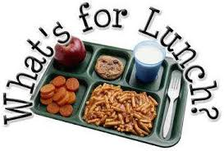

Slide 39
Local Team Plan Development: Developing Your GOTV Timeline
What does a typical GOTV timeline look like?
6-9 Months Before Election Day: Structure
Developing Budget
Staff Assignments
Voter Match-List Enhancement Consultants Planning
6 Month Before Election Day: Building the Team
Coalition Building - MOU
Developing GOTV Plan
Voter Registration Drive

Slide 40
Local Team Plan Development: Developing Your GOTV Timeline
What does Your GOTV timeline look like in your community?
4 to 5 Months Before Election Day: Growing the Team
In-Person Volunteer Recruitment (IPVR)
Begin Voter Match – List Enhancement Process
3 to 4 Months Before Election Day: Education
First Progress Report to Director/Board
GOTV Phone Banks Begin: Intro & Voter Education

Slide 41
Local Team Plan Development: Developing Your GOTV Timeline
What does Your GOTV timeline look like in your community?
2 to 3 Months Before Election Day: Campaign Begins
Direct Mail Prep
Voter Registration Final Push
Develop Phone Bank Logistics Plan
Final Month: Final Push
Full Swing GOTV: Volunteer Confirmation, Voter Contact Phone Banks, Direct Mail, Robocalls
Election Day: Last Chance
All Day Phone Banks
Poll Check: Knock n’ Drag
1 to 4 Months After Election Day
Review and Evaluate: Learn and Plan

Slide 42
Local Team Plan Development: Developing Your GOTV Timeline
3 Resources
Money: Fundraise
People: Volunteers and Voters
Time: Start Early!!!
Unleash the Dragon!!!
Training
Process Driven
More Training
Then Do it!
The Golden Rule: the decisions you make early on will most determine you success in the end.

Slide 43
Developing Your Campaign Plan
Handout Worksheets
Breakouts: Geographic and Colleague Groups
Work Backwards

Slide 44
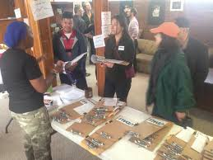
Let’s Build Electoral Power!
Sharing Your Local GOTV Plans

Slide 45
The Protection & Advocacy Network
Established by Congress to protect the rights of people with disabilities through legal support, advocacy, referral, and education.
In all 50 states, DC, Puerto Rico, US Territories, and the Native American Consortium (Hopi, Navaho and Piute Nations in the Four Corner region of the Southwest).
Largest provider of legal advocacy services to people with disabilities in the US.

Slide 46
PAVA
Protection & Advocacy for Voter Access
Federal mandate to the P&As
A unique, responsive project of every P&A
Established under HAVA to “ensure the full participation in the electoral process for individuals with disabilities, including registering to vote, casting a vote, and accessing polling places.”

Slide 47
NDRN
National Disability Rights Network
The nonprofit membership organization for the federally mandated Protection and Advocacy (P&A) Systems for individuals with disabilities
Michelle Bishop, specialist/subject matter expert for the PAVA program

Slide 48
California Foundation for Independent Living Centers

Slide 49
We organize accessible communities where people with disabilities live, work learn shop play and vote!
On Line Voter Registration - #1 Nationwide
Increased Voter Education Materials Alternate Formats
DOJ Polling Place Access Campaign
And Now: Building Electoral Power!

Slide 50
The Ask: will you join a national election collaborative?
Take a quick quiz on today’s workshop and let us know if you will make the commitment.
Question and Answers

