Slide 1


NHT During COVID-19 Pandemic:
Emergency Disaster Relocation
https://www.april-rural.org/
Emergency Relocation for People with Disabilities in Congregate Settings
Misty Dion, CEO
Roads to Freedom;
Center for Independent Living of North Central PA
www.cilncp.org
Notes:
Drone Footage Video: 2:48 (Misty) https://vimeo.com/manage/videos/608492258/b03d9e8ba8

Slide 2


Transition Services
Workforce Innovation and Opportunity Act (WIOA) 2014
~ACL & 5th Core Service
Money Follows the Person (MFP) 2005/2019/2020
Notes:
In July 2014 the Workforce Innovation and Opportunity Act (WIOA) was signed into law, transferring the Independent Living programs, the National Institute on Disability, Independent Living, and Rehabilitation Research (NIDILRR), and the Assistive Technology programs to ACL. WIOA also included statutory changes that affect independent living programs, including the addition of new core services, shifts in the process of developing and adopting state plans and changes in the functions of the SILC.
Money Follows the Person
Authorized in Section 6071 of the Deficit Reduction Act of 2005 (P.L. 109-171), as amended by Section 2403 of Patient Protection and Affordable Care Act (P.L. 111-148), the Medicaid Extenders Act of 2019 (P.L. 116-3), the Medicaid Services Investment and Accountability Act of 2019 (P.L. 116-16), the Sustaining Excellence in Medicaid Act of 2019 (P.L 116-39), Sec 205: Further Consolidated Appropriations Act, 2020 (P.L. 116-94), and Sec 3811: Coronavirus Aid, Relief, and Economic Security Act, 2020 (P.L. 116-136) the Money Follows the Person (MFP) demonstration supports state efforts for rebalancing their long-term services and supports system so that individuals have a choice of where they live and receive services. From the start of the program in 2008 through the end of 2019, states have transitioned 101,540 people to community living under MFP.
MFP Program Goals
Increase the use of home and community-based services (HCBS) and reduce the use of institutionally-based services
Eliminate barriers in state law, state Medicaid plans, and state budgets that restrict the use of Medicaid funds to enable Medicaid-eligible individuals to receive support for appropriate and necessary long-term services and supports in the settings of their choice
Strengthen the ability of Medicaid programs to provide HCBS to people who choose to transition out of institutions
Put procedures in place to provide quality assurance and improve HCBS

Slide 3

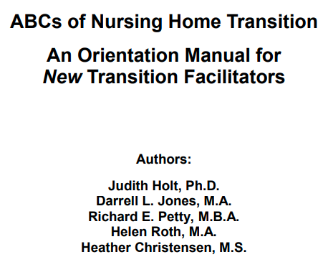
Transition Services
https://www.ilru.org/sites/default/files/ABCs%20of%20Nursing%20Home%20Transition-An%20Orientation%20Manual%20for%20New%20Transition%20Facilitators.pdf
https://acl.gov/sites/default/files/news%202018-08/ILProgramsIG.FinalWeb.pdf

Slide 4
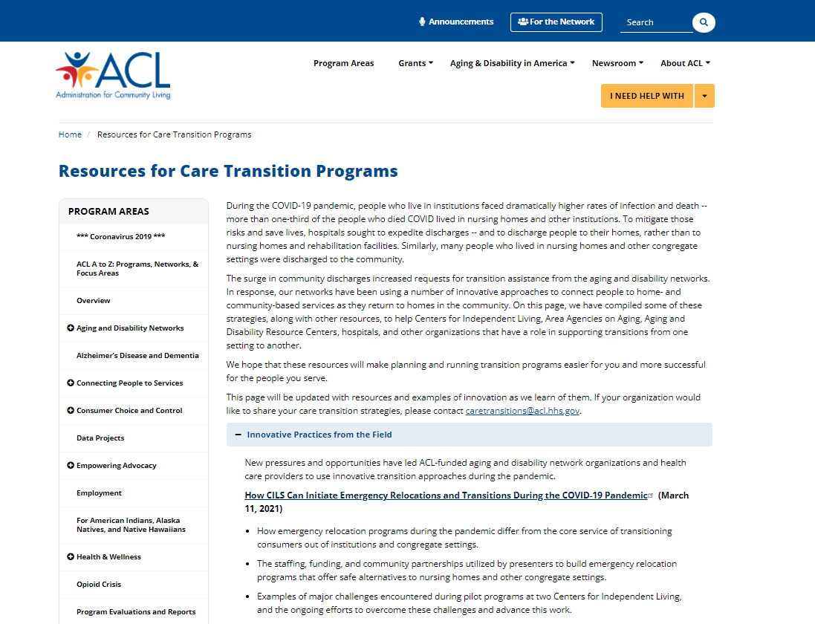
ACL Transition Servicess
CIL Pandemic Response: How CILs Can Initiate Emergency Relocations and Transitions During the COVID-19 Pandemic
https://www.ilru.org/training/cil-pandemic-response-how-cils-can-initiate-emergency-relocations-and-transitions-during
https://acl.gov/caretransitions
Notes:
Adapting NHT programs to incorporate emergency relocation in hotel/motel/dormitories with services and supports to meet personal assistance needs, while finding permanent housing and services in the community.
During Federally Declared Disasters FEMA can reimburse state, local, tribal, territorial governments and certain eligible private non-profits through Public Assistance for their costs of debris removal, life-saving emergency protective measures, and restoring public infrastructure.
FEMA Public Assistance Category B Reimbursement
Life-saving emergency protective measures
Includes personal assistance services in congregate and non-congregate shelters
To prevent admission, and promote and support safe relocation
Examples from Roads To Freedom, CILNCP

Slide 5
Advocates Respond to FEMA Sheltering Funding
No Data
No Data
No Data
No Data
Infections in Long Term Care Facilities
Deaths Long Term Care Facilities
Infections in Long Term Care Facilities
Deaths Long Term Care Facilities
APRIL 3, 2020
FROM: Mary Anne Tierney, FEMA Regional Administrator
TO: David Padfield, PEMA
MAY 13, 2020
FROM: Misty Dion
TO: Pennsylvania State & County Officials
FEMA Approves
Category B Funding
(Non-congregate sheltering)
    Limited to:
    “homeless”
    first responders
    healthcare workers
PA Advocates Ask Officials for Emergency Relocations
    To give residents of institutions the option of moving to a safe environment (hotel) where they will
    receive the equivalent or
    more individualized care.

Slide 6
Advocates Convene First Meeting on FEMA B Funds
124,249
36,591
JUNE 23, 2020
  Meeting with FEMA, PEMA, PA DHS, PA DOH
Infections
Deaths
FEMA: Other regions are eager to hear what advocates come up with and PA can be a lead in this forefront. Jeremy Fannon expressed a willingness to explore this possibility.
PA DHS: Listening and taking notes and will be convening the next day to look to tweak policy. 11/2020 – Advocates follow up and request help from PA DHS to seek allocation from DOH and PEMA of FEMA Category B funds for emergency non-congregate sheltering to move people out of nursing facilities and into hotels/dorms.
PEMA: Says funding goes only to facilities.
Advocate debrief: “FEMA basically agreed that FEMA Category B
applies to LTC and not just homeless.”

Slide 7
Inconsistent Government Policy Positions
FEMA (Federal): “We want to have flexibility on how communities can respond and what’s available to respond.” (11/2020 – FEMA Disability Summit).
PA Governor (State): Says Cat B Funding is only for FEMA specified categories (11/2020).
PEMA (State): Says ILC are explicitly excluded as an advocacy group per FEMA rules and sheltering does not fit into the current allowable Non-Congregate Sheltering actions, as defined by FEMA (10/2020). Later asks if ILC operates a “facility”, as a FEMA question. (11/2020).
LCEMA (County): Provided information to advocates in contradiction to
FEMA and PEMA (10/2020). Say they have no say in reimbursement rules
set forth by FEMA (12/2020).

Slide 8
December 7, 2020
FEMA Addendum:
Delivering Personal Assistance Services
in Congregate and Non-Congregate Sheltering
Notes:
Page 7 & 8 calling on Counties to Establishing Relationships with Community-Based Organizations Long before an emergency or disaster occurs, SLTT emergency managers and shelter planners must work closely with individuals in the community who require PAS to understand their perspective
Includes a list of recommended CBOs providing or advising on PAS with Centers for Independent Living11 at the top.
NOTE: Hit “Ctrl” and click on the underlined text to view the addendum

Slide 9
Inconsistent Policy Hinders Life Saving Work
617,447
122,180
JANUARY 25, 2021
FROM: Misty Dion
TO: Teresa Miller, Secretary PA DHS
Infections
Deaths
“As an NHT provider, CILNCP has successfully transitioned 54 people in 2020 from nursing facilities, during the COVID-19 pandemic. Disappointingly, we have had 6 people die from COVID before their transitions could be completed. I urge you to advocate for emergency relocation options to be made available to this most at-risk Community.”

Slide 10
An “interesting and innovative” approach that has faced
several policy-based and procedural barriers to implementation, while COVID-19 continues to threaten people in institutions.
644,456
127,650
MARCH 4, 2021
FROM: Veronica Hogan, ACL
TO: Misty Dion
Infections
Deaths
“ACL has heard that the CIL of North Central PA is working with FEMA to use emergency relocation funding as part of nursing home transitions during the pandemic. This is an interesting and innovative approach, and we’d like to have an informal meeting to learn more.”

Slide 11
Approval Delays as COVID Numbers Climb in Facilities
635,202
635,202
FEBRUARY 2, 2021
FROM: Misty Dion
TO: Scott Metzger,
LC Commissioner
  CILNCP submits MOU to LCEMA (County) on January 13.
  LCEMA Responds “It has been sent to the solicitor for review. I will follow up and see where it stands.”
Infections
Deaths
646,462
128,149
MARCH 19, 2021
FROM: Misty Dion
TO: Mya Toon,
LC Procurement Officer
    Message sent to check on status
    LCEMA sends link to a survey form, “Survey 123,” stating this is required for funding
Infections
Deaths
652,458
129,440
MAY 4, 2021
FROM: Kelle Robinson,
LC EMA
TO: Karen Koch, CILNCP
“I spoke with PEMA. In order for anything to go forward, the invoices that were originally submitted must be changed from FEMA to the County of Lycoming.”
Infections
Deaths
665,075
130,936
AUGUST 9, 2021
FROM: Philip Mattiacci,
FEMA
TO: Misty Dion
  “CILNCP is not currently an eligible Applicant for
  FEMA’s Public Assistance Program, we recommend
  that you reach out to PEMA as the Recipient managing the program, or Lycoming County.”
Infections
Deaths
679,146
132,316
AUGUST 31, 2021
FROM: Misty Dion
TO: Mya Toon,
LC Procurement Officer
Update requested. LC responds: “Currently, we are waiting for PEMA to provide guidance on the next step in the process. There is no other official documentation I can provide you.”
Infections
Deaths

Slide 12
AUGUST 19, 2021
  FROM: Jo Linda Johnson, Director, Office of Equal Rights, FEMA
  TO: Partnership for Inclusive Disaster Strategies
673,865
132,316
Infections
Deaths
My office conferred with all the relevant offices in FEMA on this issue. That includes Public Assistance, the Office of Disability Integration and Coordination (ODIC), and Region III. What we learned is that the Center for Independent Living North Central Pennsylvania (CILNCP) has not submitted a RPA and, as such, is not an Applicant. CILNCP seeks reimbursement for assisting an individual with sheltering in August 2020. PEMA staff and Lycoming County staff have had had multiple calls CILNCP to advise them on how to get reimbursed for this eligible work. That’s why the MOU was created.
Lycoming County (an eligible Applicant for this work) can attach CILNCP’s invoice to a project and get CILNCP reimbursed. The County is willing and has reached out to CILNCP to address this directly with them. The work performed in August 2020 is eligible for reimbursement and why the MOU was developed and executed. However, what we learned from Region III is that CILNCP is refusing to work with the County, thru the MOU. No one is quite sure why, but this is the avenue to resolution and payment for CILNCP. Their request to somehow submit an invoice directly to FEMA is not an option…but it’s also not needed, as they have an option with the county. FEMA, PEMA, and Lycoming County have held several calls with CILNCP to assist and
remain committed to resolving this matter. I hope this is helpful.
AUGUST 31, 2021
    FROM: Mya Toon, LC Procurement Officer
TO: Misty Dion
LC responded to update on status request: “Currently, we are waiting for PEMA to provide guidance on the next step in the process. There is no other official documentation I can provide you.”

Slide 13
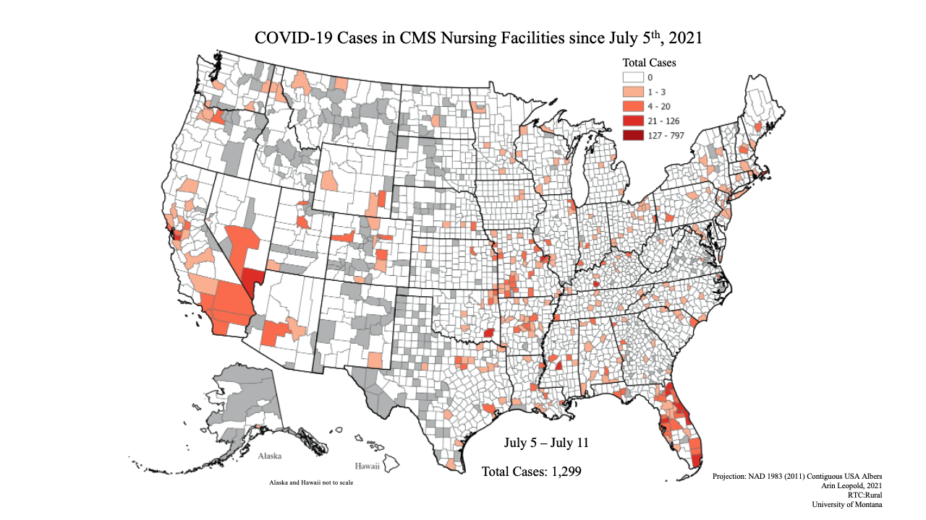
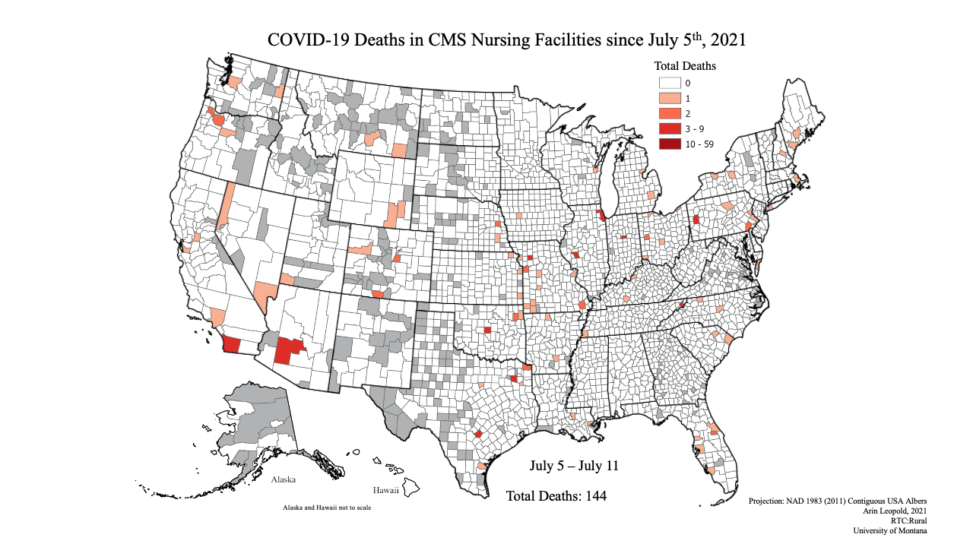
An “interesting and innovative” approach that has faced
several policy-based and procedural barriers to implementation, while COVID-19 continues to infect and kill people in institutions.
JULY TO SEPTEMBER 2021
Infections
Deaths

Slide 14

Saving Disabled Lives in Disasters
FEMA Public Assistance Category B
Emergency Protective Measures
World Institute on Disability | www.wid.org | © 2021 WID. All rights reserved.

Slide 15
Disaster Declarations Process
Disaster or Threat of Disaster
State Resources Overwhelmed
Governor requests federal assistance
Presidential Declaration

Slide 16
Disaster Declaration Process
Presidential Declaration
Major Disaster Declaration
Public Assistance
Individual Assistance
Emergency Declaration
Hazard Mitigation

Slide 17
FEMA ASSISTANCE AVAILABLE UNDER
EMERGENCY DECLARATIONS
Public Assistance (PA) – Only Categories A - debris removal and
B - emergency protective measures may be authorized under an emergency declaration.
Individual Assistance (IA) – The Individuals and Households Program (IHP) is the only form of IA that may be authorized under an emergency declaration. Authorization of IHP under an emergency is rare. Housing Assistance under IHP is provided at a 100% federal share, while Other Needs Assistance under IHP requires a 25% non-federal cost share.
The Hazard Mitigation Grant Program (HMGP) - is not available for emergency declarations.

Slide 18
FEMA Public Assistance Program
The mission of the Federal Emergency Management Agency’s (FEMA’s) Public Assistance (PA) Program is to provide assistance to State, local, Territorial, and Tribal (SLTT) governments, and certain types of private nonprofit (PNP) organizations so that communities can quickly respond to and recover from major disasters or emergencies declared by the President.

Slide 19
FEMA Public Assistance Program and Policy Guide
https://www.fema.gov/sites/default/files/documents/fema_pappg-v4-updated-links_policy_6-1-2020.pdf

Slide 20
Emergency Protective Measures
Saving Lives and Protecting Public Health and Safety
Emergency Protective Measures (Category B) conducted before, during, and after an incident are eligible if the measures: • Eliminate or lessen immediate threats to lives, public health, or safety;
OR • Eliminate or lessen immediate threats of significant additional damage to improved public or private property in a cost-effective manner.
Eligible emergency protective measures and costs include, but are not limited to: • Transporting and pre-positioning equipment and other resources for response; • Supplies and commodities; • Medical care and transport; • Evacuation and sheltering, • Use or lease of temporary generators for facilities that provide essential community services; • Dissemination of information to the public to provide warnings and guidance about health and safety hazards using various strategies, such as flyers, public service announcements, or newspaper campaigns;

Slide 21
Private Nonprofit Essential Social Services:
Certain types of facilities, such as senior centers are considered to provide essential social services to the general public
Facilities that do not provide medical care, but provide:
• Day care for individuals with disabilities or access and functional needs (for example, those with Alzheimer’s disease, autism, muscular dystrophy)
• Residential services for individuals with disabilities
• Sheltered workshops that create products using the skills of individuals with disabilities

Slide 22
Non-congregate Sheltering
FEMA may reimburse costs related to emergency sheltering provided in non-congregate environments.
FEMA’s Assistant Administrator for Recovery has the authority to approve this policy exception.
The Applicant must submit a request for PA funding for costs related to emergency, non-congregate sheltering and obtain FEMA approval prior to sheltering survivors in non-congregate facilities.

Slide 23
Non-congregate Sheltering
FEMA has approved 100% cost reimbursement to states relocating people experiencing homelessness to non-congregate settings, like hotels and motels for the period from January, 2020 through November 30, 2021.

Slide 24
Infectious Disease Incident
The HHS Centers for Disease Control and Prevention (CDC) has primary authority to enable support and assistance to SLTT governments in response to an infectious disease incident.
FEMA may provide assistance for the rescue, evacuation, and movement of persons; movement of supplies; and care, shelter, and other essential needs of affected human populations.
Any assistance provided by FEMA in response to an infectious disease incident is done in coordination with the CDC.

Slide 25
FEMA Emergency Non-Congregate Sheltering during the COVID-19 Public Health Emergency
FEMA intends that non-congregate sheltering is available meet the needs of communities when there is a demonstrated disaster-caused need for shelter.
FEMA also intends that those sheltered are transitioned to the next phase of recovery when there is no longer an immediate threat to life or public health and safety.

Slide 26
Emergency Protective Measures Eligible for Temporary Location
Essential community services provided by an eligible Applicant are eligible to be relocated.
The following services are considered essential community services (these differ from the list of PNP essential social services): • Education; • Election and polling; • Emergency, including police, fire, and rescue; • Homeless and domestic violence shelters; • Emergency medical care; • Prison; • Utility; and • Other facilities that provide public health and safety services of a governmental nature.

Slide 27
FEMA Emergency Non-Congregate Sheltering during COVID-19
FEMA Policy 104-009-18, Version 3 (6/1/20-11/30/21)
FEMA recognizes sheltering operations during the COVID-19 Public Health Emergency may require State, Local, Tribal and Territorial Governments to consider additional strategies to ensure that disaster survivors who are unable to return to their pre-incident or new housing option are sheltered in a manner that provides a level of separation between individuals / households and does not increase the risk of exposure to or further transmission of COVID-19.

Slide 28
FEMA Emergency Non-Congregate Sheltering during COVID-19
Legally responsible SLTT governments may enter into formal agreements or contracts with private entities, including private nonprofit organizations to conduct sheltering activities when necessary, as an emergency protective measure in response to a declared incident.
In these cases, PA funding is provided to the government entity legally responsible for sheltering, which may then reimburse a private organization for the cost of providing those services under the agreement or contract.

Slide 29

Contact slide
Marcie Roth
Executive Director and CEO
(301) 717-7447
marcie@wid.org
www.wid.org

Slide 30
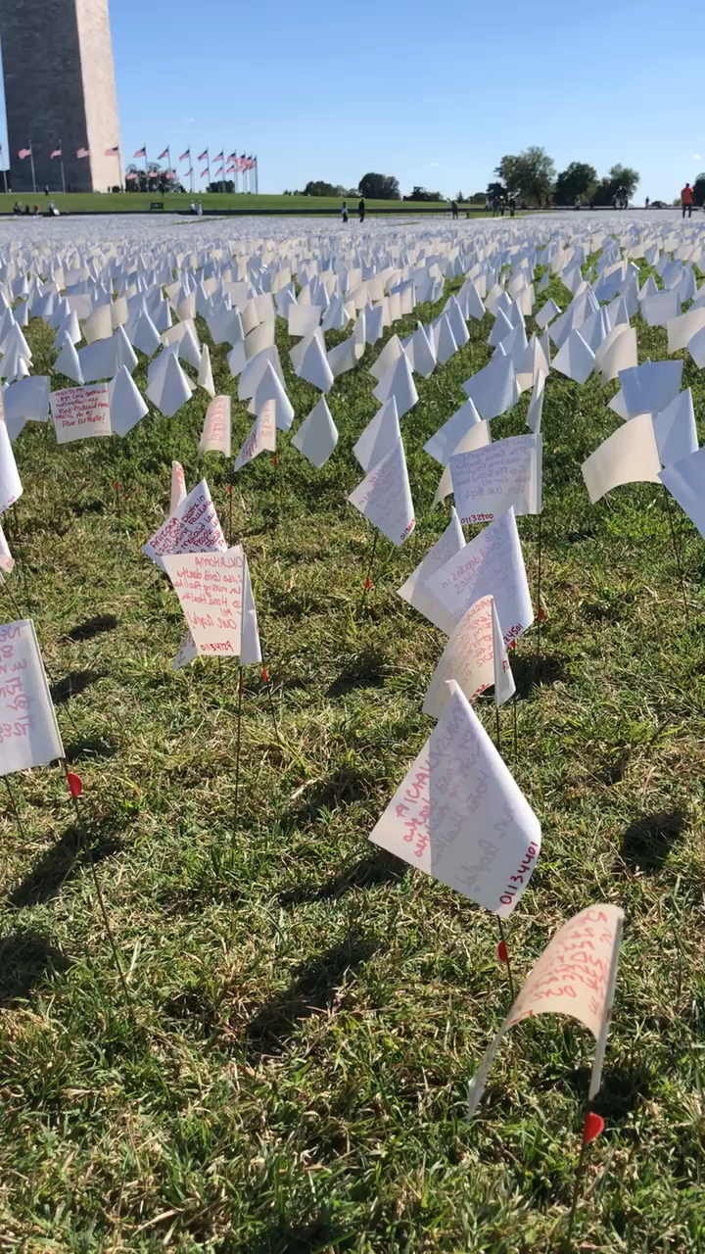
In American Remember Art Installation
Notes:
“In America: Remember,” a public art installation honors the more than 700,000 people in the United States who have died from COVID-19.
Each flag in the exhibit, on the grounds surrounding the Washington Monument, represents a life taken.
Walking through the hundreds of thousands of white flags blanketing 20 acres of the National Mall to honor the Americans who have died of covid-19, visitors stop to write a few words of farewell on the flags themselves.
They are goodbyes that many never had a chance to say in person. It is an intimate goodbye. And a national one.

Slide 31
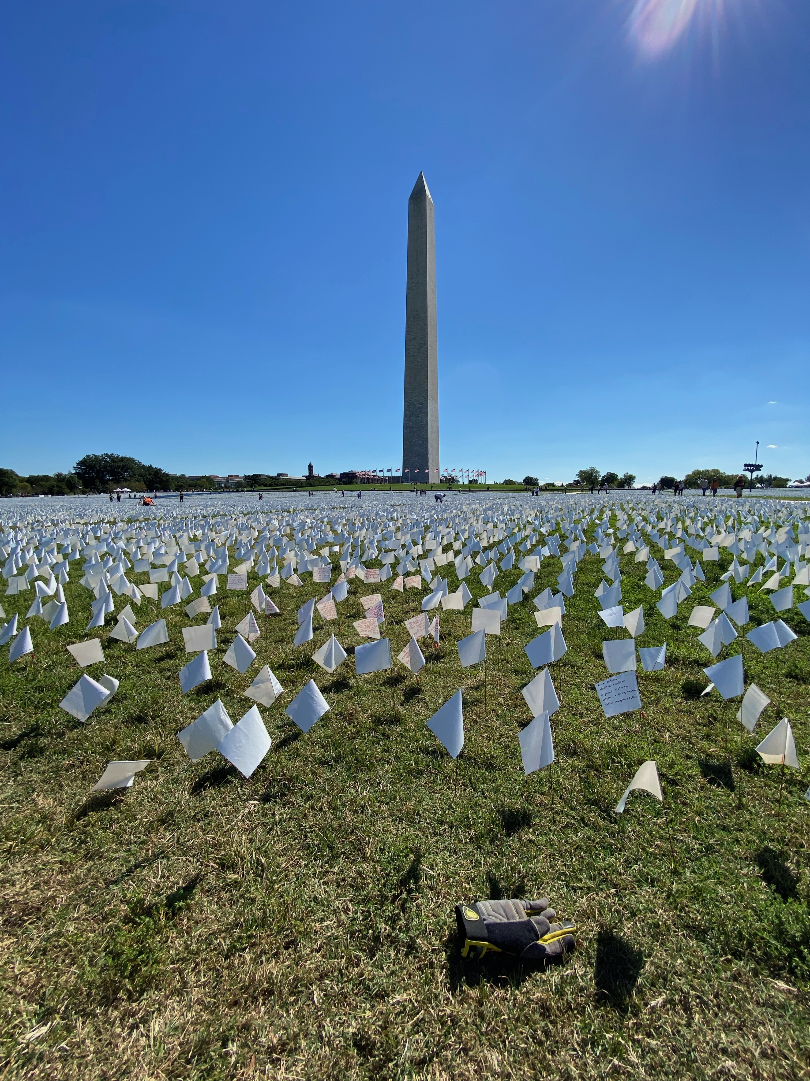
Covid-19 art installation of those who have died from COVID
Notes:
“In America: Remember,” a public art installation honors the more than 700,000 people in the United States who have died from COVID-19.
Each flag in the exhibit, on the grounds surrounding the Washington Monument, represents a life taken.
Walking through the hundreds of thousands of white flags blanketing 20 acres of the National Mall to honor the Americans who have died of covid-19, visitors stop to write a few words of farewell on the flags themselves.
They are goodbyes that many never had a chance to say in person. It is an intimate goodbye. And a national one.

Slide 32
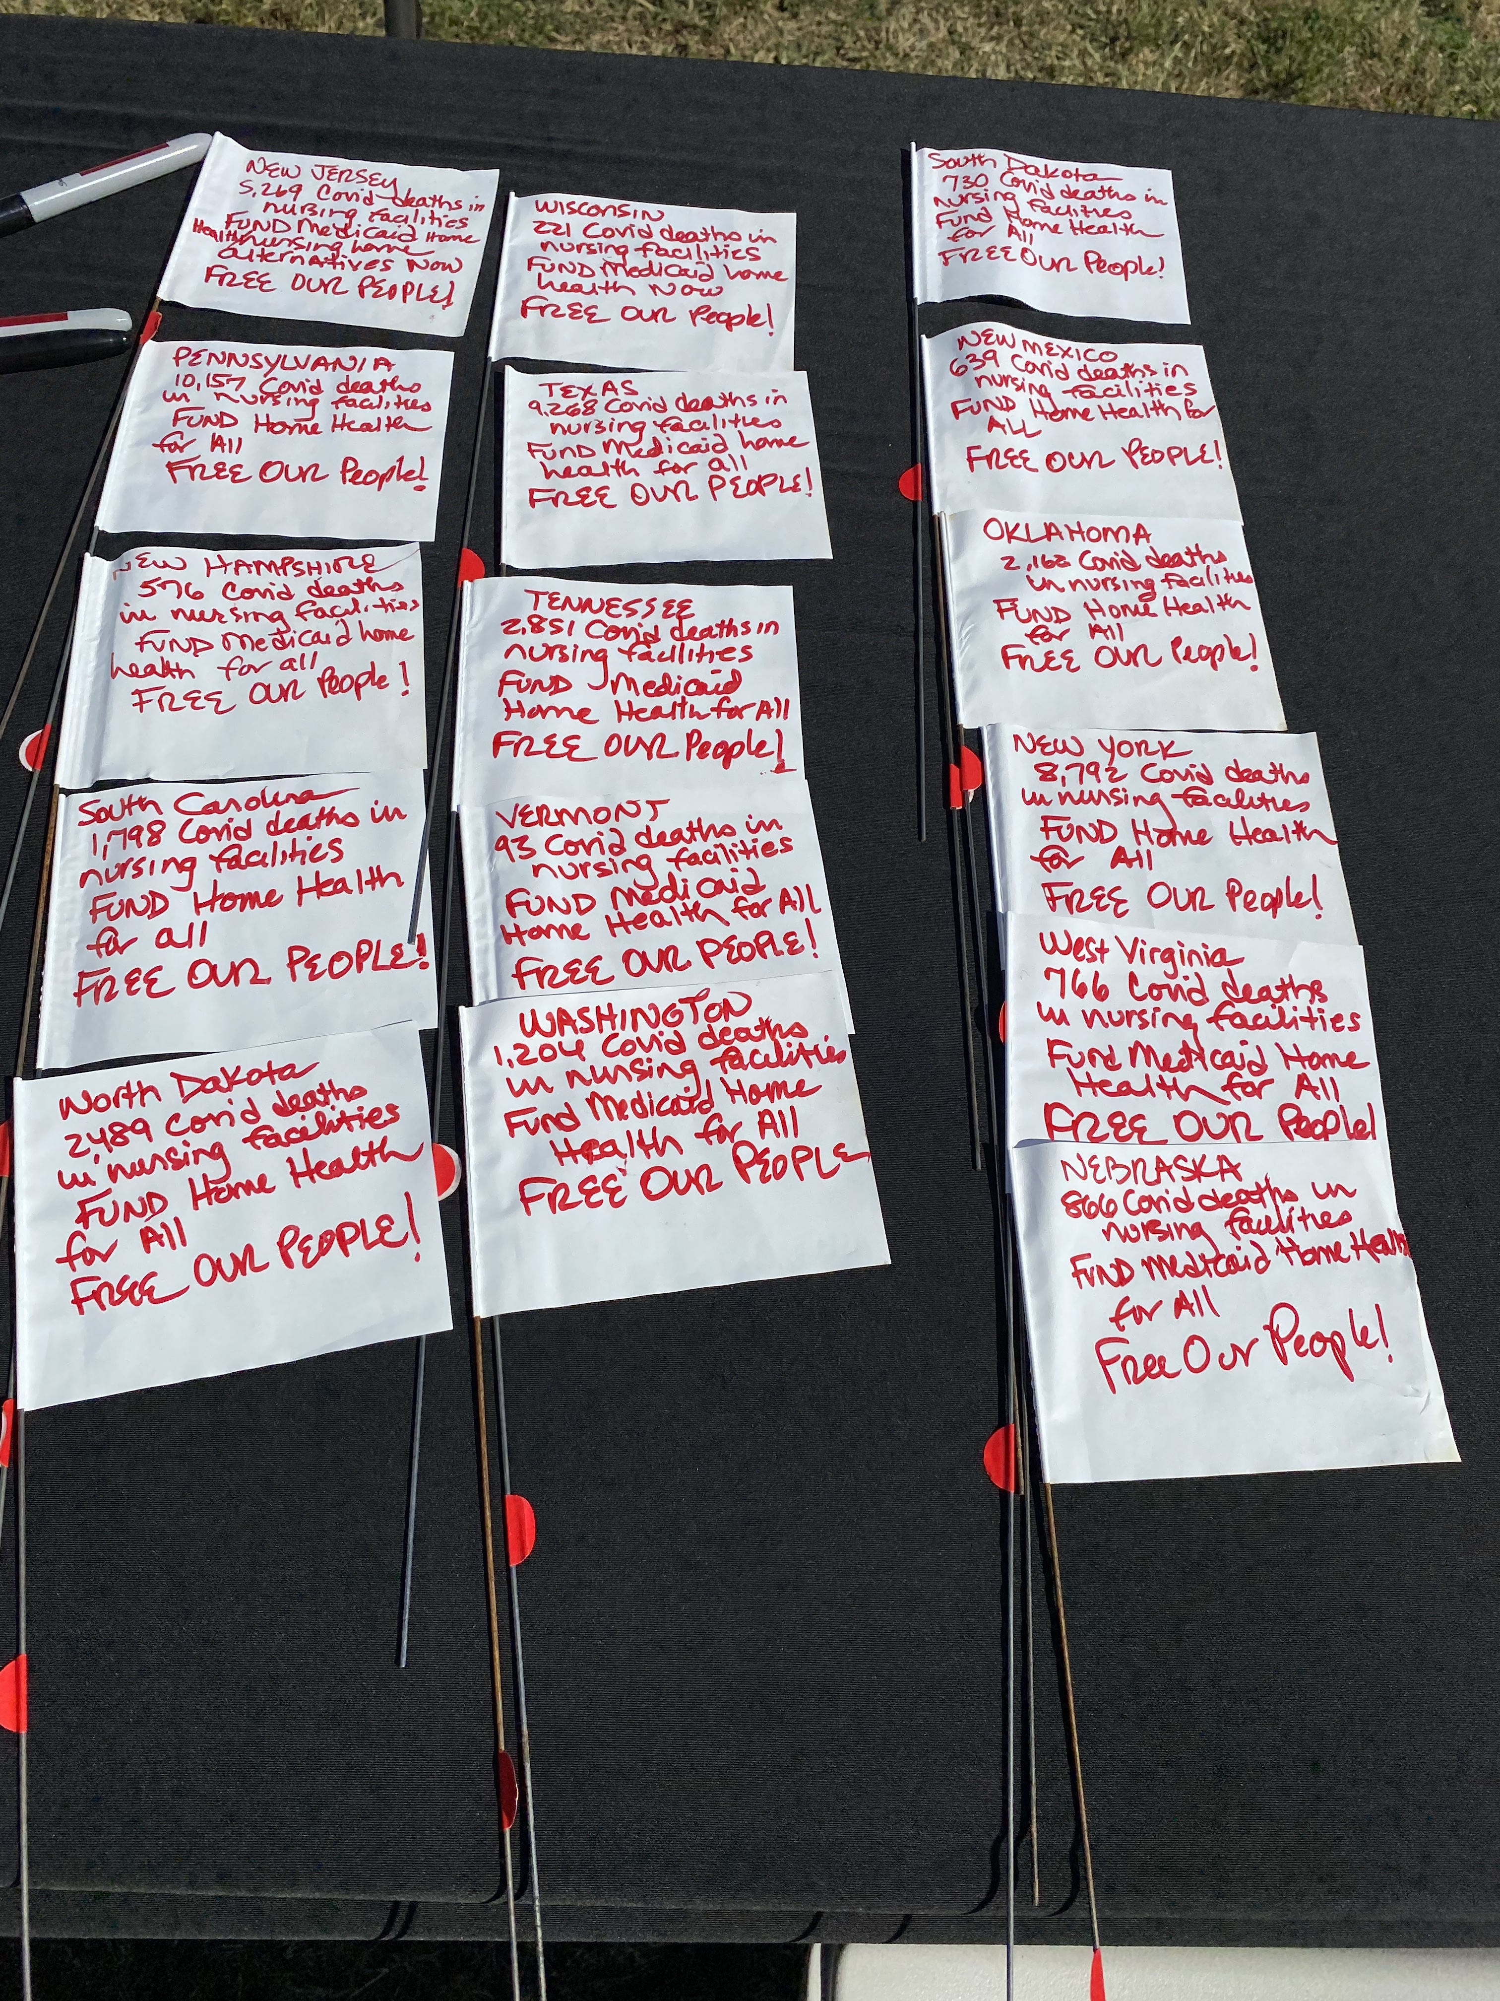
Flags for those disabled lives lost to covid in nursing facilities
Notes:
Flags for disabled lives lost from COVID-19 in nursing facilities that were among the 700,000 flags in front of the Washington Monument.
Examples from the flags from all 50 states with the amount of COVID deaths in nursing facilities in the state. And the words “Fund Home Health for All Free Our People”

Slide 33
Disability & Disaster
Systems Advocacy
www.reaadi.com
Notes:
GERMAN, SHAY, & MISTY
Policy Change:
Recognizing Centers for Independent Living (CILs) and other disability-led organizations as eligible private non-profits in the FEMA Public Assistance Program and Policy Guide.
Legislative:
Real Emergency Access for Aging and Disability Inclusion (REAADI) for Disasters Act
H.R. 4938 & S. 2658
Disaster Relief Medicaid Act
H.R. 4937 & S. 2646
More at www.reaadi.com

Slide 34

Systemic Solutions
Actions FEMA could take today
Acknowledge CIL’s (and other CBOs) as eligible private non-profit organizations under FEMA Public Assistance Program and Policy Guide (PAPPG)
Engage with disability community leaders at every level
Strategies HHS/ACL could take on
Fund CIL’s 5th Core Service (NHT)
Create and fund 6th Core Service (Emergency Management)

Slide 35
Legislative Solutions
REAADI - Real Emergency Access for Aging and Disasbility Inclusion for Disasters Act
  (H.R. 4938) (S. 2658)
DRMA - Disaster Relief Medicaid Act
  (H.R. 4937) (S. 2646)
Learn more at reaadi.com!

Slide 36
More Strategies on Thursday
Join The Partnership for Inclusive Disaster Strategies Workshop!
Thursday, October 21st
at 12pm ET/ 11am CT/ 10am MT/ 9am PT
“Inclusive Disaster Resilience During a Pandemic”

Slide 37
Contact Us:
Ebony Payne
(312) 636-6686
epayne713@gmail.com
Misty Dion
Chief Executive Officer
CILNCP
24 East 3rd Street,
Williamsport, PA 17701
(Voice) 570-327-9070
or 800-984-7492
(VRS) 570-279-4590
(Captel) 570-601-1429
mdion@cilncp.org
http://www.cilncp.org
German Parodi
Shaylin Sluzalis
Co-Executive Directors
The Partnership for Inclusive Disaster Strategies
(215) 971-0660
directors@disasterstrategies.org
www.disasterstrategies.org
Marcie Roth
Executive Director and CEO
World Institute on Disability
(301) 717-7447
marcie@wid.org
www.wid.org

Slide 38
QUESTIONS?

