Slide 1

Making Your Presentation Accessible to All
Incorporating Audio Description Into Your Presentation
Rebecca Williams – Lead Information Specialist
Southeast ADA Center

Slide 2

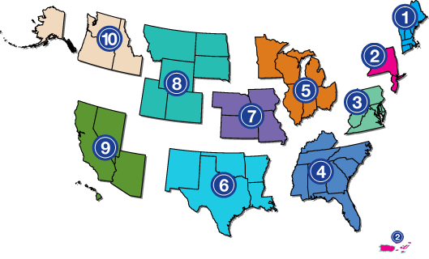
ADA National Network
1-800-949-4232
www.adata.org
Notes:
The Southeast ADA Center is a member of the ADA National Network. The ADA National Network consists of 10 regional centers and an ADA Knowledge Translation Center. The regional centers are distributed throughout the United States to provide local assistance and foster implementation of the ADA. The Network provides information, guidance and training on the Americans with Disabilities Act (ADA), tailored to meet the needs of business, government and individuals at local, regional and national levels. The Network is not an enforcement or regulatory agency, but a helpful resource supporting the ADA's mission to "make it possible for everyone with a disability to live a life of freedom and equality.“
The 10 regional centers along with the ADA Knowledge Translation Center, work together to develop projects and events of national significance. Each regional center also focuses on the specific needs of the residents who reside within its service area. The regional nature of the ADA National Network is critical to ensuring the network can adequately support the diverse population of ADA Stakeholders throughout the country.

Slide 3


Our Funding
Administration for
Community Living (ACL)
National Institute on Disability, Independent Living, and Rehabilitation Research (NIDILRR)
Notes:
All Centers in the ADA National Network are funded by the U.S. Department of Health and Human Services, Administration on Community Living, National Institute on Disability, Independent Living, and Rehabilitation Research (NIDILRR). The Centers have been known by different names through the years (DBTACs, ADA & IT Centers, and now ADA Centers), however, our mission has always been the same.

Slide 4
A Project of Burton Blatt Institute at
Syracuse University
Notes:
The Burton Blatt Institute, established at Syracuse University in 2005, is an organization that aims to advance civic, economic, and social participation of persons with disabilities in a global society. Peter Blanck, a University Professor at Syracuse University, is the chairman of BBI.
BBI builds on the legacy of Burton Blatt, former dean of Syracuse University School of Education and a pioneering disability rights scholar, whose mission was to better the lives of people with disabilities.

Slide 5

Southeast ADA Center Overview
A project of Burton Blatt Institute (bbi.syr.edu)
Serve 8 states in the Southeast region
  Alabama
  Florida
  Georgia
  Kentucky
  Mississippi
  North Carolina
  South Carolina
  Tennessee
Notes:
The Southeast ADA Center is a project of the Burton Blatt Institute at Syracuse University. We serve 8 states in the Southeast Region (Alabama, Florida, Georgia, Kentucky, Mississippi, North Carolina, South Carolina, Tennessee).

Slide 6
Our Mission
Facilitate voluntary compliance with the Americans with Disabilities Act (ADA)
Conduct research to reduce and eliminate barriers to employment and economic self-sufficiency and to increase the civic and social participation of Americans with disabilities

Slide 7

Disclaimer
The contents of this presentation were developed under a grant from the National Institute on Disability, Independent Living, and Rehabilitation Research (NIDILRR grant number 90DPAD0005-00-01). NIDILRR is a Center within the Administration for Community Living (ACL), Department of Health and Human Services (HHS). The contents of this publication do not necessarily represent the policy of NIDILRR, ACL, HHS, and you should not assume endorsement by the Federal Government.
The information, materials, and/or technical assistance provided by the Southeast ADA Center are intended solely as informal guidance, and are neither a determination of your legal rights or responsibilities under the ADA, nor binding on any agency with enforcement responsibility under the ADA. The Southeast ADA Center does not warrant the accuracy of any information contained herein. Furthermore, in order to effectively provide technical assistance to all individuals and entities covered by the ADA, NIDILRR requires the Southeast ADA Center to assure confidentiality of communications between those covered and the Center. Any links to non-Southeast ADA Center information are provided as a courtesy, and are neither intended to, nor do they constitute, an endorsement of the linked materials.
You should be aware that NIDILRR is not responsible for enforcement of the ADA. For more information or assistance, please contact the Southeast ADA Center via its web site at adasoutheast.org or by calling 1-800-949-4232 or 404-541-9001.

Slide 8
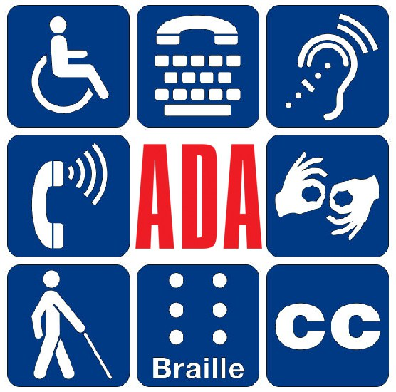
The Americans with Disabilities Act
Notes:
Graphic images of various accessibility symbols arranged in a square. ISA, text phone, assistive listening, phone amplification, ASL hands, caricature with a white cane, Braille tile, closed captioning. ADA in red lettering in the center of the square

Slide 9
What is Audio Description?
Provides spoken information about key visual elements
Provides people with vision loss with a more complete picture of visual information
Accomplished through technology
  a track on a TV or movie audio feed
  FM signals throughout an audience
  separate channel on their existing assistive listening systems
Notes:
Audio description, also referred to as visual description, provides spoken information about key visual elements in a visual experience. Audio description is not just for the performing arts. Any event or exhibit that contains visual information may be audio described, providing people with vision loss with a more complete picture of museum exhibits, parades, public events, films, websites, cruise ships and more.
Sometimes this is accomplished through technology, such as a track on a TV or movie audio feed. In the theater it is performed by a describer talking into a microphone or court reporter’s “mask”, sending FM signals throughout the audience. The patron who is using the service has a receiver with an earbud or other auditory device. Many venues provide audio description via a separate channel on their existing assistive listening systems. These descriptions are inserted into natural pauses in the program's dialogue.
In addition to offering information about visual content, audio description offers a measure of independence to people with vision loss. No longer do they have to rely on a companion to tell them what’s happening onstage. They can receive detailed information from a professional describer via a headset, and enjoy the show independently.

Slide 10
Who Uses Audio Description?
People with low vision or who are blind
People on the autism spectrum [sensory overload]
People for whom ESL is a second language
People with language processing impairments
People who prefer to acquire information primarily by auditory means
Notes:
The percentage of non-institutionalized, male or female, all ages, all races, regardless of ethnicity, with all education levels in the United States reported a visual disability in 2017 is 2.3% of the population surveyed.
Source: Cornell University Disability Statistics
Website: www.disabilitystatistics.org
The National Eye Institute states that there are 4.2 million Americans ages 40 and older who are visually impaired. This number is projected to reach 7.2 million Americans by the year 2030.
Audio description makes the visual images accessible for people who are blind or have low vision. Using words that are succinct, vivid, and imaginative, describers convey the visual image that is either inaccessible or only partially accessible to a segment of the population.
Whereas ADS was originally developed to provide greater for people with sight impairments to visual aspects of theater, museums, TV, dance, etc. new uses are being implemented. For example people on the autism spectrum [sensory overload], people for whom ESL, people with language processing impairments, people who prefer to acquire information primarily by auditory means.

Slide 11
Why Should I Provide Audio Description?
Federal Laws
  The Americans with Disabilities Act (ADA)
  Section 508 of the 1973 Rehabilitation Act
  The Twenty-First Century Communications and Video Accessibility Act of 2010 (CVAA)
  Most importantly, to make your presentation inclusive for all audience members and enhance your presentation
.
Notes:
28 CFR 36.303 (g)(1)(ii) Audio description means the spoken narration of a movie's key visual elements, such as the action, settings, facial expressions, costumes, and scene changes. Audio description generally requires the use of an audio description device for delivery to a patron.
On April 30, 2010, audio description was adjudicated as “clearly an auxiliary aid and service” under the Americans with Disabilities Act by the Ninth Circuit Court of Appeals in the case State of Arizona v. Harkins. https://law.justia.com/cases/federal/appellate-courts/ca9/08-16075/08-16075-2011-02-25.html
Reasons to Describe
There may be session participants who are calling in on a phone and can’t see the PPT presentation
Participants will get a better understanding of your visuals –What are the people doing? Description tells us their facial expressions or body language if needed to make our point. What does the housing look like? Is it a duplex or an accessible duplex because there is a ramp at one of the entrances – description supplies this information to the participants with vision loss. In a “guess the service animal” poll the type of each animal needs to be verbalized so all attendees can respond.
Description can help pull your presentation together

Slide 12
Where is Audio Description Used?
Dance Performances
Displays
Fashion shows
Museums
Nature Museums
Parades
Trainings, conferences, presentations
Presidential Inaugurations
Theater
Websites
Any time information is presented visually

Slide 13
So How Do I Describe My Presentation?
If there is more than one picture, image, graph, map, etc. begin on the left and move right
If there is one large picture start with the foreground and move towards the background
If your image has colors, shapes or sizes which are important to understand the content describe these
Alt text is not the same as audio/visual description
Notes:
Allow the listener to make their own conclusions based on what the describer verbalizes.
If your face is on-screen, please describe what you look like.
Logos, such as those on the first few slides of this presentation [Southeast ADA Center, BBI, ACL, and NIDILRR] generally are not necessary to visualize to understand this presentation. If however; a logo somehow supported the presentation it should be described.

Slide 14
The Americans with Disabilities Act
Notes:
Alt text is a short description of the image - Graphic symbols of various accessibility requirements
Graphic images of various accessibility symbols arranged in a square. ISA, text phone, assistive listening, phone amplification, ASL hands, caricature with a white cane, Braille tile, closed captioning. ADA in red lettering in the center of the square

Slide 15

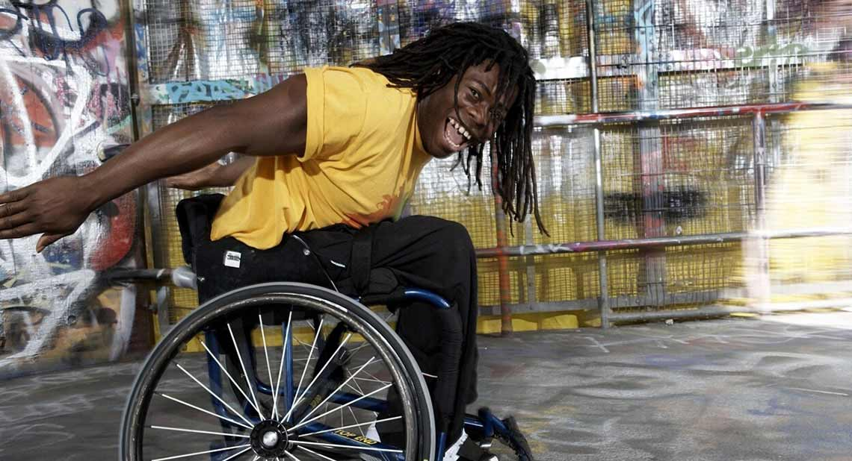
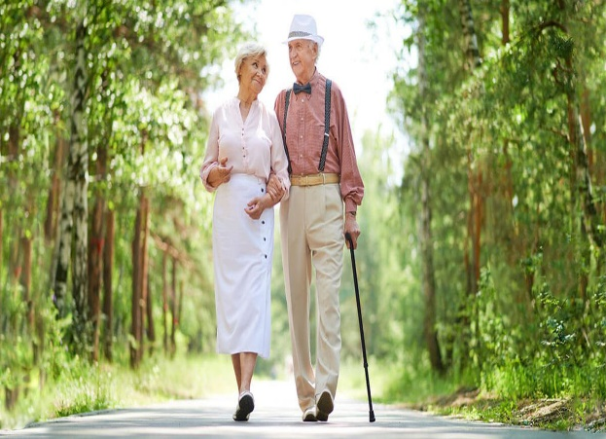
Notes:
This slide was used in a basic ADA training to show who is protected by the ADA.
There are three pictures on this slide. The picture on the left is that of a sun-tanned, blonde-headed 20-something girl in a tank top and blue shorts facing us. She is holding a surfboard with her right hand. There is a big, semi-circular chunk of the top side portion missing. The girl’s left arm is missing immediately below her shoulder.
The middle picture shows a light skinned senior couple strolling down a tree-lined path. The suspendered man is using a cane.
The picture on the right is that of a smiling, dark-skinned man sitting in a manual wheelchair. He is bending slightly forward with his arms outstretched behind his body. His long, braided hair hangs almost to his knees.

Slide 16
ADA National Network
1-800-949-4232
www.adata.org
Notes:
This slide shows a map of the United States and indicates the location of the ten regional ADA Centers that compose the ADA National Network. Each number region [from 1 to 10] is a different color and is separated from adjacent regions as if the regions were pulled slightly apart.
It’s not important to mention what color each region is, the important piece of information is that each region is indicated by a different color.

Slide 17
Just the Facts
No one sees motives or emotions, we see actions that indicate motives or emotions.
Describers should not interpret or explain an action or event.
One should describe the things that they see that may help an attendee/participant understand the action or event more completely.
Notes:
Allow the listener to make their own conclusions based on what the describer verbalizes.
If your face is on-screen, please describe what you look like.

Slide 18
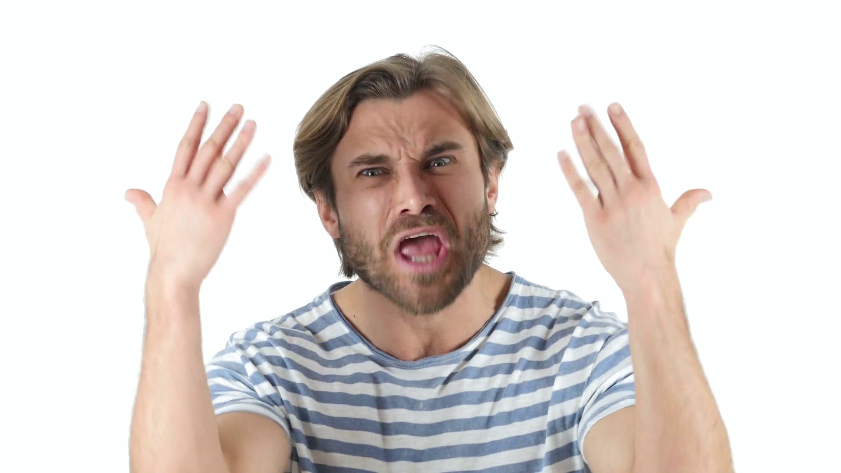
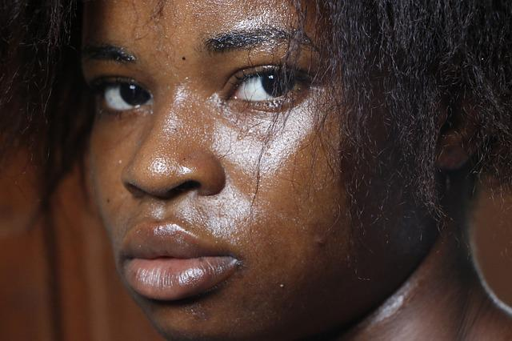
Notes:
There are two pictures on this slide. The picture on the left is that of a light-skinned man with brown hair, beard and moustache. He’s wearing a steel blue and white striped T-shirt. His brow is furrowed, his mouth opened in a big O and his hands are thrown up in front of his face, palms facing him.
The picture on the left is that of a dark-skinned, late twenty-ish woman staring out with dark eyes. A tear runs down her left cheek.
There has been discussion among describers whether to describe skin tone/color. The folks that I have talked with that use description services have said to me “Describe what you see. If you see people of varying skin tones, then you describe that”. Of course, this decision is up to the sescriber unless the color of the skin is important to understand the presentation. For instance, if a presentation is about the disparities in medical care for the elderly and people of color and the picture is that of a free community medical clinic, then the race/ethnicity and age of those in the waiting room may be important to the presentation.

Slide 19
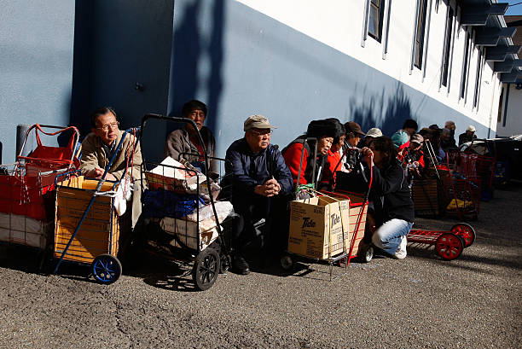
Notes:
Description – A row of people of color sitting in front of a grey and white building. Most are sitting and have grocery shopping carts in front of them. Some are metal, store bought carts, others are made of metal frames and large cardboard boxes.
Let’s suppose this was a slide in a presentation on food deserts found in low-income urban areas. For this presentation it may be important to know the skin tone.

Slide 20
What About Videos?
Eating Well Video
  http://healthycommunityliving.com/LWCfacilitator/assignments/eating-well
Encouragement Video – Scott James
  http://healthycommunityliving.com/LWCfacilitator/assignments/staying-course
Notes:
The videos used in Community Living with a Disability run from 25 seconds to up to 6 minutes. We are providing a brief description of individuals and scenes shown in each video in the order in which they appear. There is not sufficient time for audio description between scene changes during the video presentation without stepping on the narrator’s lines. The words next, then or stop in the audio description indicate scene changes. When only one person is in the video the description will inform of all the actions made by the individual. These videos are also captioned. The captions are visible at the bottom of the screen.
Eating Well
Eating Well | Living Well in the Community | Facilitator Training (healthycommunityliving.com)
http://healthycommunityliving.com/LWCfacilitator/assignments/eating-well
Bowls of lush fruits and vegetables line a table: red and white potatoes, dark plums, green peas in the hull. Next. A table piled high with fresh produce at an outdoor farmers’ market. Next. Someone flips a burger on a charcoal grill. Next. A picture of an inside farm market. A Plain Sect girl stands behind one of the stands. Fade to black.
Encouragement
Staying On Course | Living Well in the Community | Facilitator Training (healthycommunityliving.com)
http://healthycommunityliving.com/LWCfacilitator/assignments/staying-course
An empty manual wheelchair and kayak sit on a shoreline in front of a body of water. Mountains are in the background. Next. A young man in a wheelchair rolls down a street. He gives a thumb’s up to someone off screen. Two people walk behind him. Next. A kayaker is on the water. A little boy throws a rock into the lake. Next. A twenty-something man with a brown goatee wearing a red sweat jacket and blue ball cap addresses the camera. The words “Scott James has a C6 C7 quadriplegic injury” appear on screen. Next. A group of folks using wheelchairs gather around an outdoor picnic table. Next. Back to Scott who is riding in the back of a motorboat. Next. A thirty-something man with short brown hair wearing a sleeveless grey shirt. The words “James Hektner SCI BC’s Kelowna Peer Coordinator”. Next. Scotty wearing a blue and black life vest rides in a boat. Next. Back to James. Next. Scott in the water attempting to use adaptive water ski equipment. Next. A woman with brown hair that falls below her shoulders. The words “Lindsay James Scott’s Sister” are on screen. Next. Action shots of Scott pursuing various sports activities and talking with groups of others with spinal cord injuries. Next. Lindsay and James address us again. Next Scott finishes up the video Fade to black.

Slide 21

Questions?

Slide 22
Connect With Us!
Join our email list
adasoutheast.org/contact/subscribe.php
Like us on Facebook!
facebook.com/southeastadacenter
Follow us on Twitter!
twitter.com/adasoutheast

Slide 23
Still Have Questions?
Contact the Southeast ADA Center
Telephone
800-949-4232
404-541-9001
711 (relay)
E-mail
adasoutheast@law.syr.edu
Website
www.adasoutheast.org
Notes:
BARRY

