Slide 1
Accessible presentation Basics

Slide 2
Begin with the end in mind

Slide 3
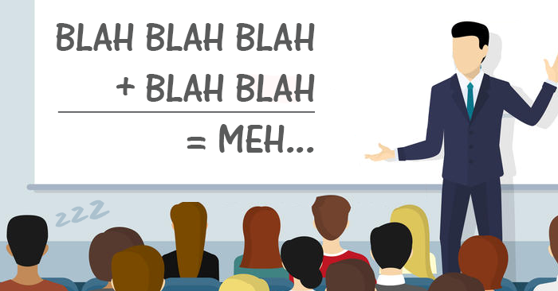
Why is This Important?
Inclusion
Reaching your audience
Respect
Engagement
Why would you want to exclude anyone?

Slide 4
Universal Design for Learning
Universal Design for Learning and for Instruction
Diverse learners
Inclusive from the start
Variability
What is disabling?

Slide 5
Visual+ Disabilities

Slide 6
Describe!
Visuals
When to use
Is it necessary?
Alt text
Who does it benefit?
Contrast

Slide 7
Screen Reader Considerations
Use punctuation in your alt text
“,” and “.” add pauses
If there is no alt text, the file name is read
Don’t over describe
Be mindful of acronyms in alt text

Slide 8
Slide Show Considerations

Slide 9
Slide Design
Unique titles
Alt text for all images
Space for captions
White space - don’t use blank lines for white space
Text, white space and images
Think about contrast and projections
Don’t use all caps or too much bolding

Slide 10
Tip: Avoid busy backgrounds

Slide 11
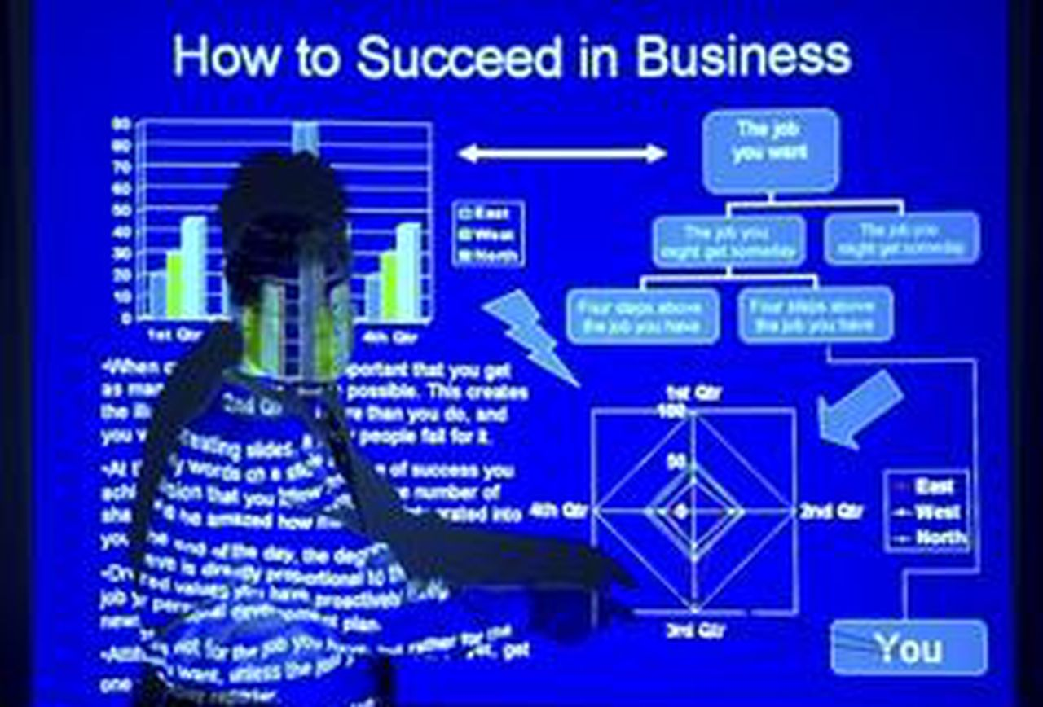
Spot the Problems

Slide 12
Is this Accessible?

Slide 13
Think about Legibility

Slide 14
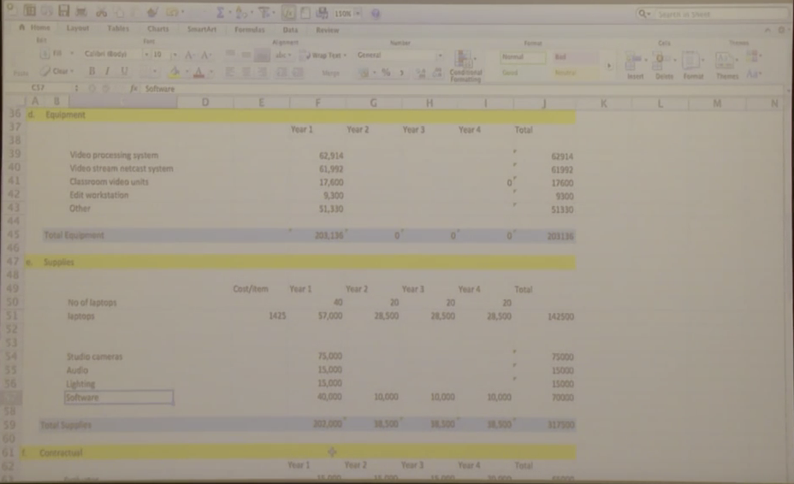
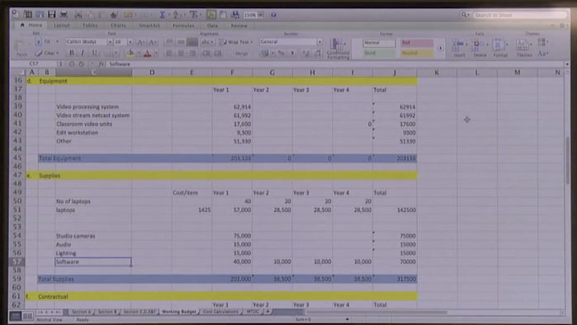
Projector vs Monitor

Slide 15
Media Considerations

Slide 16
The Basics of Using Media
Never use an uncaptioned video
Don’t assume an interpreter will be doing the video
Audio descriptions should be used
Add description where needed
Avoid any strobing imagery
Do not have any part of your presentation rely solely on sound/visuals without reasonable accommodations

Slide 17
Requesting Feedback

Slide 18
Audience Participation
Allow time for answers to questions asked
How to get responses? (Auditory, visual or vocal?)
Live surveys (check accessibility!)
Don’t single people out for responses

Slide 19
Tip: Your content is not more important than a participant’s access

Slide 20
Presentation Tools

Slide 21
What to Use?
PowerPoint - cost
Keynote - free
Slides - free

Slide 22
Microsoft Accessibility Checker
Provides an easy way to double check yourself
Looks for images with not alt text
Checks for duplicate slide titles
Alerts for missing headings and table issues
Reading order
On the ribbon click “review” and then click “Check Accessibility”

Slide 23
Slide Show Cheat Sheet
Slides should have:
Good contrast
At least 30 point sans serif font
Images with alt text
A balance of text, images and white space
Unique titles for each slide
A color scheme that can work for projections
Space for captions at the bottom (depending on platform)

Slide 24
Presenting Cheat Sheet
When presenting you should:
Always use a mic!
Face your audience
Describe images on the screen
Speak at a rate that allows time for interpreters/captioners to keep up
Provide materials in advance upon request
Never use inaccessible media
Allow time for questions to be answered (10 seconds min)

