Slide 1
Let’s Talk (plain) Language
Universal Design for Learning, Plain Language Basics and Tools and Resources to Create Plain Language Documents

Slide 2
Paige Winget
Director of Youth Transition Services

Slide 3
Objectives
Review Universal Design for Learning
Understand the importance of plain language and easy read as it pertains to UDL
Provide best practices for creating plain language and easy read documents
Provide larger context of how plain language is used for accessibility in the community

Slide 4
Universal Design for Learning
Derived from the concept of Universal Design
A set of principles for curriculum development that give all individuals equal opportunities to learn
Provides a blueprint for creating instructional goals, methods, materials, and assessments that work for everyone
Notes:
Doesn't mean you don't’ have to provide accommodations!
It’s a process that allows you to evaluate and remove as many barriers as possible by providing lots of various “points of entry/engagement”

Slide 5
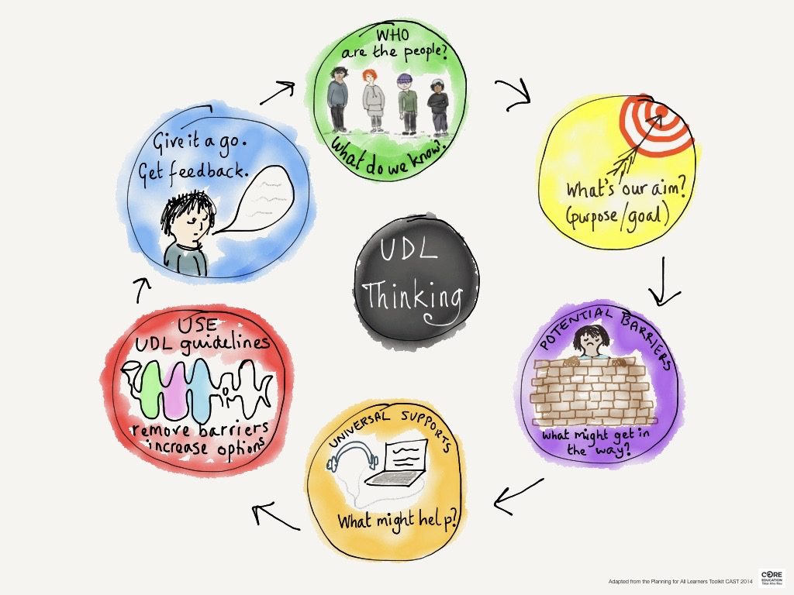
Notes:
http://blog.core-ed.org/blog/2019/03/why-udl-is-valuable.html
Culturally responsive as well! Disability is a culture and community

Slide 6
Plain Language
“If you can’t explain something simply, you don’t understand it well.”
Albert Einstein

Slide 7
What is Plain Language?
Definition
Communication that is made to ensure as many people as possible can read, understand, and process the information given.

Slide 8
Why is Plain Language Important?
Plain Language uses everyday language that is accessible to people with low-literacy, people who speak English as a second language, and people with disabilities.
Jargon, academic/legal and complex language are access barriers to many people with disabilities.
Notes:
Simply put plain language removes barriers between you and your consumers. Plain Language is a necessity and can have a big pay off for both consumers and organizations. If someone is not understanding the content-- you are not reaching them. 20% of Americans read below a 5th grade level while the majority has an 8th grade level-- therefore, are you meeting the expectations?

Slide 9
Why is Plain Language Important??
Communication is Key
Fun Fact! Federal Entities must use Plain Language
Plain Writing Act of 2010
Requires Federal agencies to use “clear government communication that the public and understand and use”.
Purpose: to enhance citizen access to information and services
Established: that public issued documents must be written clearly
Helps: to make information more accessible to the public
Notes:
There are a lot of resources out there. If you arent considered a federal entity-- you may want to still check the resources as it will ensure you are reaching all possible customers.

Slide 10
Plain Language
Does
Does Not…
Put the audience first
Improves writing style, content, organization and format
Promotes honest and open communication
Improves service through cleaner forms, documents, letters and signs
“Dumb it down”
Use improper language use
Use patronizing language
Change the essential ideas of the content
Use inaccurate, incomplete or imprecise writing

Slide 11
Plain Language Example
Before
After
Infants and children who drink water containing lead in excess of the action level could experience delays in their physical or mental development. Children could show slight deficits in attention span and learning abilities. Adults who drink this water over many years could develop kidney problems or high blood pressure.
Source: Federal Communication Network
Lead in drinking water can make you sick. Here are some possible health effects of high lead levels in your drinking water:
Children:
Delayed growth
Short attention span
Adults:
Kidney problems
High blood pressure

Slide 12
Tips for plain language
Know your audience
Use everyday language
Use personal pronouns like “you”
Avoid slang
Write short and logical sentences
Leave out details that may distract your reader
Avoid undefined technical terms
Be direct-- not wordy
Use headings/subheadings, margins, and whitespace to organize the information
Make information easy to find
Use words with fewer syllables
Keep wording between 3-5 grade
Notes:
the reading level is not a perfect way to know if something is easy to understand, but it is a good start. All text should be no more than a 5th grade reading level, at most. REMEMBER-- that a 5th grade reading level is not the same thing as appropriate for a 5th grader. “Grade level” is just the language used by most readability scales.

Slide 13
What is Easy Read?
Definition
Easy Read is written information, often supported with pictures, that is clear and easy to read and understand.
Notes:
Easy Read is developed to support people with intellectual disabilities better understand written content.
Although Easy Read is different from Plain Language it uses the similar principles

Slide 14
Why is Easy Read Important?
Easy Read helps those who have difficulty reading understand written information by using easy words and picture images.
Good Easy Read tells the reader what they really need to know.
Notes:
Easy read information works for everyone.

Slide 15
Easy Read Content Essentials
Write in short sentences.
Use one idea per sentence.
Use larger (about 14-16), clear, font.
Do not write in upper case.
Do not use jargon, acronyms, or italics.
Do not underline, use bold to emphasis words.
Always use numbers, do not spell out the word.
If photos are used, use good quality photos and make sure it reflects what the text is saying.
Reduce punctuation as much as you can.
Make sure the layout is the same throughout
Notes:
No more than 5th grade reading level

Slide 16
Writing Readable Content
Readable content is accessible content.
Creating content using plain language and easy read requires investing some time and effort into the process in order to benefit in the long run.
Before you start, ask yourself:
Is this content of long term interest or need?
Can this content be clarified without losing its meaning?
Notes:
Keep in mind that people adjust content to make it easier to for them to identify and understand the information that is being given. Your content should could include adjustments such as:
Making audio content easier to hear and visual content easier to see.
Combining audio and visual content to make information easier to understand.
Providing alternative presentations of your content.

Slide 17
Writing Readable Content 2
Tips and Techniques
Organize to Serve the Reader
Arrange your content so that short titles describe each page’s content and distinguish it from other pages.
Put the unique and most relevant information first.
Use Headings
Use heading to group related paragraphs and clearly describe the sections of your content.
Notes:
We all navigate and find content differently, depending on our preferences, skills and abilities. Content should be presented in a way that supports different styles of web navigation.
Reminder: The page title is often the same as the main heading of the page.
Screen readers indicated stuctural information on webpages such as heading, list items, links and more to help users navige the page. Accessing information in an effective manner.

Slide 18
Writing Readable Content 3
Tips and Techniques
Keep Things Short
Smaller pieces of information are easier to digest.
Use Pronouns
Because they…
Speak directly to readers.
Make your writing relevant to readers.
Require less work from your readers to understand
Notes:
Easy read encourages us to write in short, clear sentences, using one idea in every sentence.
Personal pronouns are preferable to using things like “one” (ie. “To participate in the program, one must complete an application”)
Also, shorthand may include a lack of repetition of subject pronouns, but this may turn into subject confusion without a pronoun to keep the person on track.

Slide 19
Writing Readable Content 4
Tips and Techniques
Use an Active Voice, Not Passive
Using an active voice is more, clean, concise, and direct.
Use Familiar Language
Fit your language to your audience
Provide definitions for unusual words and abbreviations.
Avoid using jargon.
Notes:
Easy Read suggest using active verbs because they describe what someone does.
Jargon: Specific words or expressions that are used by a particular profession or group and are difficult for others to understand.

Slide 20
Writing Readable Content 5
Tips and Techniques
Use Familiar Language
To communicate effectively with the general US population. Your writing should be at the 3th-5th grade reading level.
Notes:
The reading level is not a perfect way to know if something is easy to understand, but it is a good start. All text should be no more than a 5th grade reading level, at most. REMEMBER-- that a 5th grade reading level is not the same thing as appropriate for a 5th grader. “Grade level” is just the language used by most readability scales.

Slide 21
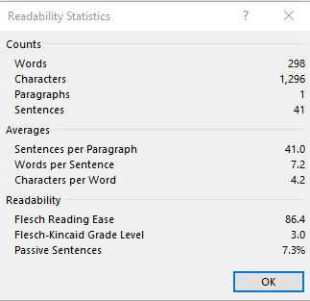
Writing Readable Content Tips and Techniques
Read, Test, and Revise
Test your writing to make sure it is clear enough for your consumers.
You can test your writing using a Word document in just a few clicks.

Slide 22
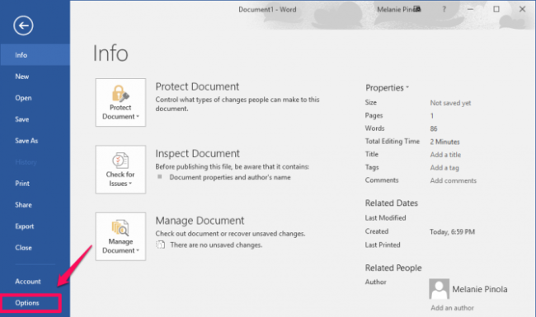
Tips and Techniques: Read, Test, and Revise
Step 1. Go to File > Options.

Slide 23
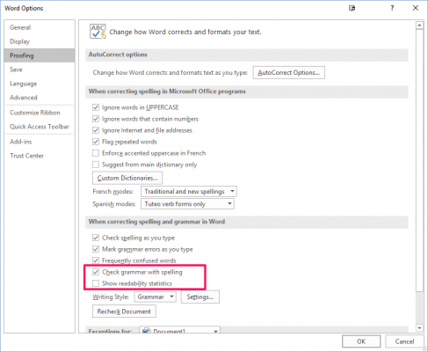
Writing Readable Content Tips and Techniques: Read, Test, and Revise
Step 2. In the “Proofing” tab, check the following options.
Check grammar with spelling.
Show readability stats.

Slide 24
Writing Readable Content Tips and Techniques: Read, Test, and Revise
Step 3. Click “OK”.

Slide 25
Remember
Communicating clearly builds transparency and trust within your own network as well as the people you serve.
The more you say, the less people remember.
- Anatole France

Slide 26
Benefits and application of plain language
Creates inclusion for all families and students
Everyone gets information on a level they can understand
Breaks down larger concepts into understandable content
Notes:
Beyond support for students...larger accessibility reach

Slide 27
Where can I apply this?
Presentations
Notes home
Study guides
Meeting notes and agendas
Websites
Social Media
Internal communication
Notes:
Examples:
Presentations: we all want to sound smart, but using plain language engages more of the audience, including students or professional training
When you send notes home and study guides in plain language, you increase the chance that parents will understand and apply the information as well
Meeting notes and agenda- focus on the important information and your point won’t get lost in the jargon
Websites and Social Media- to reach a broader audience and get your message across clearly
Internal communication- memos, emails, etc, can cut down miscommunication and increase understanding

Slide 28
We are here for you!
Consult with organizations run and operated by people with disabilities, like Able SC!

Slide 29
Questions?

Slide 30
Contact Us!
Paige Winget
Pwinget@able-sc.org
Able South Carolina
youthteam@able-sc.org
advocacy@able-sc.org
803.779.5121

Slide 31
Resources
https://selfadvocacyinfo.org/wp-content/uploads/2019/08/Plain-Language-Resources.pdf
Plain Language Resources
www.plainlanguage.gov
Federal Plain Language information.
www.centerforplainlanguage.org
National organization dedicated to promoting Plain Language.
https://www.ada.gov/effective-comm.htm
ADA Requirement: Effective Communication
http://accessingsafe.wpengine.com/wp-content/uploads/2015/06/make-it-clear-apr09.pdf
Mencap’s Make it Clear: Guide to making easy read information.
https://thenounproject.com/
Noun Project. Images/symbols to include in easy read
https://rewordify.com/index.php
Rewordify. Site that gives suggestions for plain language. Youth friendly teaching resource

