Slide 1
Our Homes, Not Nursing Homes!: Benefits of Living In the Community Rather than In the Nursing Home
By Katrina Parsons
disABILITY LINK
Tucker, GA

Slide 2
Introduction
“Everyone will become disabled if they’re lucky enough. Aging is a privilege. Far too few of us get the opportunity to be a ripe old age. And if you do get the opportunity, you will likely become disabled.” (Maria Town, President and CEO of the American Association of People with Disabilities).

Slide 3
Community Integration for Everyone
Olmstead Act:
The story of the Olmstead case begins with two women, Lois Curtis and Elaine Wilson, who had mental illness and developmental disabilities, and were voluntarily admitted to the psychiatric unit in the State-run Georgia Regional Hospital. Following the women's medical treatment there, mental health professionals stated that each was ready to move to a community-based program. However, the women remained confined in the institution, each for several years after the initial treatment was concluded. They filed suit under the Americans with Disabilities Act (ADA) for release from the hospital.

Slide 4
The Decision
On June 22, 1999, the United States Supreme Court held in Olmstead v. L.C. that unjustified segregation of persons with disabilities constitutes discrimination in violation of title II of the Americans with Disabilities Act. The Court held that public entities must provide community-based services to persons with disabilities when (1) such services are appropriate; (2) the affected persons do not oppose community-based treatment; and (3) community-based services can be reasonably accommodated, taking into account the resources available to the public entity and the needs of others who are receiving disability services from the entity.

Slide 5
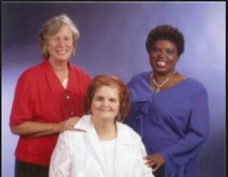
Olmstead Photo:
Sue Jamieson, Lois Curtis and Elaine Wilson.

Slide 6
What is a Nursing Home?
A nursing home (or sometimes called nursing facility) is a residence for people with severe physical disabilities or psychological impairments that need total care with activities of daily living (ADL’s) such as grooming, cooking, cleaning, transferring, bathing, and hygiene

Slide 7
Nursing Home Statistics
Average age- 80 and older
More women than men
Majority of residents are single
Dementia- common disability found in residents even if not primary
~ 25% of people admitted stay there for three months or less
About ½ of them stay for a year or more
About 20% of them stay for 5+ years

Slide 8
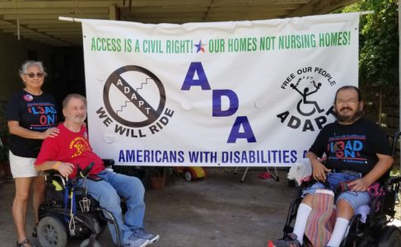
Bringing it to Life
Jimmy’s story
Early age
Working
Transitioned
Photo is Texas
Adapt members

Slide 9
Services Provided in a Nursing Home
Skilled Nursing Care
Wound Care
Breathing Treatments
Physical, Occupational, or Speech Therapy
Respite Care
Orthopedic Care
IV Care
Assistance with ADL’s

Slide 10
Risk Factors for Going into a Nursing Home
Age
Little or no resources
Severe physical or mental disability
Photo is a patient in a bed surrounded by medical personnel

Slide 11
Cons and Safety Issues of Nursing Homes
Slow responses to calls
Poor food quality
Staff shortages
Little social interaction
Sleep disruptions
Incorrect Medical Care
“This place is terrible. They won’t take care of my catheter”.
Abuse and Neglect
High Infection Rates

Slide 12
Nursing Homes and COVID-19
1,204,959 confirmed cases (according to Centers for Medicaid and Medicare)
155,840 deaths
More confirmed cases among staff than residents
First identified COVID case in the US was at a nursing home in Washington State
Reports of nursing home staff taking stimulus checks from residents and using them to pay for their stays
Reports of vaccines that were being distributed to the nursing homes at first were given to wealthy donors instead of the residents

Slide 13
Programs that our CIL Uses to Transition in the Community
Georgia Money Follows the Person (MFP)
Georgia Nursing Home Transition (NHT)
Georgia Independent Care Waiver Program (ICWP)

Slide 14
Services that Georgia MFP Provides
Housing Search
Furniture and other household furnishings
Moving Expenses
Security and Utility Deposits

Slide 15
Services that Georgia MFP Provides (Cont.)
Caregiver Supports and Education
Vehicle Adaptations
Transportation from the Nursing Home
Supported Employment

Slide 16
Services that Georgia NHT Provides
$2000 budget limit
1st month’s rent
Accessible/Adaptive Equipment
Electricity

Slide 17
HCBS Waivers in GA: A Preferred Alternative to Nursing Homes
Independent Care Waiver Program (ICWP)
Community Care Services Program (CCSP)
Service Options Using a Community Waiver (SOURCE)
NOW (New Options Waiver)
Comprehensive Supports Waiver Program (COMP)
Katie Beckett
Georgia Pediatric Program (GAPP)

Slide 18
Services Waivers Provide
Support Coordination/Case Management
Personal Support Services (Personal Care Attendant) to help with ADL’s.
Medical Supplies
Home Modifications
Emergency Response Systems
Home Delivered Meals
Skilled Nursing
Respite
Adult Day Program

Slide 19
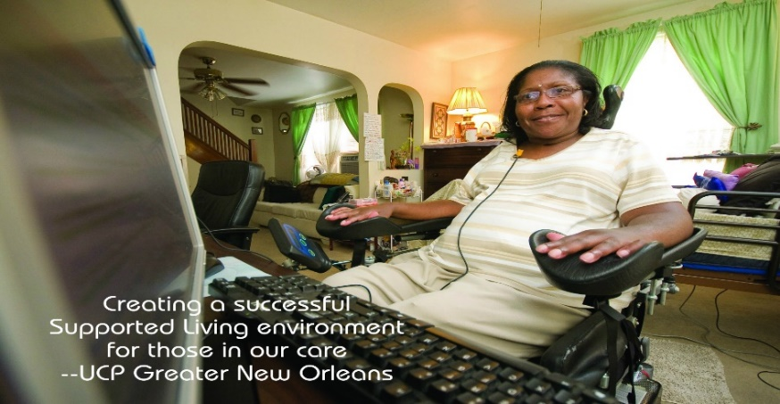
Waivers include Personal Support Services
In GA, Personal support aides are not paid to provide 24 hour individual care.
Crucial that individuals have informal support from family and close friends.
On average, an individual living out in the community with the waivers actually gets about 65-70% more care needed than if the individual was in a nursing home Photo is of a wheelchair user in front of her home computer

Slide 20
Cost Savings
In Georgia, the average cost of a private room in a nursing facility is $7,173 per month or $86,076 per year, which is below the national average.
The average cost of at home care is $3,183 per month or $45,756 per year, which is below the national average
$40,000 per year difference

Slide 21
Support for Caregivers
Caregivers can experience extreme burnout
Caregivers should reach out to others for support
Should practice self-care
Schedule down time
Be an advocate for the people that they are caregiving

Slide 22
Resources for Caregivers
Elizabeth Dole Foundation
National Alliance for Caregiving
Rosalynn Carter Institute of Caregiving
National Respite Coalition Network
AARP
Christopher Reeves Foundation

Slide 23
Success Stories
An individual who discharged at the beginning of the COVID -19 pandemic
An individual who is doing more activities he likes to do since out of the nursing home

Slide 24
Final Thought
Living in the community is more affordable, preferable, and provides more choices for people with severe disabilities.

Slide 25
References
https://www.christopherreeve.org/living-with-paralysis/for-caregivers/tips-and-resources-for-caregivers#:~:text=The%20Family%20Caregiver%20Alliance%20(FCA,%2D877%2D333%2D5885.
https://data.cms.gov/covid-19/covid-19-nursing-home-data
https://www.advocate.com/politics/2020/7/13/disabled-advocate-everyone-will-become-disabled-if-theyre-lucky
https://www.seniorliving.org/nursing-homes/costs/
https://www.nytimes.com/2020/05/17/opinion/nursing-home-coronavirus.html
http://ucpgno.org/wp-content/uploads/2015/03/reid-with-text.jpg

Slide 26
Contact Information
Katrina Parsons
kparsons@disabilitylink.org

