Slide 1
Reaching and Engaging Farm Workers
Kimber J. Nicoletti-Martinez
AgrAbility Latino Farm Worker Outreach Coordinator
National AgrAbility Project
Purdue University

Slide 2
AgrAbility: Cultivating Accessible Agriculture
Several similar programs prior to establishment of AgrAbility at federal level
AgrAbility began through the 1990 Farm Bill with funding starting in 1991
In 1991, there were 8 funded state and regional AgrAbility projects (SRAPS); as of 2022, there are 21 SRAPs and several previously-funded affiliate projects
One National AgrAbility Project (NAP) supports the SRAPs
Notes:
Included in 1990 Farm Bill; funded in 1991. Other pre-AgrAbility models existed in Vermont and Iowa. Maximum number of funded AgrAbility projects was 23 covering 25 states – reduced since 2013.
The vision of AgrAbility is to enhance quality of life for farmers, ranchers, and other agricultural workers with disabilities, so that they, their families, and their communities continue to succeed in rural America. For this target audience, “success” may be defined by many parameters, including: gainful employment in production agriculture or a related occupation; access to appropriate assistive technology needed for work and daily living activities; evidence-based information related to the treatment and rehabilitation of disabling conditions; and targeted support for family caregivers of AgrAbility customers. AgrAbility addresses a wide variety of disabling conditions in agriculture, including, but not limited to:
Arthritis
Spinal cord injuries/paralysis
Back impairments
Amputations
Brain injury
Visual impairments
Hearing impairments
Disabling diseases
Cerebral palsy
Respiratory impairments
Head injury

Slide 3
Who are farm workers?
Notes:
Immigrant farm workers
H2A workers
Undocumented
Citizens
H2A visas
Latino and other immigrants and communities

Slide 4
What do you know about Farm Workers?
Notes:
Ask participants to type in chat box what they know about farm workers and comment

Slide 5
Potential Obstacles
What are some obstacles that confront farmworkers and low wage immigrant workers?
Notes:
Cultural barriers
Fear of the system
Undetected disabilities

Slide 6
Farm workers in our communities

Slide 7
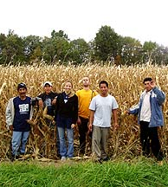
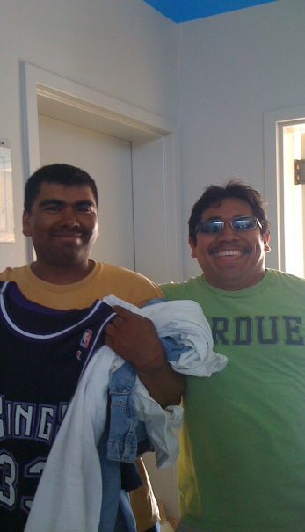
What are the needs of farm workers?

Slide 8
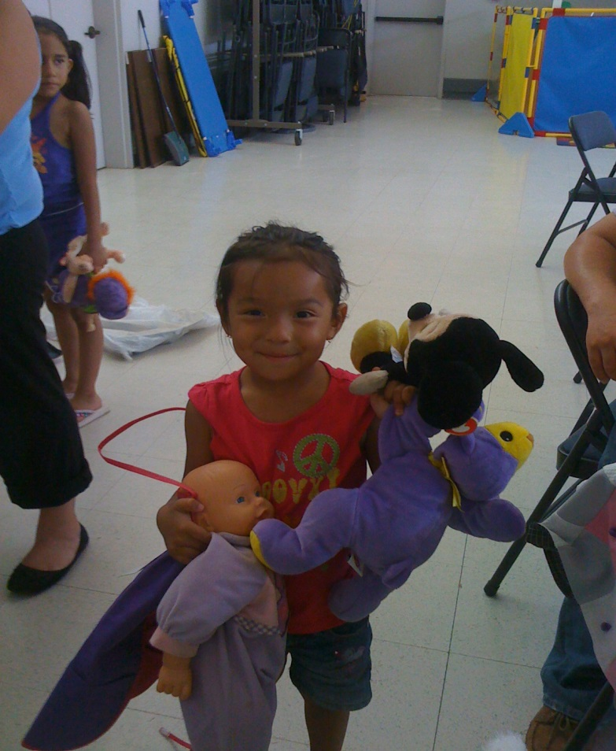
Engagement
How do we reach farm worker communities?

Slide 9
Training Organizations and Service Providers
Training organizations and service providers

Slide 10
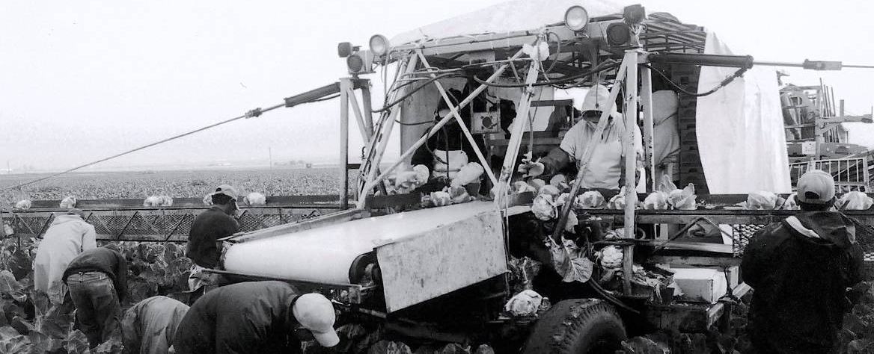
Outreach and Education
Centering outreach around the family and community
Identify community leaders
Create community-specific educational opportunities

Slide 11
The importance of Education

Slide 12
Actions we can take
Engaging the Community
Learn more about community needs
Adapt our approach

Slide 13
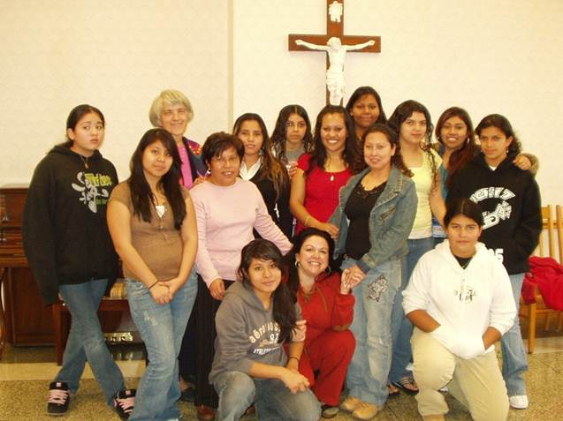
Developing Rapport

Slide 14
Culturally affirming outreach events

Slide 15
Questions

Slide 16
Speaker Contact Information
Kimber J. Nicoletti-Martinez, LCSW
AgrAbility
915 W. State Street
West Lafayette, IN 47907 765-496-3492
knicolet@purdue.edu

