Slide 1
Finding and Using your Strengths to Forward the IL Movement
Or… 6 Strength Based Concepts and what they mean to me!

Slide 2
“Who Tells You Who You Are?”
Notes:
Rev William Sloan Coffin Jr., former Yale Chaplin, Riverside Church, and Keynote Speaker at Association for Experiential Education poses this question. “ Some people need money to tell them who they are. Others need power to tell them who they are.. “ In a sermon, Coffin noted, “Abraham Lincoln, while a member of Congress, declared the war against Mexico was unnecessary and unconstiitutional. It cost him his seat in Congress. “ You never have to prove who you are… “

Slide 3
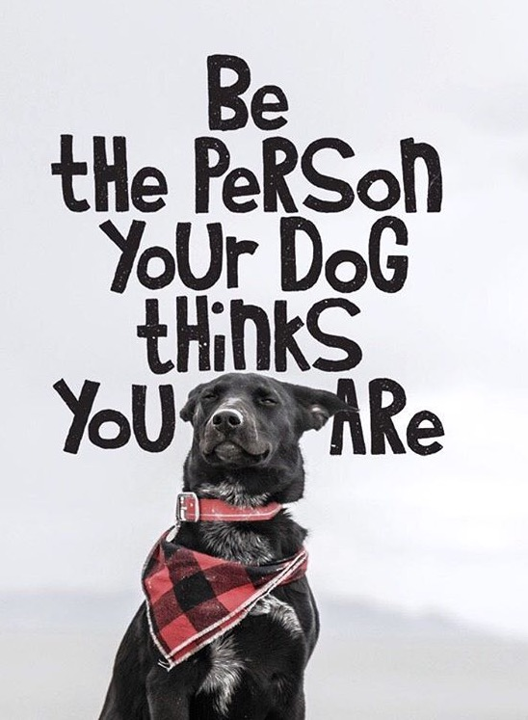
Notes:
Wonder Woman Opening Scene: Opens the package and the note says: “Maybe one day you will tell me your story.” We all have a story..

Slide 4
Focus on our Strengths
From a Strengths Perspective
Six Concepts: Empowerment, Membership, Regeneration/Redefining/Reaffirming, Synergy, Collaboration and Communication, and Letting Go of Old Assumptions.
Adapted From Daniel Saleebey’s writings on Strength Based Perspectives and Cynthia Gessinger, LCSW, Strength-Based Professional Development

Slide 5
Our strengths are forged
•

Slide 6
1. Empowerment
Reducing the sense and current reality of an individual’s powerlessness by helping people discover the considerable power within themselves, their family and their community.
Becoming aware of tensions and conflicts that are oppressing or limiting one and working towards liberating from these restraints.

Slide 7
2. Membership
Places where individuals become known for what they do, are supported in becoming more adept and knowledgeable, and can establish solid relationships within and outside of this community.
Loss of membership makes discovery of strengths more difficult and can lead to isolation.

Slide 8
3.Regeneration/Redefining/Reaffirming
Life Transformations, birth, death, aging, marriage, divorce, etc. are part of life… and through creating and maintaining a sense of autonomy, the ability to envision a positive expectation of a transition becomes a reality.
Accept what happens, learn from it and explore the options available to you to take action.

Slide 9
4. Synergy
When people are brought together into inter-relationships, new and often unexpected patterns are developed with relationships that are positive and promote the sharing of resources.
Resources include: the strengths, capacities, adaptive skills of the individual, family, or collective community.

Slide 10
5. Collaboration and Communication
Possibilities for choice, control, commitment and personal development are magnified by exchanging personal perspectives on how to move forward that can create momentum for growth.
Creating accountability by promoting shared ownership towards future goals.

Slide 11
6.Letting Go of Old Assumptions
Suspension of Disbelief: In order to create a new story for the future, you need to ‘Believe in the Impossible’ (TED talk introduction)
Create a narrative that others can relate to… describe the realities in such a way that context is easily understood and recognized.
Notes:
Remember that you Become what you Practice Most handout

Slide 12
Magnificence
Notes:
If the Butterfly remains with the Old Beliefs and Patterns of the Caterpillar, do you think it will be able to explore it’s Magnificence? Never… So why hold on to past beliefs/experiences and relationships which hold no positive for you?

