Slide 1
Preserving Access and Independence: Understanding Supported Decision Making and Other Alternatives to Guardianship
Charlie Walters,
Director of Transition Programs at Able South Carolina

Slide 2
Why Guardianship at APRIL?
It’s one of the most pressing issues in disability rights today
The IL movement speaks intimately to the issue of the right of people with disabilities to direct their own lives
CILs may be unaware
2017 Denver ILRU Youth Transition Training
Guardianship support from CILs

Slide 3
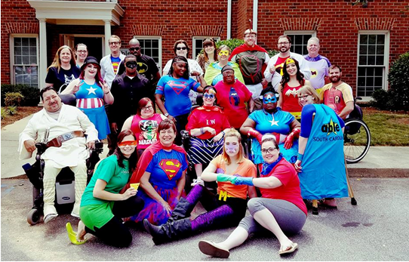
Able South Carolina
Center for Independent Living, run by and for individuals with disabilities
Serve Midlands and Upstate, with some programs statewide
Non-profit, federally and grant funded
Cross-disability

Slide 4
Today’s Agenda
Cover Guardianship Basics
Establish the Importance of Consumer Control and Self-Determination
Survey Supported Decision-Making as an Alternative to Guardianship
Brainstorm Next Steps

Slide 5
Can you independently make decisions about…
Complex medical procedures?
Major car or home repair?
Contacts for major purchases?
Contracts for minor purchase?
Complicated situations in relationships?
Financial planning or taxes?

Slide 6
Since you were 18, who has…
Made a terrible relationship decision?
Bought something without understanding the terms?
Mismanaged a checking account or credit card?
Made a decision only to have to make another because you went in the wrong direction?
Acted impulsively without understanding the consequences?

Slide 7
And what do we believe about these things?
Is it healthy to make decisions with support?
Do all people have the right to fail and learn from bad decisions?
Is the threat of bad decisions and/or the need for support cause to have an adult’s decision-making authority taken from them?

Slide 8
Surrogate/Substitue Decision Making
Surrogate
Provider
Individual

Slide 9
Forms of Surrogate Decision Making
Guardianship
"Incapacitated person means any person who is impaired by reason of mental illness, mental deficiency, physical illness or disability, chronic use of drugs, chronic intoxication, or other cause (except minority) to the extent of lacking sufficient understanding or capacity to make or communicate responsible decisions."-Uniform Probate Code
Power of Attorney
Conservatorship
Representative Payee

Slide 10
The Start of Guardianship
449 BC - Roman Twelve Tables
“The first expressed legislation on Roman private law, made reference to guardianship by providing that a family or paternal relative should protect a person and his goods if that person was unable to take care of himself.”
By the end of the millennium, curators were being appointed to handle the affairs of the “feeble-minded”
By the Middle Ages, the British appoint committees to make decisions for “idiots” and “lunatics”
“Best interest” decision making is something we are intimately aware of in IL
Forced sterilization, facility placements, and on and on

Slide 11
Setting the Stage for Guardianship
18 is the age of majority (19 in Alabama and Nebraska)
Before Age of Majority: Rights and responsibilities of the parent are emphasized
Upon Age of Majority: Rights of the parents automatically transfer
For youth without disabilities, no assessment of fitness is given for this transfer
For many youth with disabilities, this transfer causes many families to worry…
What’s different about turning 18 for young adults with disabilities?
The IEP process and systematic detailing of individual weaknesses
IQ scores and developmental ages, grade level measurements, assessments of adaptive functioning, etc.
Lower expectations
Myths about the role of parents of youth with disabilities

Slide 12
The Truth About Guardianship
There is not a single study out there that shows guardianship improving lives
There are hundreds that show the positive effects of empowerment and self-direction
Over 90% of guardianships awarded in the US are full (plenary) guardianships (TASH, 2015)
Guardianship referrals: teachers (IEP process) and service providers (service decisions)
Since 1995, the rate of guardianships in the US has tripled (TASH, 2015)
In 20 years, we’ve put 1,000,000 more people under guardianship
This is post-ADA, post-Olmstead decision, and post-HCBS Final Rule (sort of – implementation has been pushed back)
Some states require people to try less-restrictive options first, most do not

Slide 13
The Truth About Guardianship (cont.)
Loss of autonomy and self-determination is associated with higher incidents of abuse, neglect, and exploitation
People under guardianship are less likely to be employed, practice their religion of choice, or have friends other than service providers
Process is expensive – attorneys, hearings, evaluations (follow the $!)
Very difficult to modify or terminate
Tremendous and continuous responsibility of the guardian
Damages relationships
Guardianship hinges on one’s incapacity – what range of movement do people with the label “incapacited” have?

Slide 14
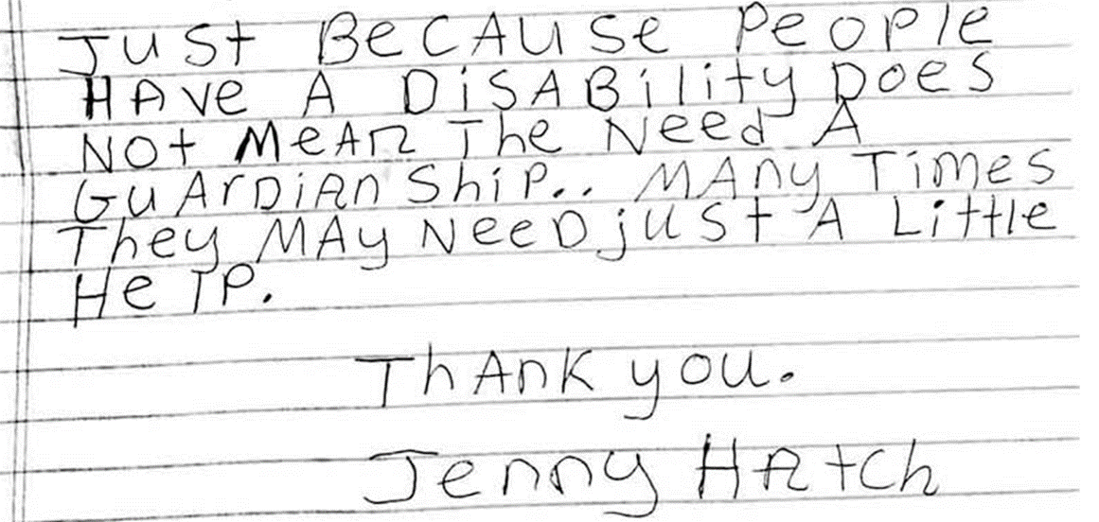
The Truth About Guardianship (cont.)
“The typical ward has fewer rights than the typical convicted felon. They no longer receive money or pay their bills. They cannot marry or divorce ... It is, in one short sentence, the most punitive civil penalty that can be levied against an American citizen, with the exception ... of the death penalty.” U.S. Representative Claude Pepper

Slide 15
Self-Determination and Consumer Control
In IL we live by consumer control. Why?
We are the best experts on our own lives.
We know our consumers often come from environments where they are not trusted to direct their own lives.
This is supported by 40+ years of research on self-determination

Slide 16
Let’s Talk About Self-Determination!
Many people believe that people with intellectual disabilities cannot be self-determined because of their cognitive impairment - research consistently shows that while SD is positively correlated with IQ, that relationship is generally weak and IQ is not predictive of self-determination status.
Multiple research studies find that a person’s self-determination status predicts higher quality of life.
Self-determination status is positively correlated with more positive post-secondary outcomes, including employment, independent living, and community inclusion for youth with disabilities.
A National Gateway to Self‐Determination
funded by the US DHHS, Administration on Developmental Disabilities
Notes:
Studies show

Slide 17
People with Greater Self-Determination Are:
Healthier
More independent
More well-adjusted
Better able to recognize and resist abuse
(Khemka, Hickson, & Reynolds, 2005; O’Connor & Vallerand, 1994; Wehmeyer & Schwartz, 1998).
SUPPORTED DECISION-MAKING: NEW ALTERNATIVE TO GUARDIANSHIP
Richard LaVallo, Disability Rights Texas

Slide 18
Supported Decision Making
Info
Individual
Provider
Supporters

Slide 19
Supported Decision Making (cont.)
Supported decision-making is a process in which individuals with disabilities are assisted in making decisions for themselves. Supported decision-making happens when an individual is the decision maker but is provided support from one or more persons who explain issues to the individual in a manner that he or she can understand. There is no one model of supported decision-making.
(Adapted from the American Bar, 2012)

Slide 20
Supported Decision Making (cont.)
Formal agreements
Notarized SDM Agreement
Outlined in a POA
Informal agreements
Knowing who to go to for what
Example: I talk with mechanic friend before making car repairs
Most states do not formally recognize SDM
This is not a barrier!
Right to accommodations under the ADA, HIPAA, etc.

Slide 21
Benefits of Supported Decision Making
Individual is always at the center of decision-making.
Individual decides who offers support.
Individual retains legal rights.
No expensive attorney fees or court fees.
Teaches individual about decision making and details of his or her affairs

Slide 22
Who Led the Charge?
The Rehabilitation Act?
The ADA?
The Olmstead Decision?
Others?

Slide 23
What Next?
Learn about SDM momentum in your state and get on board
If no projects currently exist, look to state affiliates of national groups that support SDM and alternatives to guardianship (e.g. ARC , P&A, State Bar Association)
The voice of IL and the disability community needs to be heard here!!!
Research your state’s guardianship law and start talking with people encountering the issue first hand
A great website to start with: http://www.supporteddecisionmaking.org/states
This includes understanding why families pursue guardianship (e.g. fears about authority in the IEP process, medical issues, money management, etc.)
Think grassroots!
The SC SDM Project began in somewhat of a vacuum with funding from the SC DD Council and support from P&A, ARC of SC, and our state’s PTI

Slide 24
Let’s Talk!
Charlie Walters, Director of Transition Programs at Able SC
cwalters@able-sc.org
(803)779-5121
www.able-sc.org
www.scsupporteddecisionmaking.org

