Slide 1
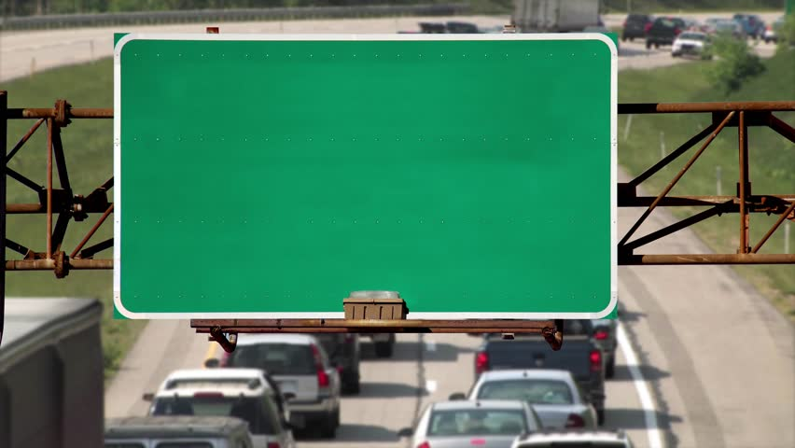
PATHWAYS TO CAREERS…
Toward an Accessible Community
Notes:
Slide 1: ADA 101 – What is the ADA?
Objective: The student will be introduced to the topic “What is the ADA?”
The Americans with Disabilities Act (ADA) is an important civil rights law that guarantees equal treatment for all people with disabilities.
People often are confused about what the ADA means.
We will learn about the major parts of the ADA and how it helps people to have equal opportunities.
The ADA is a law for all of us.

Slide 2
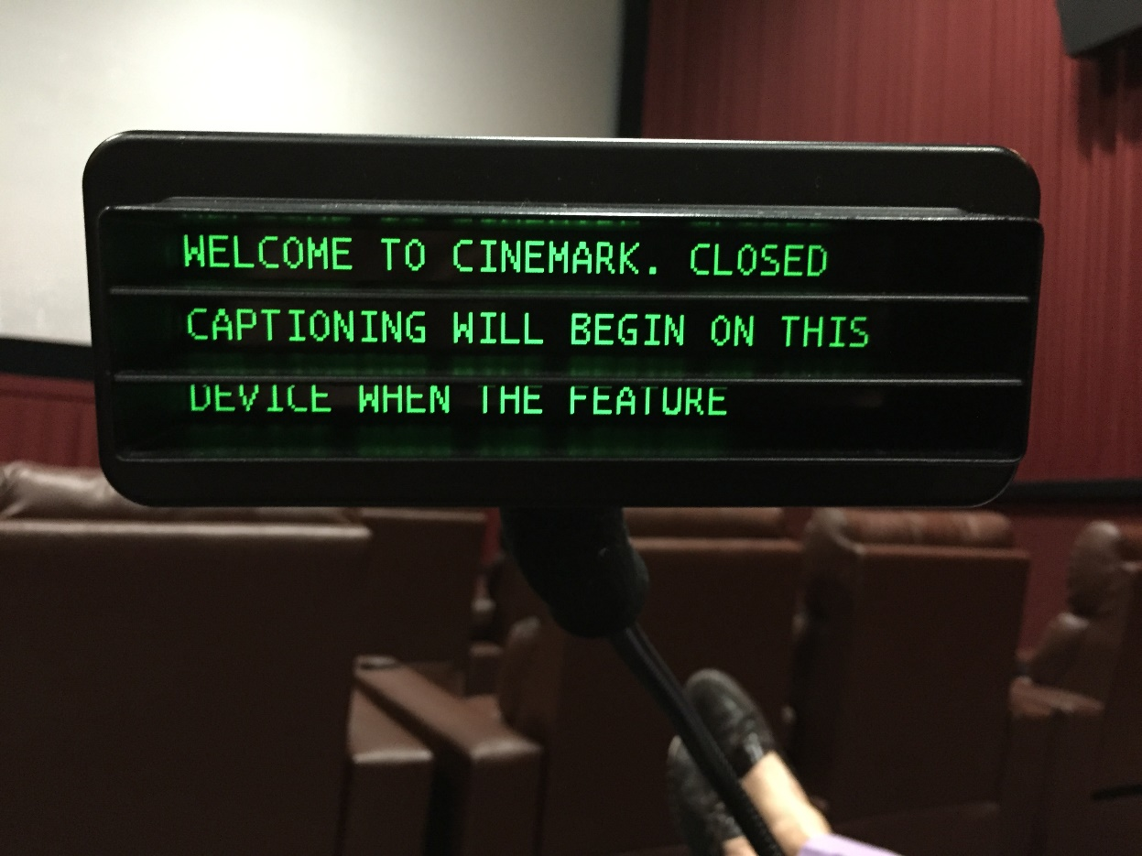
Because of the ADA…
A person with a disability can expect to:
Move around the community safely;
Participate in government programs and receive services;
Communicate with and receive services from businesses and government offices;
Shop in stores; and
Enjoy entertainment in public places such as concerts, movies, and festivals.

Slide 3
Getting Around the Community
Audible signals at crosswalks to cross roads safely
Curb cuts and ramps for people who have limited mobility or use wheelchairs
Accessible parking places

Slide 4
Getting Around the Community: Accessible Transportation
Accessible public transportation
Paratransit services for people with disabilities who are unable to use public transportation
Accessible taxi and shuttle services

Slide 5
Government Programs and Services
Equal participation and access to government services
Libraries
Parks and recreational facilities
Interpreters or other ways to communicate
Equal access to voting locations

Slide 6
Effective Communication with Businesses and Government Agencies
Braille
Large Print
Sign Language Interpreters
Video Remote Interpreting
Real Time Transcription
Apps (Smart Phone, Tablet)
Writing Notes

Slide 7
Telephones and Relay Services
Businesses and government agencies who communicate by phone must try to talk to you in a way that you understand if you are D/deaf, deaf-blind, or have a speech disability.
Telecommunications Relay Service (TRS) www.fcc.gov/consumers/guides/telecommunications-relay-service-trs
A Video Relay Service session, where a person who is Deaf or Hard-of-Hearing can communicate with a hearing person
Notes:
Slide 6 Notes – Telecommunications (Telephones, Relay Service, and Other Communication Methods)
Objective: The student will understand how the ADA allows us to communicate and be safe.
Facilitator Talking Points:
In your lifetime, we have experienced amazing changes that have affected the way we communicate. Just a few years ago people could only use phones to make voice calls. It has only been in the last ten years or so that we have been able to text messages from our phone. Today, we take it for granted that we can send a text message to someone anytime we want.
Sometimes only a phone conversation will do. If you have difficulty speaking or hearing, the fourth part of the ADA can help you.
TTY or TTDs are machines that allow people to use a standard land line to type messages to each other
Relay services allow someone who does not hear or speak to communicate with someone who does by using a third person to carry on the conversation. Here is a list of services provided by Georgia Relay Services (georgiarelay.org)
TY (Text Telephone) – A standard telephone with a typewriter-style keyboard, screen and printer for people who are deaf, hard of hearing or have difficulty speaking.
Voice Carry-Over (VCO) – For those who can speak clearly, yet have hearing loss significant enough to keep them from understanding what is being said over a standard telephone.
Hearing Carry-Over (HCO) – For people with significant speech difficulties who can hear what is being said over the phone.
Speech-To-Speech (STS) – For people with mild-to-moderate speech difficulties who can hear what is being said over the phone.
Video Relay Service (VRS) – Makes it possible for sign language users to communicate in their native language via video conferencing.
CapTel® – Uses the latest in voice recognition software to display every word the caller says.
Spanish Relay – For Spanish-speaking Relay users.
Customer Profile – Create a personal profile that lets the Relay Communications Assistant (CA) automatically know your communications preferences.
Voice Users – Learn how easy it is to communicate by phone with Georgia Relay users.
Additional Features – Including ASCII, voicemail retrieval and more.
In another important feature, if someone needs emergency help, the ADA makes sure they can get it from 911.

Slide 8
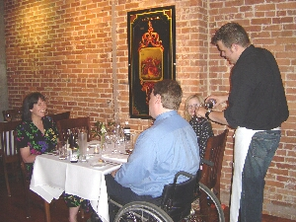
Shopping in Stores and Eating in Restaurants
Requesting assistance from store or restaurant staff
Ability to shop independently by getting into and around a store, and reaching products
Easily get into the store or restaurant
Allowing service dogs into a business
Receiving service in a restaurant
Ordering food

Slide 9
Enjoy Places of Entertainment
Accessible seating in theaters, arenas, entertainment spots
Seating for others
Equal access in buying tickets for events
Audio description for people who are blind or have low vision
Captioning devices for movies and shows

